Slide 1
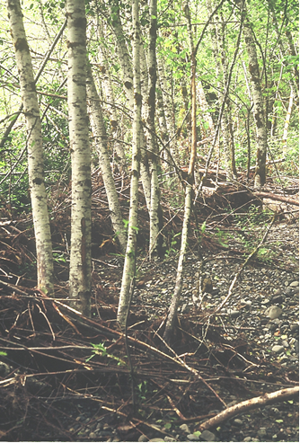
Development of analytical tools
for classification and assessment
of riparian ecosystems
in northwest Oregon
Steve Acker
Northwest Oregon Ecology Group Willamette National Forest

Slide 2
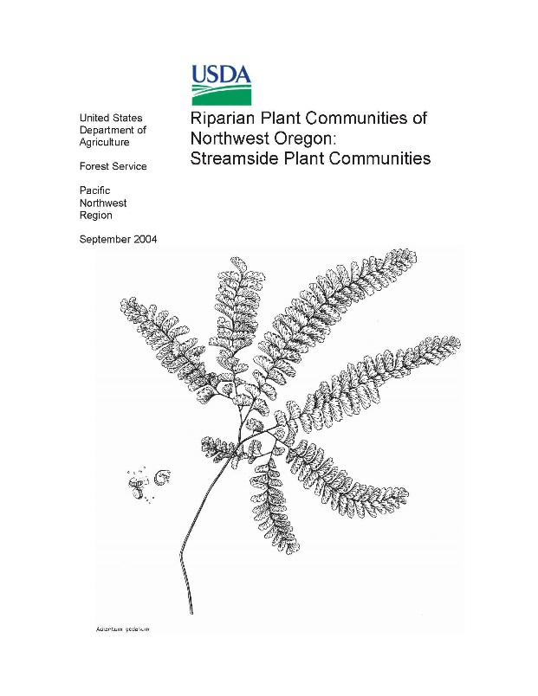
Previous riparian vegetation classifications for NW Oregon
floristics of tree-, shrub-, and herb-dominated vegetation
linked to fluvial disturbance, landform, and other site factors
Diaz & Mellen 1996
GP, MTH, CRGNSA
Fish-bearing streams
McCain 2004
MTH, SIU, WIL, adj. BLM
Some smaller streams

Slide 3
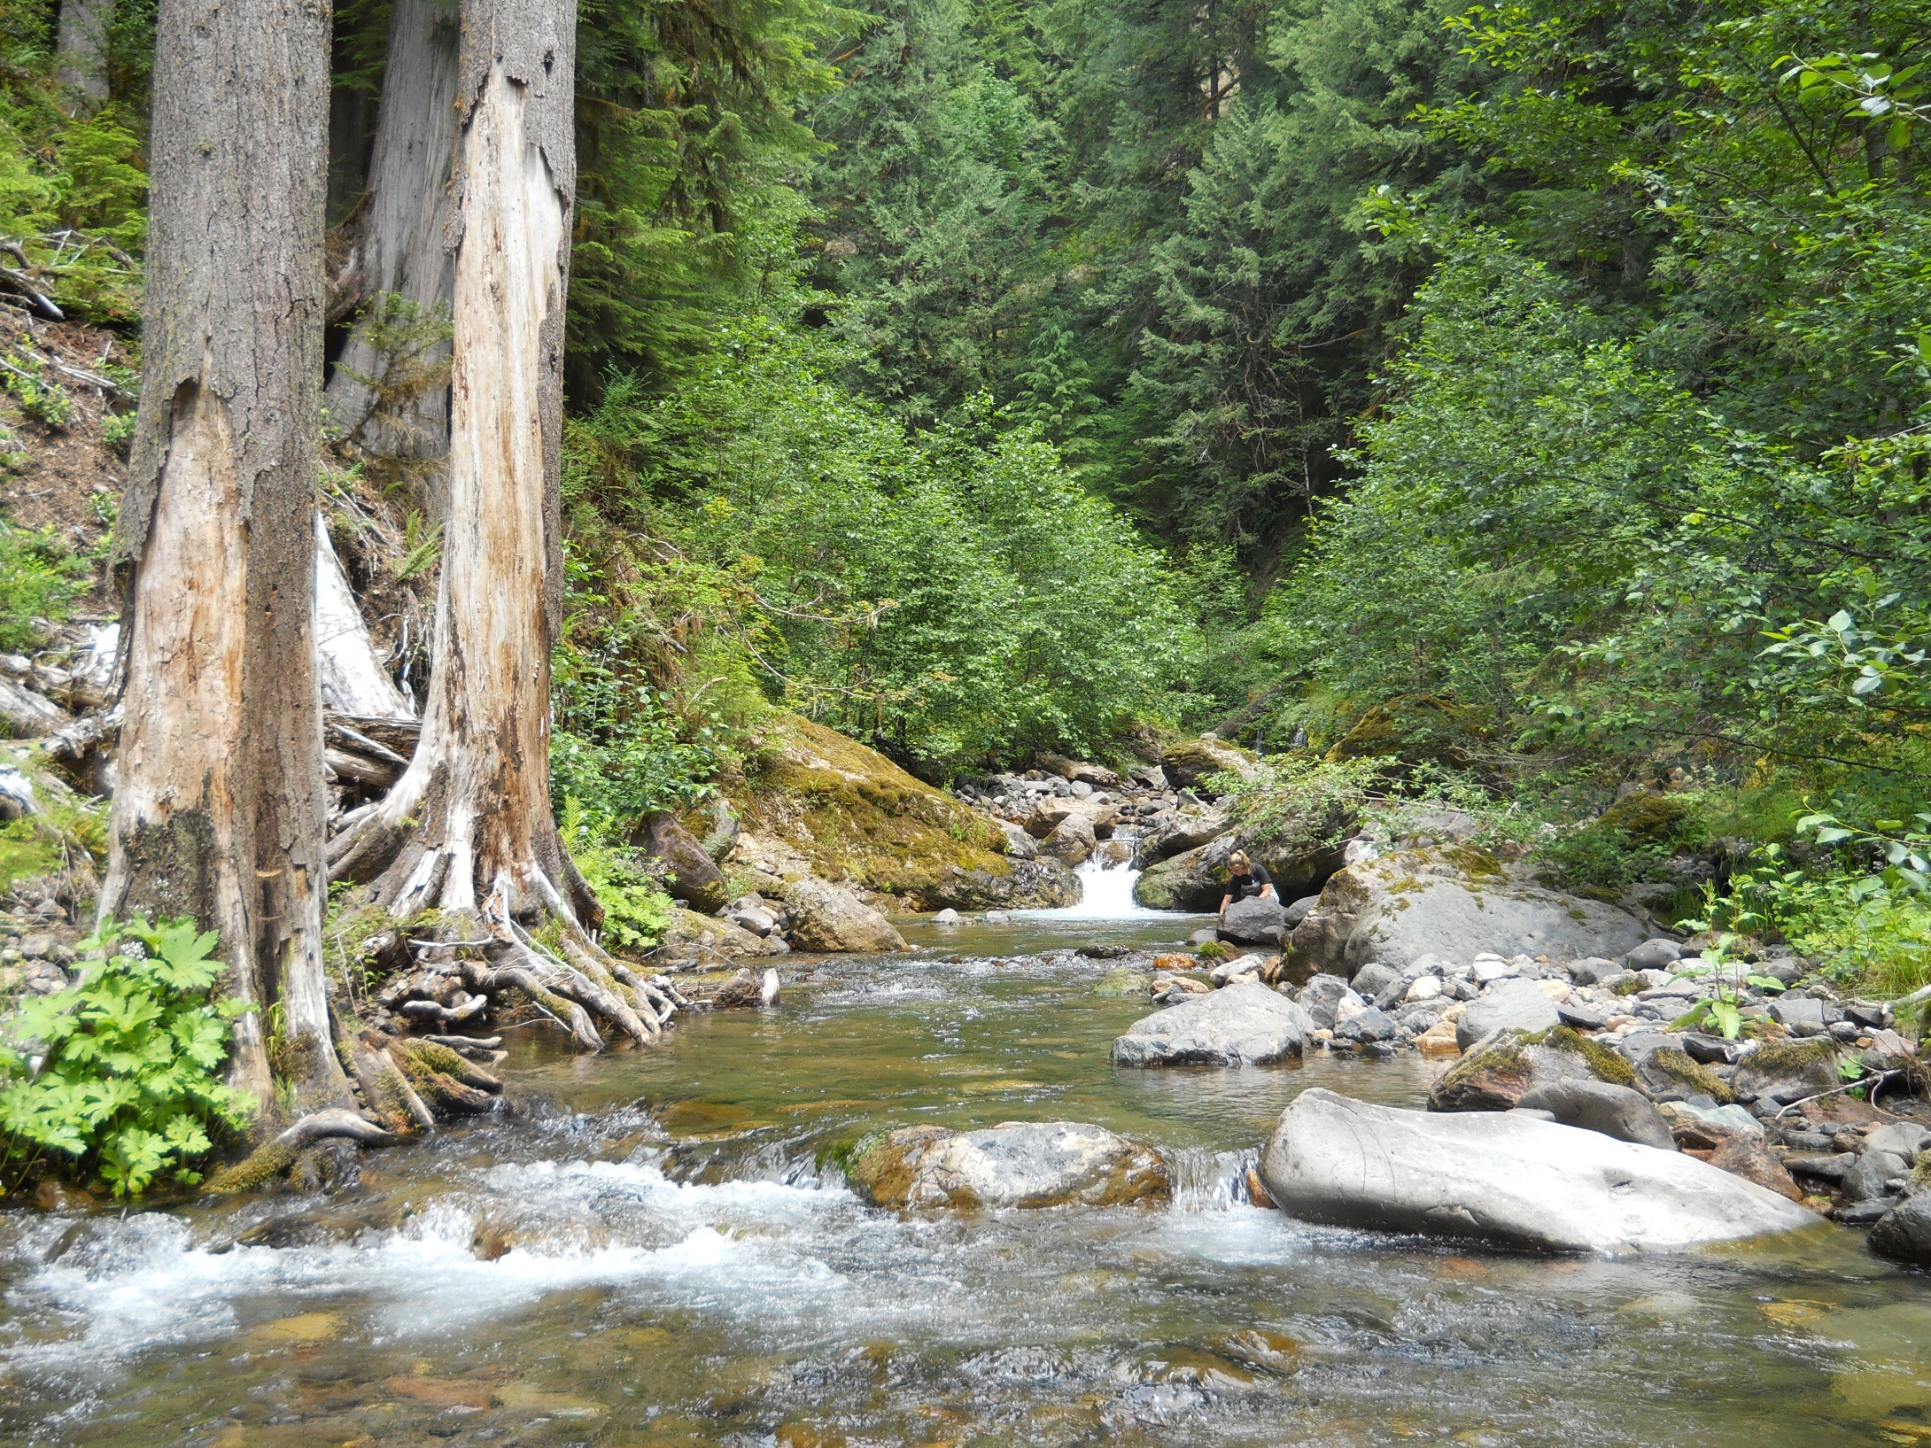
Intent of current project:
assess historical and current conditions of riparian vegetation in the context of potential vegetation, fluvial and other geomorphic processes, and non-fluvial disturbance processes (e.g., fire),
to provide a transparent, logical pathway for planning management of riparian vegetation on federal forest lands in northwest Oregon

Slide 4
Relevance of historical range and variability (HRV) to land management
Using history as a guide is a precautionary approach.
Acknowledging and describing variability is consistent with current science.
May provide diverse options for management.

Slide 5
Historical variability in riparian/aquatic ecosystems
Fluvial distur-bance
Water quality
Channel stability
Climate
Riparian vegetation-- lifeforms & stature varying over space & time
Debris torrents
}
Habitat structure
Geology
Wildfire
Food webs
Micro-climate
Wind-throw

Slide 6
Why HRV is difficult to capture
Answers will depend on spatial and temporal scope of investigation.
Information becomes more sparse and ambiguous the farther back you look (hence, role of simulation models).
Data-gathering is often opportunistic, compromising inference.

Slide 7
Why HRV is not prescriptive
We have management objectives other than emulating natural processes.
The landscape may have changed compared to the reference period in ways that will persist (e.g., infrastructure).
System drivers may be different in the future than they were during the reference period (e.g., climate).

Slide 8
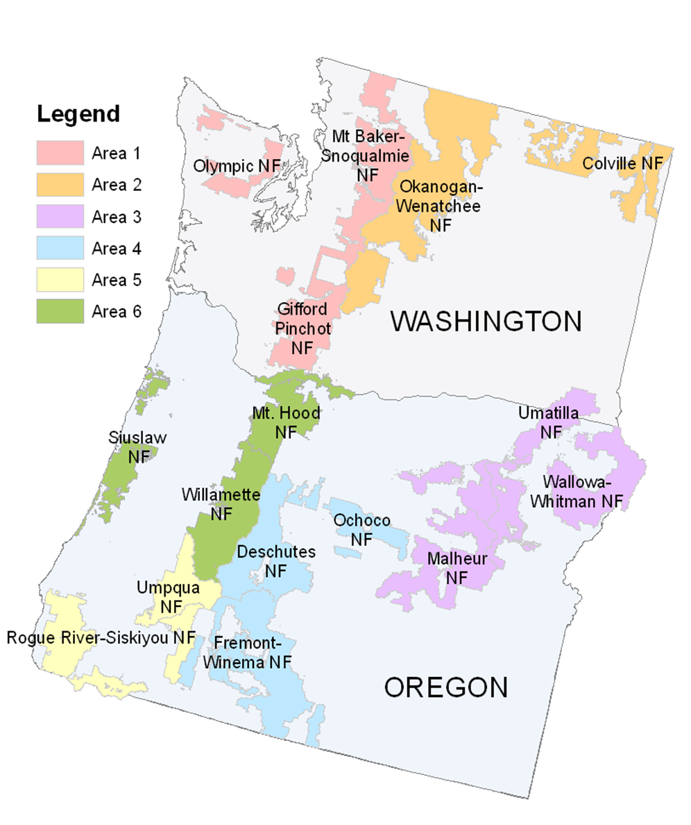
Ecology Program Areas in the Pacific Northwest Region, USDA Forest Service
Northwest Oregon Ecology Program (link to Eugene/Salem BLM)

Slide 9
Overview of analytical approach
Classify sites (reference domains)
Evaluate reference conditions (reference domains)
Assess current conditions (focus areas)

Slide 10
Riparian site classification conceptual workflow
Omernik Ecoregions
Reference domains
Potentially-forested ref. domains
Watershed boundaries
Non-forest mask
Vegetation data (various)
Segment-level site classification: disturbance regime & hardwoods (Y/N)
Hard-woods?
NetMap riparian analysis
Fluvial disturbance type (flood, debris, none)
Fire regime data
Fire regime (where no fluvial disturbance)

Slide 11
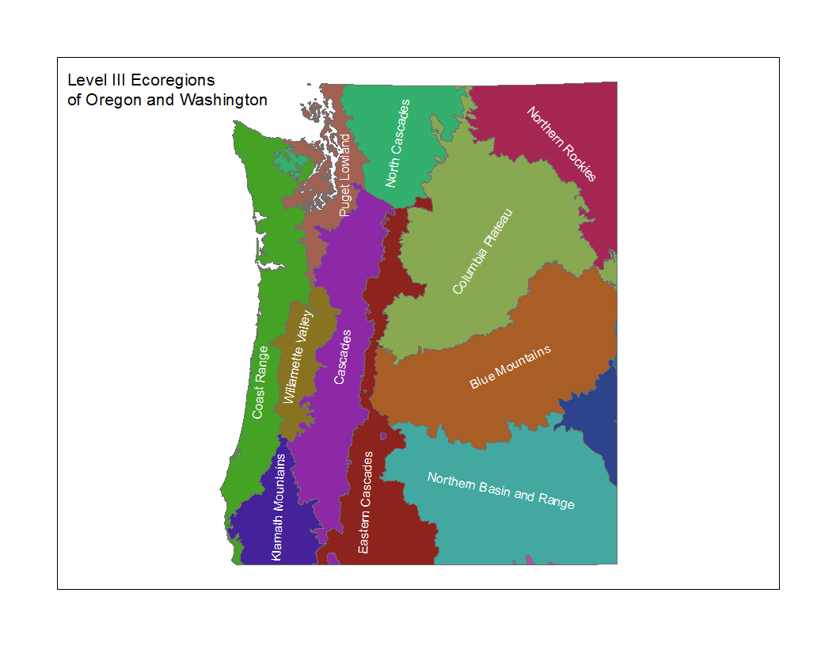

Slide 12
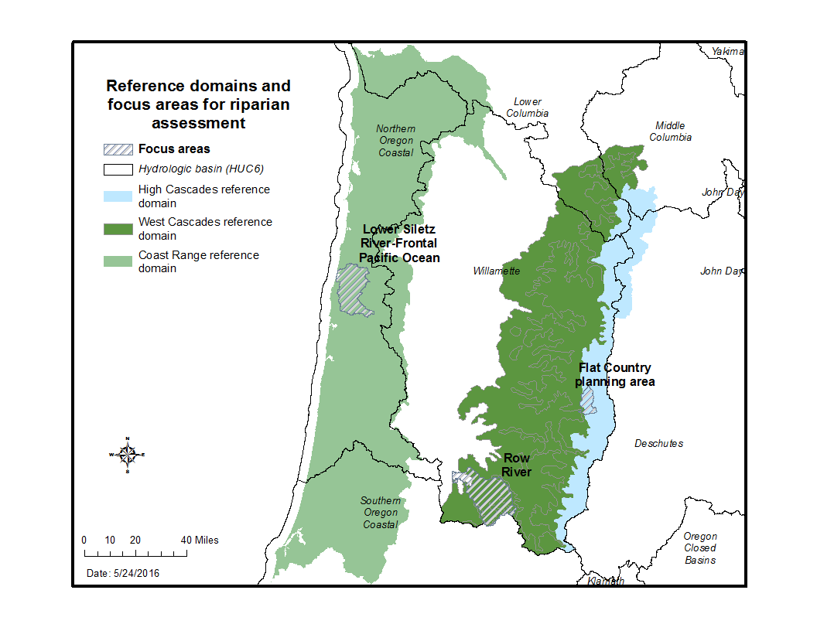

Slide 13
Potential vegetation attributes for site classification
Attribute | Data source(s)
Potentially-forested area | GNN non-forest mask (Landscape Ecology, Modeling, Mapping, and Analysis group)—exclude alpine, volcanic, ice, water, dunes
Potential presence of hardwood tree species (bigleaf maple, red alder, black cottonwood) | Silvics Manual
 | LANDFIRE Rapid Assessment models
 | Riparian vegetation guide for northwest OR (and GIP)
 | Data for northwest OR from the Forest Inventory and Analysis program

Slide 14
Evaluating dominant potential disturbance by reach—generic approach
Apply NetMap’s channel confinement tool (floodplain/
channel ≥ 4)
unconstrained
Large
streams- fluvial
Large streams
(at least 15 m wide)
(Beechie et al. 2006)
Large
streams- upland
constrained
Reach layer from NetMap
Montgomery & Buffington 1997
Select reaches with gradient<1.5%
Small
streams-
fluvial
Small streams
Select reaches with gradient ≥1.5% and debris torrent potential ‘high’
Small
streams-
debris
Select reaches with gradient ≥1.5% and debris torrent potential ‘low’
Small
streams-
upland

Slide 15
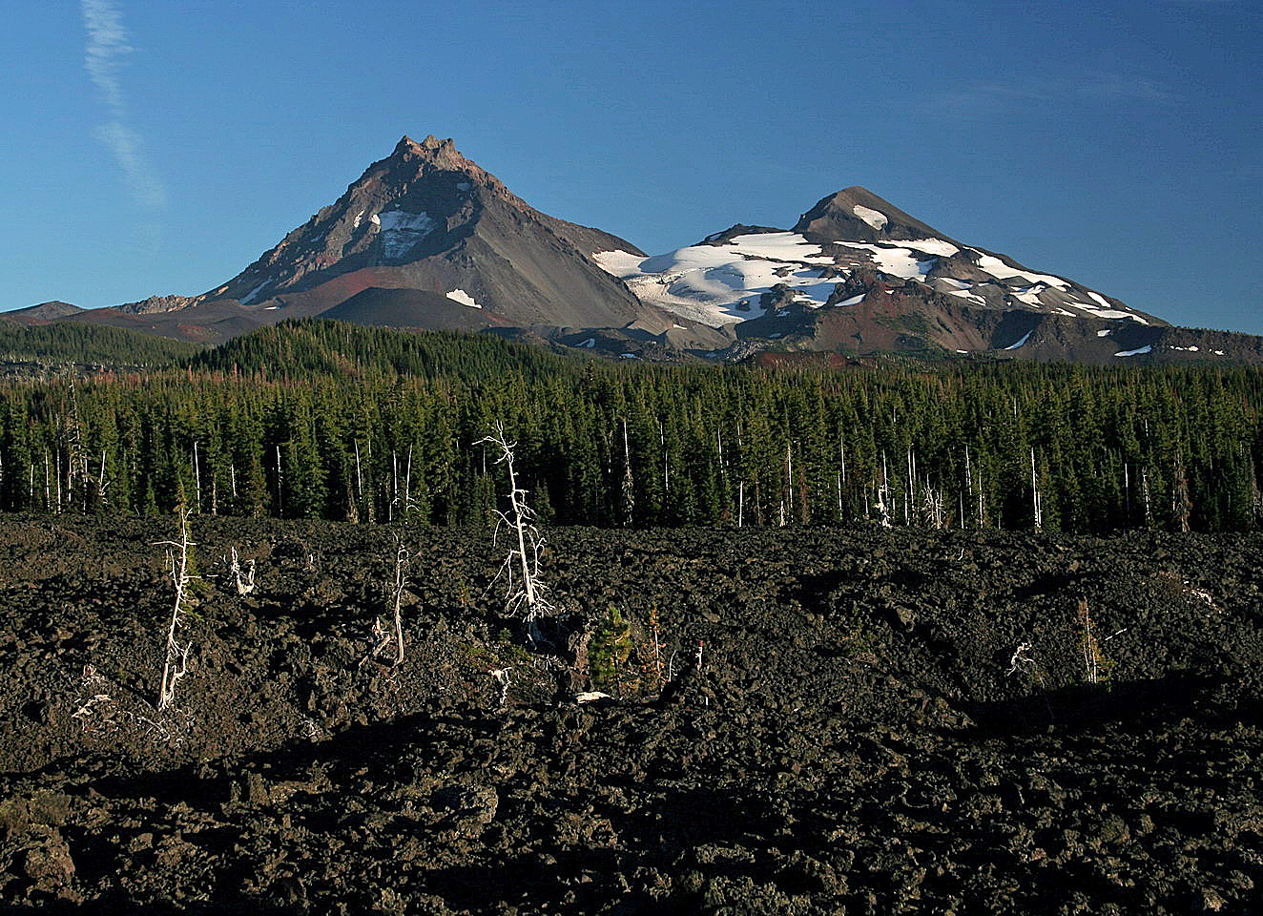
Results of informal review with aquatics staff from McKenzie River RD:
First iteration analysis does not take into account importance of ground-water dominated streams in High Cascades
The stream network depicted by NetMap over-estimates the extent of streams on highly-pervious surfaces (e.g., recent lava)

Slide 16
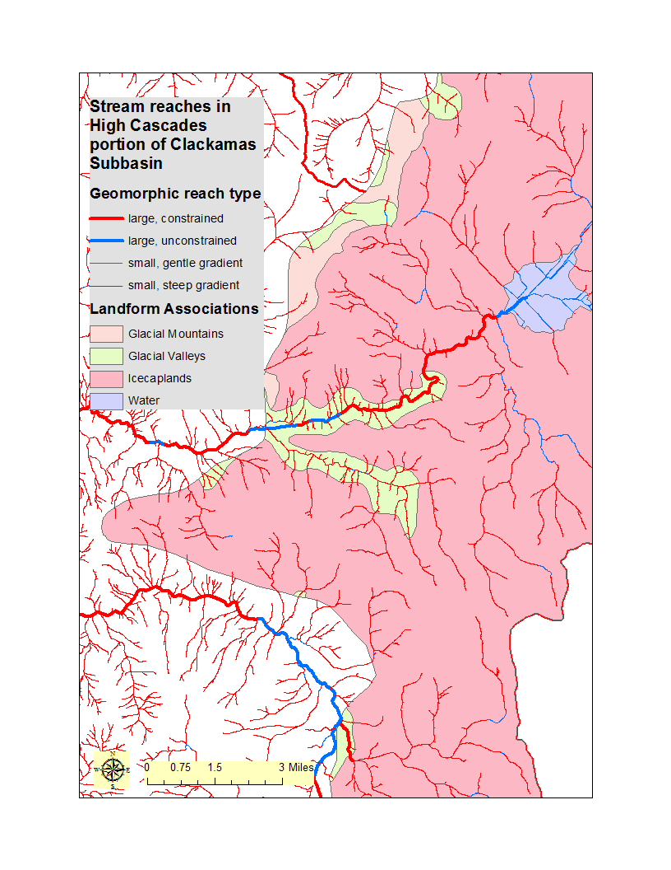

Slide 17
Evaluating dominant potential disturbance by reach—High Cascades version
Glacial Valleys
uncon-
strained
Large
streams- uncon-strained
Large
streams- fluvial
Apply NetMap’s channel confinement tool (floodplain/
channel ≥ 4)
Large streams
(at least 15 m wide)
(Beechie et al. 2006)
Other Landforms
Large
streams- upland
con-
strained
Reach layer from NetMap
Montgomery & Buffington 1997
Select reaches with gradient<1.5%
Small
streams-
gentle gradient
Small
streams-
fluvial
Glacial Valleys
Small streams
Select reaches with gradient ≥1.5%
Other Landforms
Small
streams-
upland

Slide 18
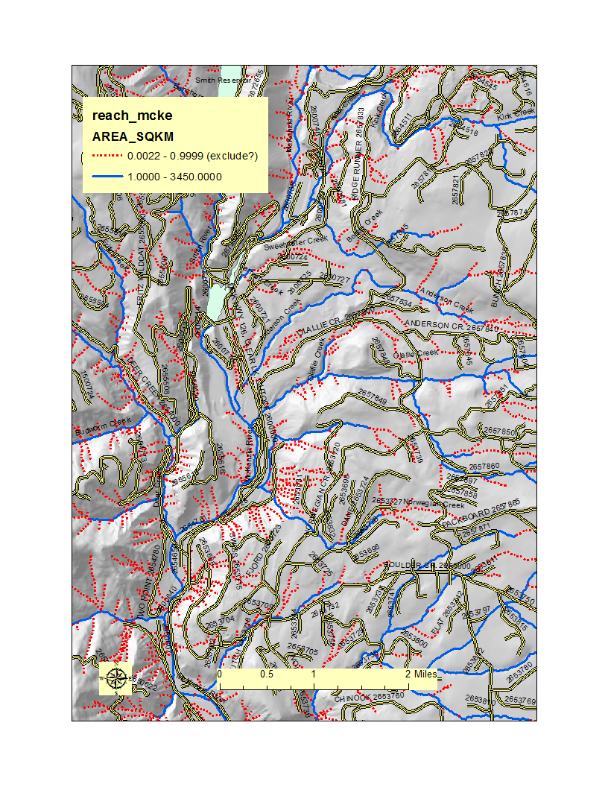
From NetMap’s online Technical Help:
“…The overall strategy in NetMap is to create high density drainage networks so as not to eliminate headwater streams, since information about network extent (or channel heads) is generally absent for most landscapes. With a liberal network within NetMap tools, a user can remove headwater channels that do not exist…”

Slide 19
Evaluating reference conditions for vegetation
Select buffer width around stream network based on ecological/physical processes (floodplain width, wood recruitment)
Construct a classification scheme with discrete vegetation classes
Potential data sources
  Historical imagery or plot data (pre-management)
  Current imagery or plot data (un-managed areas)
  State-and-transition models
  Ranges of values preferable to single values

Slide 20
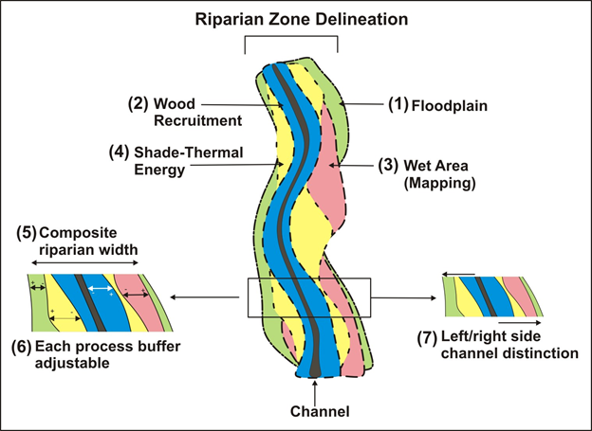
Source: http://www.netmaptools.org/Pages/NetMapHelp/8_2_delineate_riparian_zones.htm

Slide 21
Characterizing reference and current vegetation: examples of classification schemes
Burnett et al. 2007. (Ecol. Appl. 17: 66–80) | Kennedy & Spies. 2004 (For. Ecol. Manage. 200: 129–147) | Wondzell et al. 2012 (in PNW-GTR-869)
non-forest | water | barren
 | road | open shrub
 | bare soil | dense shrub
open forest | herb | young alder
 | shrub | small alder
hardwood | hardwood tree | medium alder
 | small mixed conifer | medium conifer-alder
 | medium mixed conifer | large conifer-alder
 | large mixed conifer | giant conifer-alder
 | very large mixed conifer | young conifer
small/medium conifer | small conifer | small conifer
 | medium conifer | medium conifer
large conifer | large conifer | large conifer
very large conifer | very large conifer | giant conifer

Slide 22
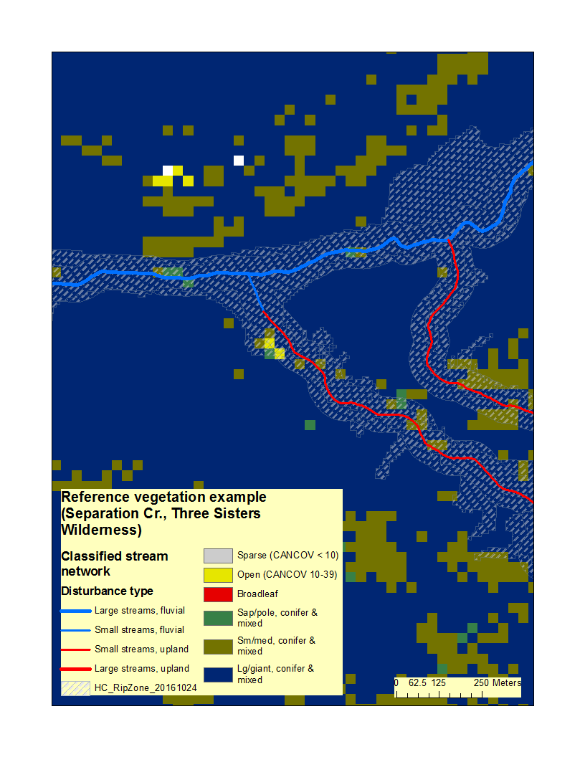

Slide 23
Hypothetical example of distribution and ranges of reference vegetation for a reference domain (ecoregion)
 | Vegetation states (% of reach type)
Reach types | Barren | Open | Broadleaf | Sapl/pole | Sm/med. | Lg./giant
Small/upland disturb. | 0-10 | 5-15 | 0-5 | 10-20 | 25-35 | 35-45
Small/fluvial disturb. | 0-10 | 5-15 | 10-20 | 10-20 | 20-30 | 25-35
Large/upland disturb. | 0-10 | 5-15 | 0-5 | 10-20 | 25-35 | 35-45
Large/fluvial disturb. | 0-10 | 5-15 | 20-30 | 10-20 | 15-25 | 20-30

Slide 24
Collaborative analytical approach
Classify sites (reference domains)
Evaluate reference conditions (reference domains)
Assess current conditions (focus areas)
Generate draft products
Revise as indicated
Consult experts/end-users

Slide 25
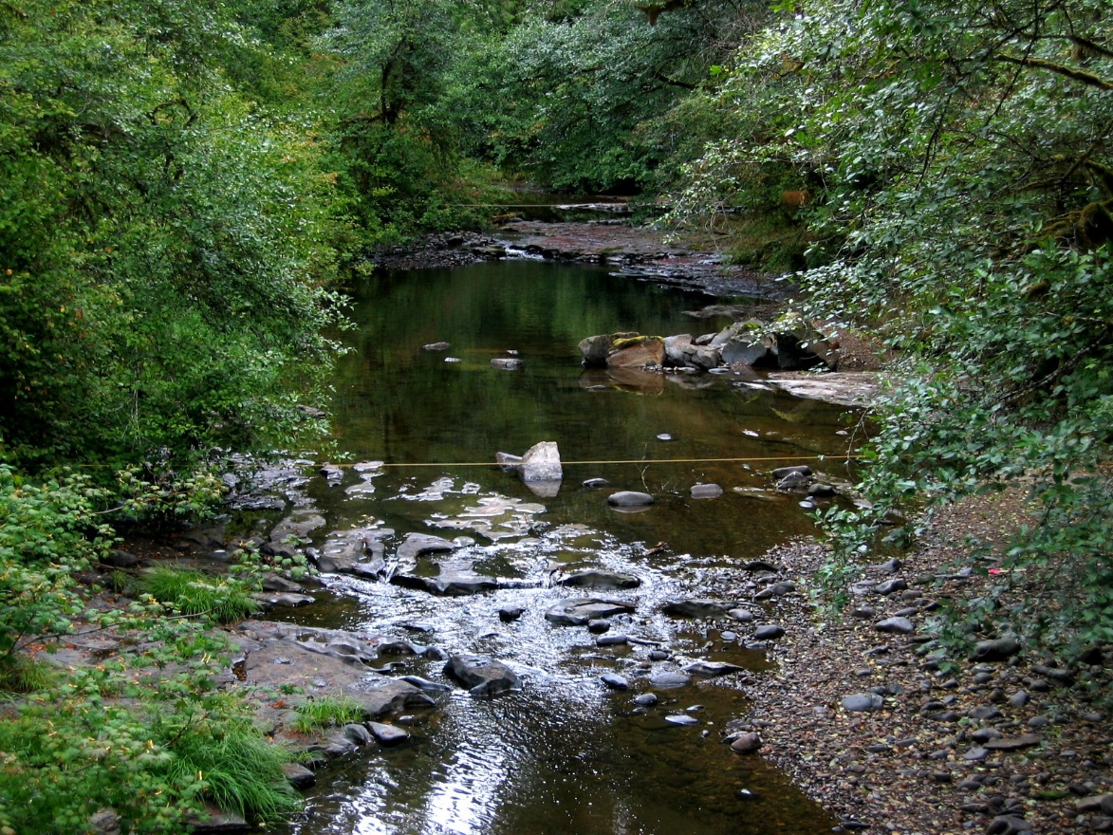
Thanks to collaborators, including:
Johan Hogervorst, Willamette National Forest
Brett Blundon, Eugene BLM/Willamette NF
Kate Meyer, Willamette National Forest
Bonny Hammons, Willamette National Forest
Kami Ellingson, Siuslaw National Forest
Todd Reinwald, Mount Hood National Forest
Todd Parker, Mount Hood National Forest
Jane Kertis, NW Oregon Ecology
Cheryl Friesen, Willamette National Forest
Dave Kretzing, Willamette National Forest, retired
Ian-Huei Yau, Region 6 Data Resources Management
Gordie Reeves, Pacific Northwest Research Station
Tom Spies, Pacific Northwest Research Station
Steve Wondzell, Pacific Northwest Research Station
Lee Benda, TerrainWorks
Kevin Andras, TerrainWorks

