Slide 1
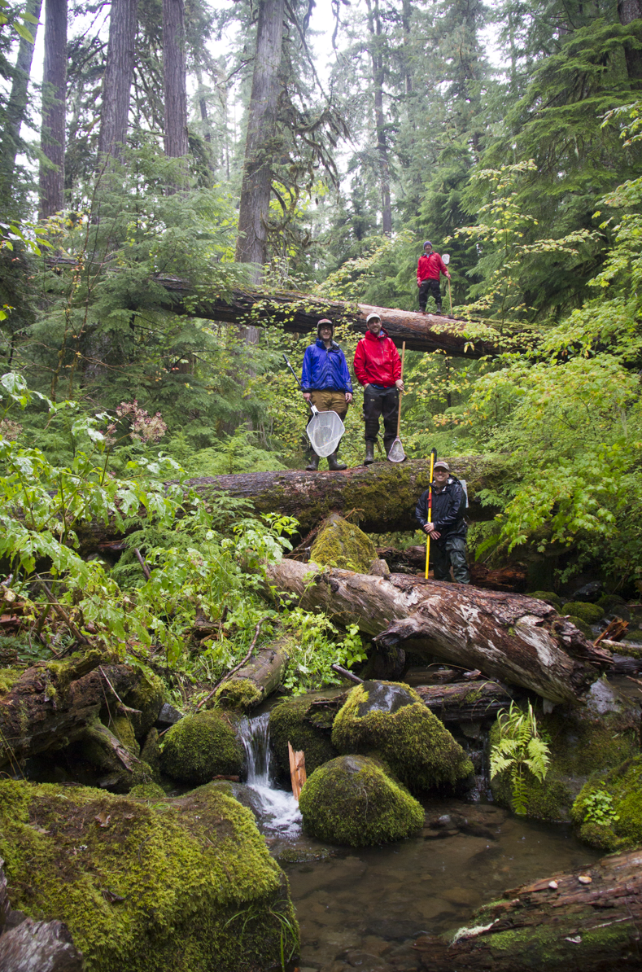

Riparian forest structure, stream light and fish production in forested headwater ecosystems
Dana Warren
Matthew Kaylor
Emily Heaston
Dept. Forest Ecosystems and Society
Dept. Fisheries and Wildlife
Oregon State University

Slide 2
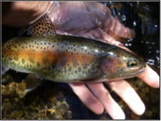
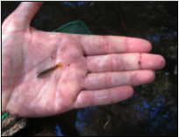
Study Hypothesis:
Changing forest structure in the riparian zone influences all levels of the food web in headwater streams
Study Premise:
Forest age/structure controls stream light, and the light environment of the stream in-turn influences in-stream primary production at the base of stream food webs

Slide 3
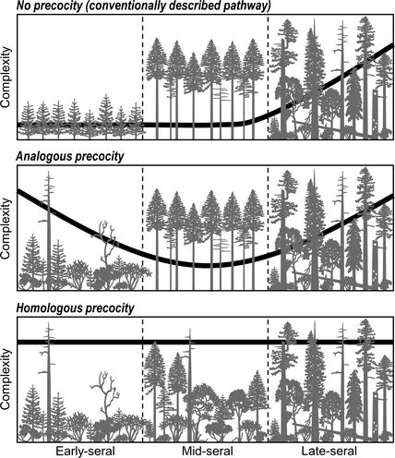
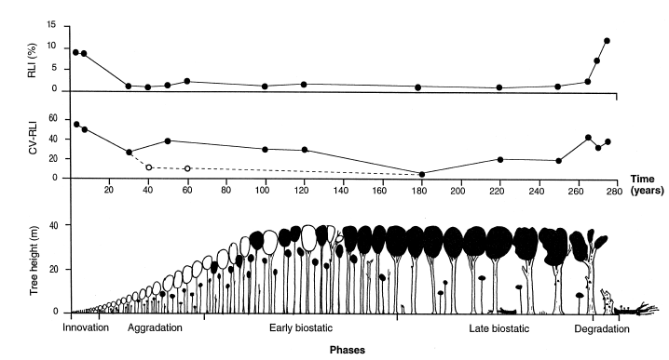
Stand development (simplified)
Donato et al. 2012
Relative Light Index value on the forest floor
Stand initiation
Stem-exclusion
Understory reinitiation
Gap-dynamic
Emborg 1998 For. Ecol. & Manage.

Slide 4
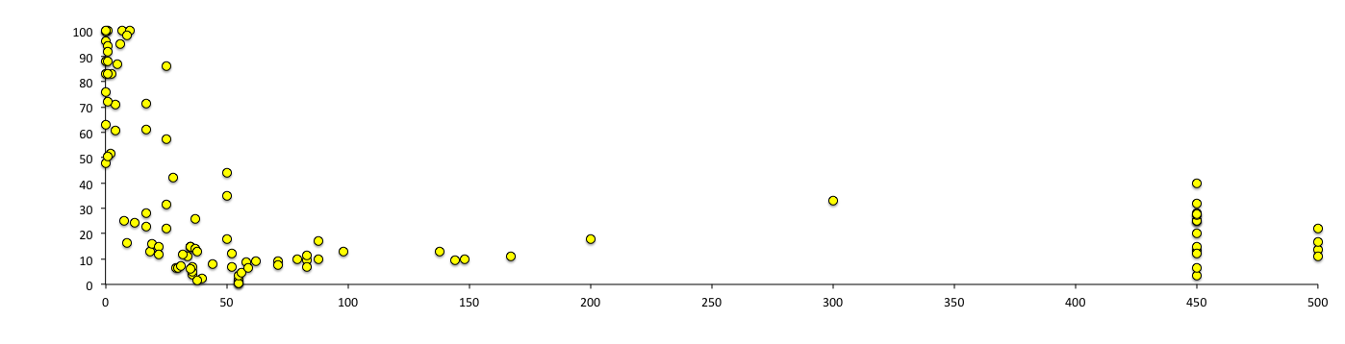
% canopy openness versus stand age across the Pacific Northwest
% open canopy
>200
Age of dominant canopy trees ("stand age") in the riparian forest (years)
Kaylor et al. In Press
Stand initiation
Stem-exclusion
Understory reinitiation
Gap-dynamic
Emborg 1998 For. Ecol. & Manage.

Slide 5
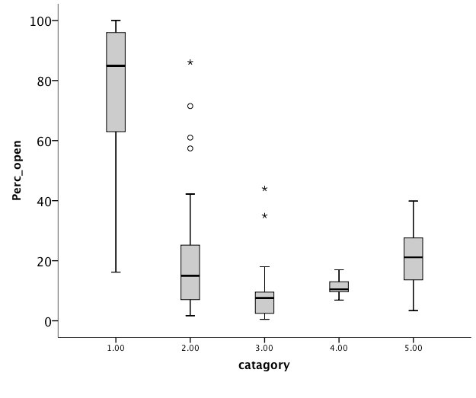
% canopy openness versus stand age across the Pacific Northwest
% open canopy
Stand initiation (<10 yrs)
Old Growth (>170 yrs)
Kaylor et al. In Press
Early stem-exclusion (10-40 yrs)
Late stem-exclusion (40-80 yrs)
Mature (understory regeneration) (80-170 yrs)
Stand initiation
Stem-exclusion
Understory reinitiation
Gap-dynamic
Emborg 1998 For. Ecol. & Manage.

Slide 6
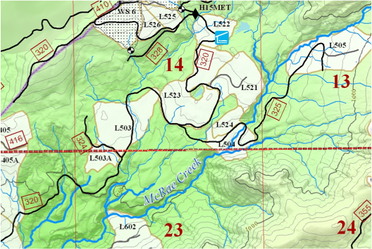
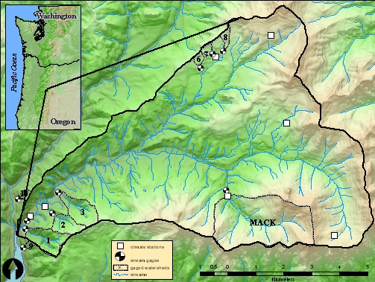
Light quantification – HJ Andrews Experimental Forest:
We used the unique management history of HJ Andrews Experimental Forest to select reach pairs with old-growth versus second-growth riparian forests

Slide 7
Forest age class comparison
Stream 1: upper third-order McRae Creek
6.6 m bankfull width

Slide 8
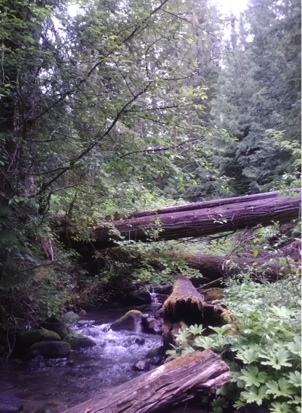
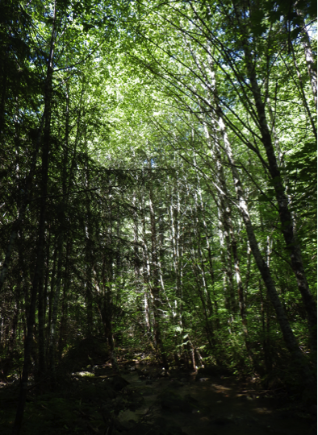
Forest age class comparison
Stream 1: upper third-order McRae Creek
6.6 m bankfull width

Slide 9
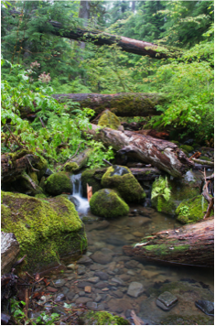
Forest age class comparison
Stream 2: McRae Creek Tributary – West
~4 m bankfull width

Slide 10
14
Second growth (~60 yrs)
Old Growth
12
(a) McRae Trib – West (4.4 m bankfull)
10
8
6
4
2
0
24 hour accumulated PAR (mol•m⁻²•day⁻¹)
14
Old Growth
OG-2G mix
Second growth (~60 yrs)
12
(b) McRae Trib – East (3.1 m bankfull)
10
8
6
4
2
0
(Upstream)
Distance (m)
(Downstream)

Slide 11
Conceptual model for changing stream light over time in a forested headwater stream
Conceptual model for changing wood loads over time in a forested headwater stream
Complex canopy with patchy openings
Dense, closed canopy
Average light to stream benthos
0
50
100
150
200
Years since stand replacing event

Slide 12
Is periphyton accrual affected by local light?
Buffer
Fluorescein decay (ppb)
Increased Light ------>
Distance (m)
Notes:
----- Meeting Notes (11/24/13 17:28) -----
Fluorescein is a photodegrading dye that can be used to assess the spatial variability and intensity of light

Slide 13
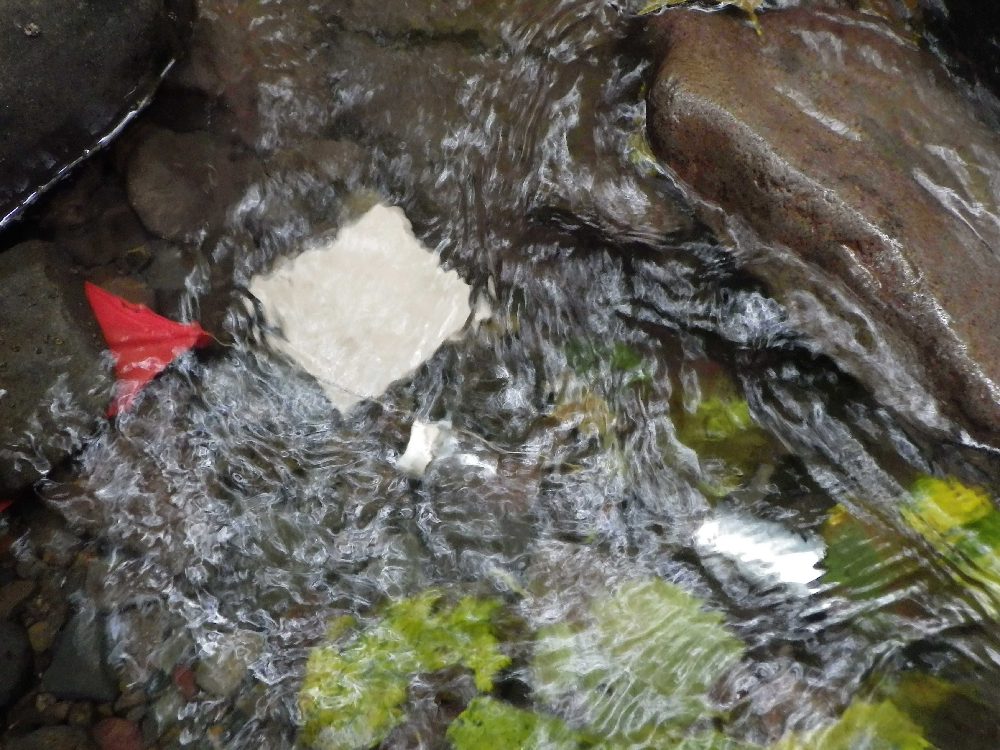
Is periphyton accrual affected by local light?
μg chl. a/cm²
Fluoroscein decay (Δppb)
(more loss = more light)
Fluorescein decay (ppb)
Increased Light ------>
Distance (m)
Notes:
----- Meeting Notes (11/24/13 17:28) -----
Fluorescein is a photodegrading dye that can be used to assess the spatial variability and intensity of light

Slide 14
Conceptual model for changing periphytion (GPP?) over time in a forested headwater stream
Complex canopy with patchy openings
Dense, closed canopy
Wood (m³m⁻²)
Periphyton stocks
Average light to stream benthos
0
50
100
150
200
Years since stand replacing event

Slide 15
Conceptual model for changing predator biomass over time in a forested headwater stream
Complex canopy with patchy openings
Dense, closed canopy
Periphyton stocks
Predator biomass?
Average light to stream benthos
0
50
100
150
200
Years since stand replacing event

Slide 16
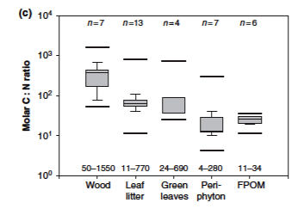
Why would a small change in periphyton matter to stream predators?
Algal material is “higher quality” food that most allochthonous material that enters streams (i.e. leaves)
Therefore relatively small increases in primary production have the potential to disproportionately impact secondary production
Cross et al. 2005 Freshwater Biology

Slide 17
Specific study hypotheses
H1: Stream reaches with old-growth riparian forests will have more light, more primary production and ultimately more trout and total vertebrate biomass than stream reaches with second growth riparian forests
H2: Canopy closure over 40 years of stand regeneration and development will lead to reduced trout biomass
H3: Experimentally shading a stream reach will reduce fish biomass.

Slide 18
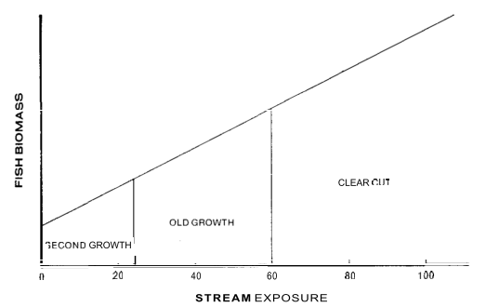
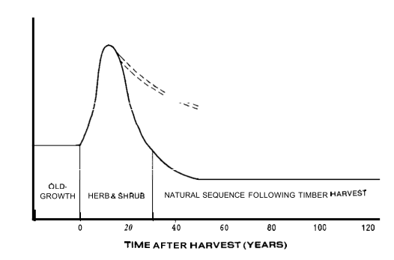
This is not a new idea. . .
“A strategy for managing streamside areas for long-term fisheries values would be to keep the large woody materials in the stream during harvest, leave large coniferous trees to serve as a future source of instream debris, and selectively thin dense second-growth stands along the stream to provide a mix of food resources, including algae”
Fish Biomass
Active management
Fish Biomass
Sedell and Swanson (1984)

Slide 19
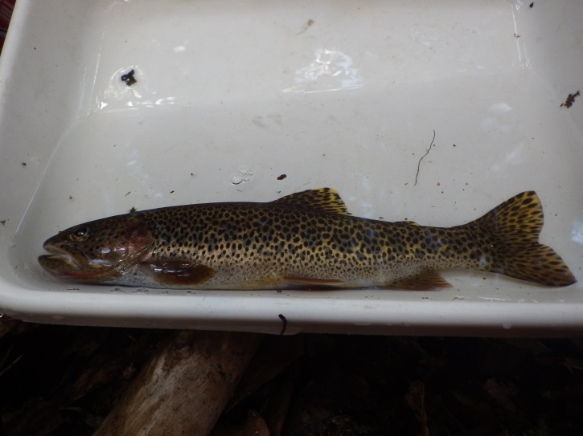
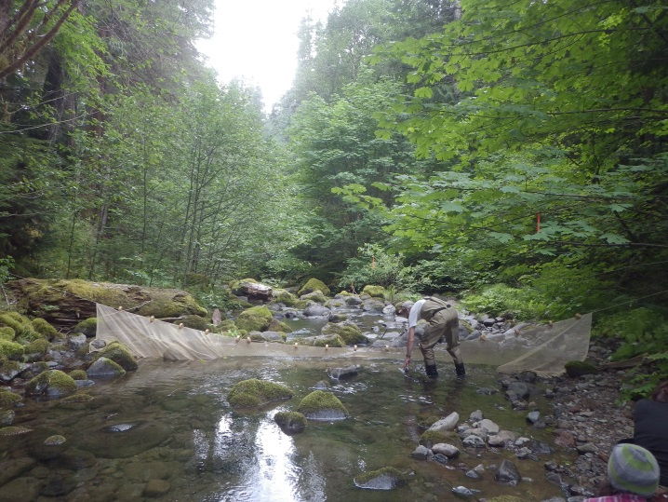
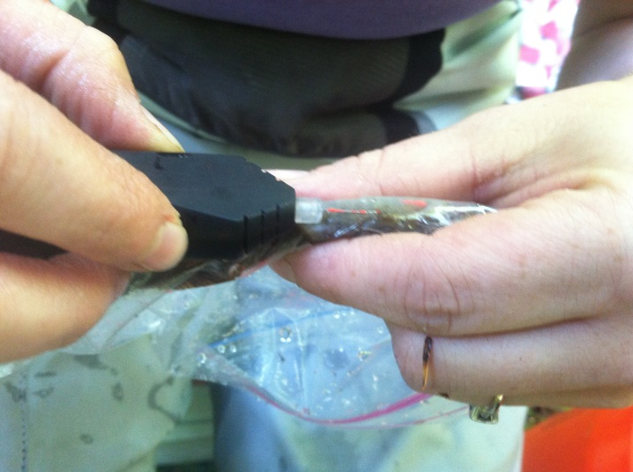
Study Design: Hyp 1
(Matt Kaylor)
Set up 9 pairs of reaches with old-growth and second-growth riparian forests and evaluate relationships among the following metrics compare across streams for each stand type.
Light/canopy cover
Stream habitat
Background nutrient concentrations
Primary production (chlorophyll a)
Macroinvertebrate biomass and community composition
Fish abundance and biomass
Salamander abundance and biomass

Slide 20
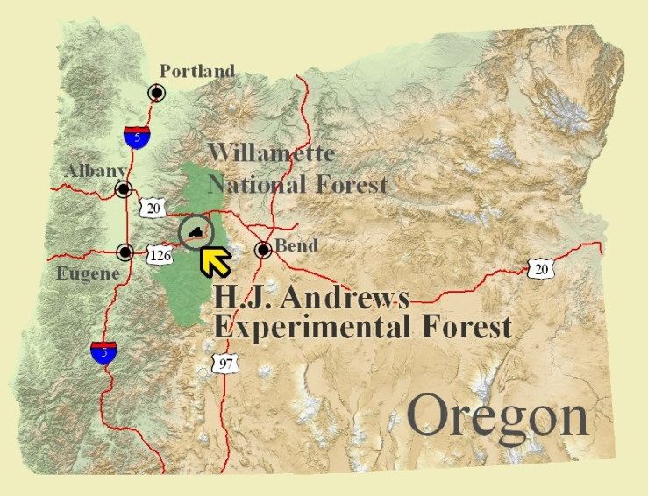

Study Design
H.J. Andrews Experimental Forest, OR
Old-growth
Previously Harvested
9 Total Pairs
18 Total reaches
2014 Fish Data from Gregory et al.

Slide 21
Results: Bottom-up Drivers?
Increased Solar Radiation
Increased Primary Production
Greater Invertebrate Biomass
Greater top consumer abundance, biomass and/or growth rates

Slide 22
Results: Bottom-up Drivers?
Increased Solar Radiation
Increased Primary Production
Greater Invertebrate Biomass
Greater top consumer abundance, biomass and/or growth rates

Slide 23
Results: Bottom-up Drivers?
Increased Solar Radiation
Increased Primary Production
Greater Invertebrate Biomass
Greater top consumer abundance, biomass and/or growth rates
Old-Growth
Second-Growth

Slide 24
Results: Bottom-up Drivers?
Increased Solar Radiation
Increased Primary Production
Greater Invertebrate Biomass
Greater top consumer abundance, biomass and/or growth rates
Old-Growth
Second-Growth

Slide 25
Results: Bottom-up Drivers?
Increased Solar Radiation
Increased Primary Production
Greater Invertebrate Biomass
Greater top consumer abundance, biomass and/or growth rates
Old-Growth
Second-Growth

Slide 26
Results: Bottom-up Drivers?
Increased Solar Radiation
Increased Primary Production
Greater Invertebrate Biomass
Greater top consumer abundance, biomass and/or growth rates

Slide 27
Results: Bottom-up Drivers?
Increased Solar Radiation
Increased Primary Production
Greater Invertebrate Biomass
Greater top consumer abundance, biomass and/or growth rates
Old-Growth
Second-Growth

Slide 28
Results: Bottom-up Drivers?
Increased Solar Radiation
Increased Primary Production
Greater Invertebrate Biomass
Greater top consumer abundance, biomass and/or growth rates
Old-Growth
Second-Growth

Slide 29
Results: Bottom-up Drivers?
Increased Solar Radiation
Increased Primary Production
Greater Invertebrate Biomass
Greater top consumer abundance, biomass and/or growth rates

Slide 30
Results: Bottom-up Drivers?
Increased Solar Radiation
Increased Primary Production
Greater Invertebrate Biomass
Greater top consumer abundance, biomass and/or growth rates
Old-Growth
Second-Growth

Slide 31
Results: Bottom-up Drivers?
Increased Solar Radiation
Increased Primary Production
Greater Invertebrate Biomass
Greater top consumer abundance, biomass and/or growth rates
Old-Growth
Second-Growth

Slide 32
Results: Bottom-up Drivers?
Increased Solar Radiation
Increased Primary Production
Greater Invertebrate Biomass
Greater top consumer abundance, biomass and/or growth rates
Old-Growth
Second-Growth

Slide 33
Results: Bottom-up Drivers?
Increased Solar Radiation
Increased Primary Production
Greater Invertebrate Biomass
Greater top consumer abundance and biomass
Old-Growth
Second-Growth

Slide 34
Kaylor et al. in Prep.
Analysis of differences
Less wood and more vert. biomass
more wood & more vert. biomass
Less wood and less vert. biomass
more wood but less vert. biomass

Slide 35
Study Design: Hyp 2
(Matt Kaylor)
“Stand regeneration experiment”
1970’s Murphy and Hall quantified effects of riparian forest harvest on stream food webs and stream habitat by evaluating stream conditions and stream biota in paired reaches with old-growth vs. recently cut riparian forests

Slide 36
Study Design
H.J. Andrews Experimental Forest, OR
Old-growth
Previously Harvested
Surveyed in Murphy and Hall 1981
2014 Fish Data from Gregory et al.

Slide 37
Results: 1970’s
Old-growth
Canopy Openness (%)
1977
Recently Harvested
% Canopy Openness
Trout Biomass (g/m²)
Large Wood
Pool Area
Chlorophyll a
Large Wood (100cm³/m²)
% Pool Area
Chl a (mg/m²)
Murphy and Hall 1981

Slide 38
Study Design: Hyp 2
“Stand regeneration experiment”
1970’s Murphy and Hall quantified effects of riparian forest harvest on stream food webs and stream habitat by evaluating stream conditions and stream biota in paired reaches with old-growth vs. recently cut riparian forests
2014’s M. Kaylor returned to these exact (or nearly exact) locations and re-assessed conditions in old-grown and now ~40 yr. old riparian forests

Slide 39
Results: 2014
Old-growth
1977
Recently Harvested
Trout Biomass (g/m²)
40 years of riparian stand development
2014
Canopy Openness (%)
% Canopy Openness
Trout Biomass (g/m²)

Slide 40
Results: 2014
Large Wood
Pool Area
Chlorophyll a
Large Wood (m³/100m²)
% Pool Area
Chl a (ug/cm²)
40 years of riparian stand development
2014
Canopy Openness (%)
% Canopy Openness
Trout Biomass (g/m²)

Slide 41
Conceptual model for changing vert. biomass over time in a forested headwater stream
Conceptual model for changing wood loads over time in a forested headwater stream
Murphy et al. 1981
Complex canopy with patchy openings
Dense, closed canopy
Periphyton stocks
Fish Biomass
Average light to stream benthos
0
50
100
150
200
Years since stand replacing event

Slide 42
Conceptual model for changing vert. biomass over time in a forested headwater stream
Conceptual model for changing wood loads over time in a forested headwater stream
Kaylor et al. In review
Complex canopy with patchy openings
Dense, closed canopy
Periphyton stocks
Fish Biomass
Average light to stream benthos
0
50
100
150
200
Years since stand replacing event

Slide 43
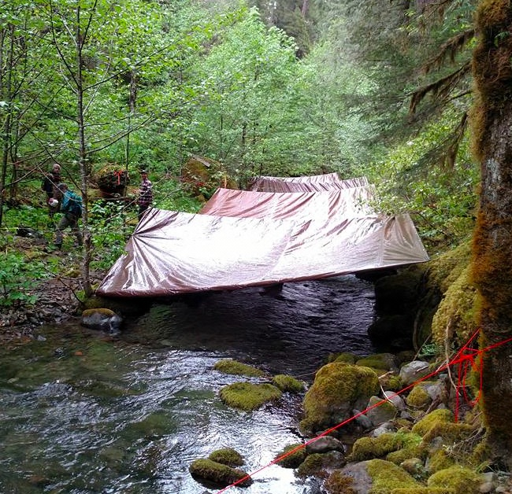
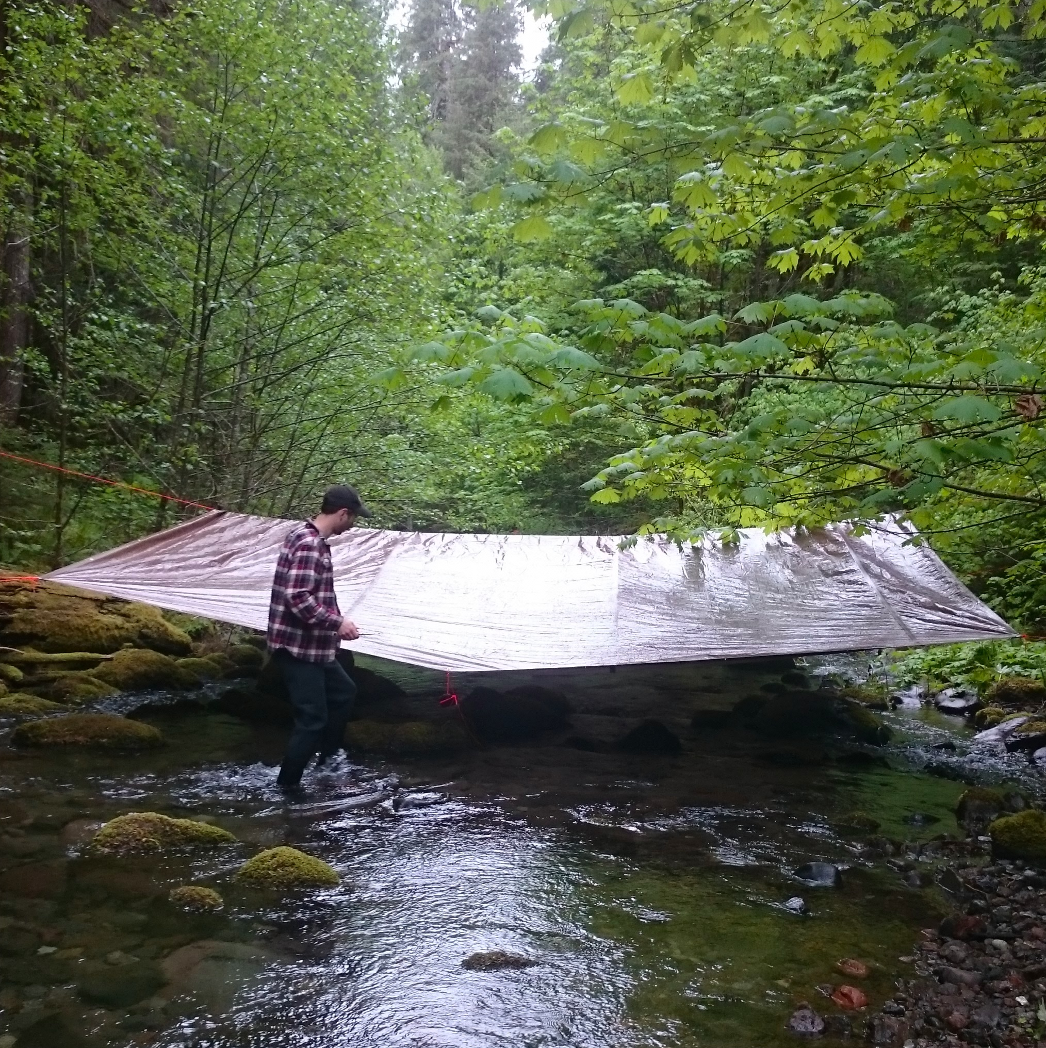
Study Design: Hyp 3
(Emily Heaston)
“Stream shading experiment”
Picked 3 of the reach pairs assessed by M. Kaylor in 2014 and shaded one of the reaches in each pair for one summer
Determine if partial shading impacts primary production, invertebrates, fish and salamanders

Slide 44
Study Design
H.J. Andrews Experimental Forest, OR
Old-growth
Previously Harvested
MR404
L703
L701

Slide 45
(a) MR404
2014
2016
(b) L703
2014
2016
PAR (mol m⁻² day⁻¹)
(c) L701
2014
2016
Distance (m)

Slide 46
(a) MR404
2014
2016
(b) L703
2014
2016
PAR (mol m⁻² day⁻¹)
(c) L701
2014
2016
Distance (m)

Slide 47
(a) MR404
2014
2016
(b) L703
2014
2016
PAR (mol m⁻² day⁻¹)
(c) L701
2014
2016
Distance (m)

Slide 48
(a) MR404
2014
2016
(b) L703
2014
2016
PAR (mol m⁻² day⁻¹)
(c) L701
2014
2016
Distance (m)

Slide 49
MR404
L703
L701
MR404
L703
L701

Slide 50
MR404
L703
L701
MR404
L703
L701

Slide 51
MR404
L703
L701
MR404
L703
L701

Slide 52
MR404
L703
L701
L701

Slide 53
MR404
L703
L701
MR404
L703
L701

Slide 54
MR404
L703
L701
MR404
L703
L701
MR404
L703
L701

Slide 55
NEXT STEPS
Stream gap experiment
(Allison Swartz)
Cut gaps into a riparian zone with close-canopy second-growth forest

Slide 56
USFS Riparian gap project
McCrae Creek
24 hour accumulated PAR x1000 (umol•m⁻²)
Chucksney Mtn. Creek
3 years of pre-treatment fish data
2 years of pre-treatment invert data
2 years of pre-treatment chl a data
1 year of pre-treatment nutrient uptake
Distance (m)
Notes:
----- Meeting Notes (11/24/13 17:28) -----
Fluorescein is a photodegrading dye that can be used to assess the spatial variability and intensity of light

Slide 57
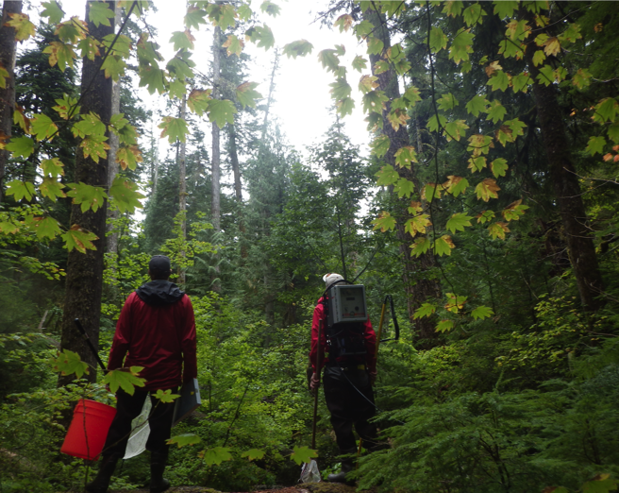
Thank you
Acknowledgements
Funding:
CoF Forestry’s Fish and Wildlife Habitat in Managed Forests Research Program
OSU’s Dept. of Fisheries and Wildlife
Fieldwork and data collection:
Matt Kaylor
Brian VerWay
Other intellectual contributions:
Lina DeGrigorio
Ivan Arismendi
Cheryl Friesen
Stan Gregory
Kathy Keable
Julie Pett-Ridge
Mark Shultz
USFS/BLM fisheries research team
Theresa Vallentine
Randy Wildman

Slide 58
McRae Crk
McRae Crk
Temperature?
0m
old-growth
160m
2nd-growth
210m
Temperature (C)
380m
Mean 24 hr daily temp based on 1 week mid-summer data

Slide 59
McRae Crk
McRae Crk
Temperature?
0m
old-growth
160m
2nd-growth
210m
Temperature (C)
380m
Mean 24 hr daily temp based on 1 week mid-summer data

