Slide 1

REMOTE SENSING TOOLS FOR FOREST RESTORATION
NANCY GRULKE, DIRECTOR
WESTERN WILDLANDS ENVIRONMENTAL THREATS ASSESSMENT CENTER
RESEARCH/S&P/NFS
google ‘WWETAC’

Slide 2
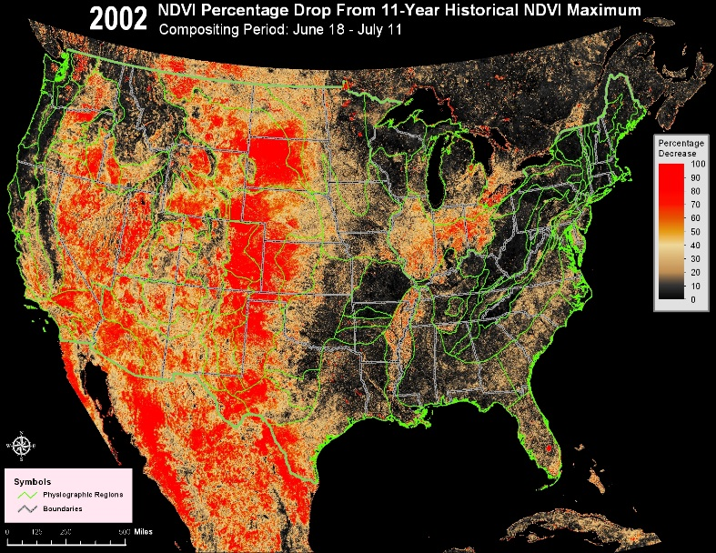
MODIS

Slide 3
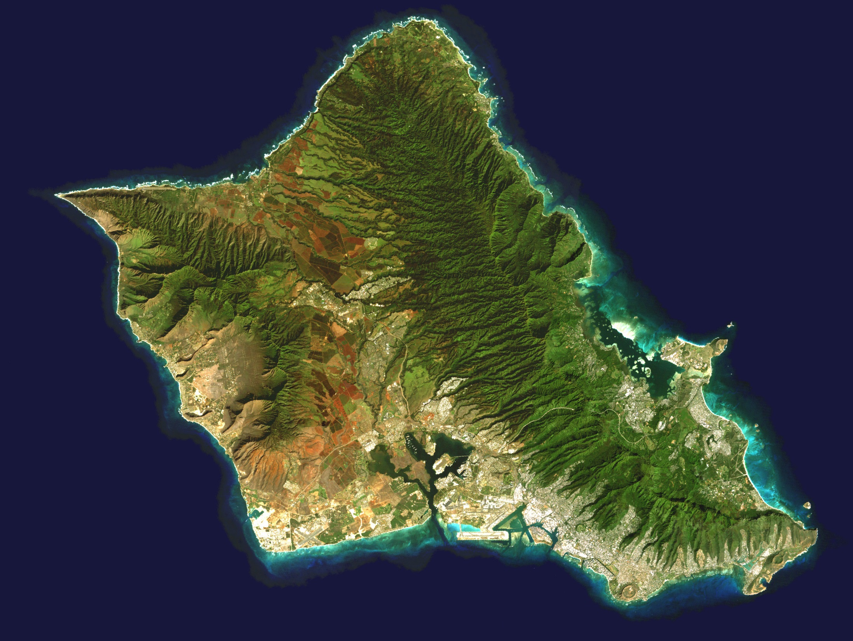
LANDSAT

Slide 4
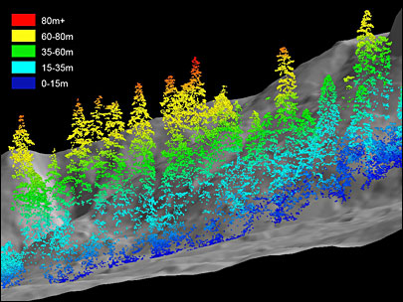
LIDAR

Slide 5
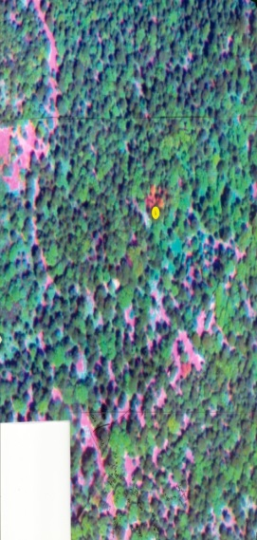
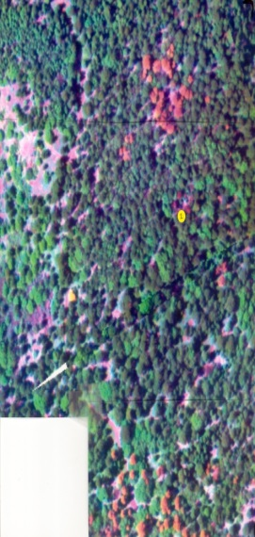
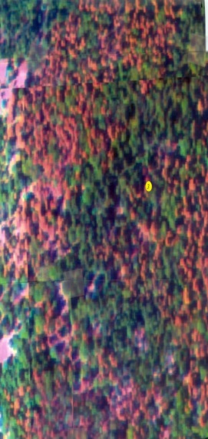
MULTISPECTRAL
HIGH RESOLUTION

Slide 6
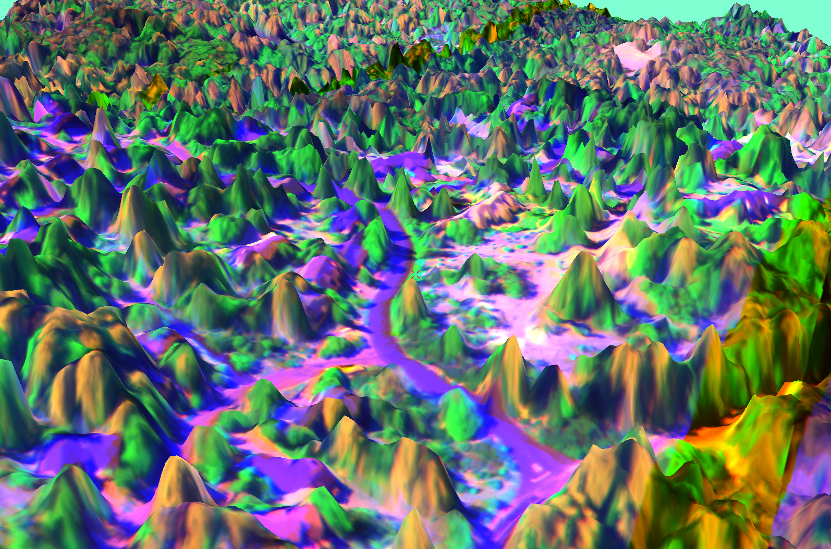
STEREOSCOPIC VIEW OF
MULTISPECTRAL
HIGH RESOLUTION

Slide 7
WWETAC REMOTE SENSING TOOLS
MODIS-based tools:
FORWARN
  FIDAR
  PHENO_MAP
High resolution, multispectral tools (FIREIMAGER)
  Identification of species
  Detection and source of disturbance agent

Slide 8
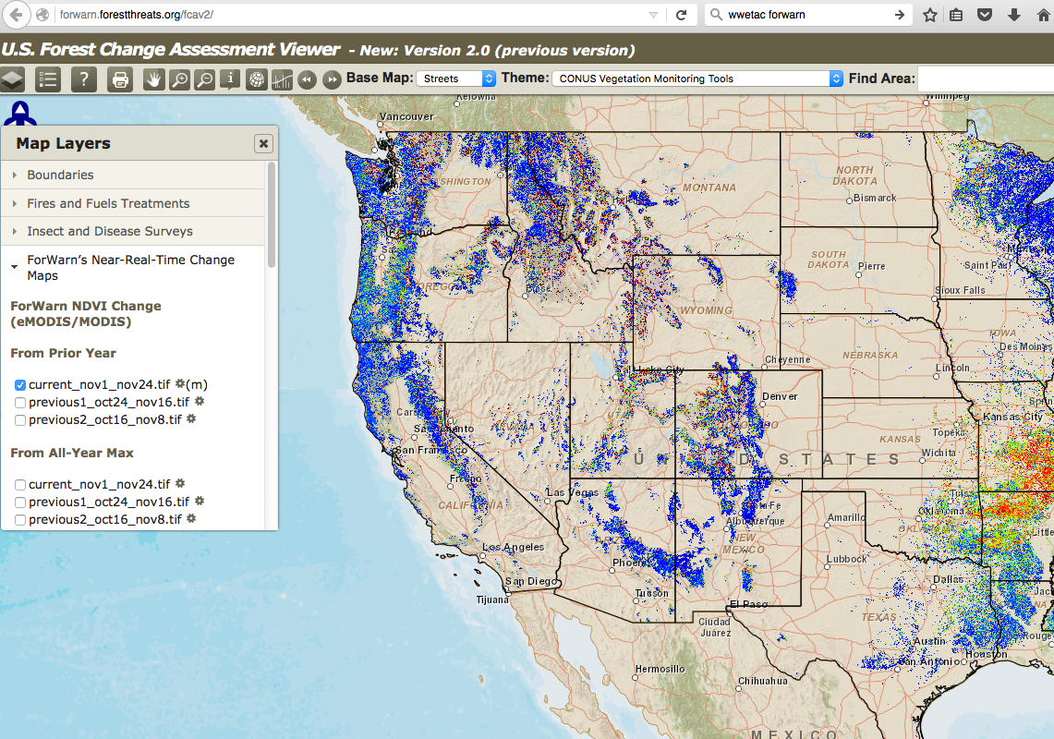
ForWarn
  ForWarn provides NRT tracking of veg changes across landscapes in the US. It’s use-ful for both moni-toring/attributing disturbance as well as yr-to-yr variability. Uses MODIS satellite data (~13 acre pixel every 8 d).
  google ‘ForWarn’

Slide 9
FIDAR:
Forest Insect and Disease Disturbance Assessment and Reconnaissance
  Overlays ForWarn imagery onto Forests’ FACTS data bases to estimate types of stands affected by disturbance agent and stand age
  Rapid update: every 8 days
  Detect & map large windthrow areas, extreme drought, insect outbreaks, and pathogen outbreaks
  Coarse: 13 acre pixel
NDVI = ‘greenness’ = photosynthetic activity
Red = high reduction in NDVI
Pink = medium reduction
Yellow = low reduction
Green = no reduction
Schrader-Patton et al., 2016

Slide 10
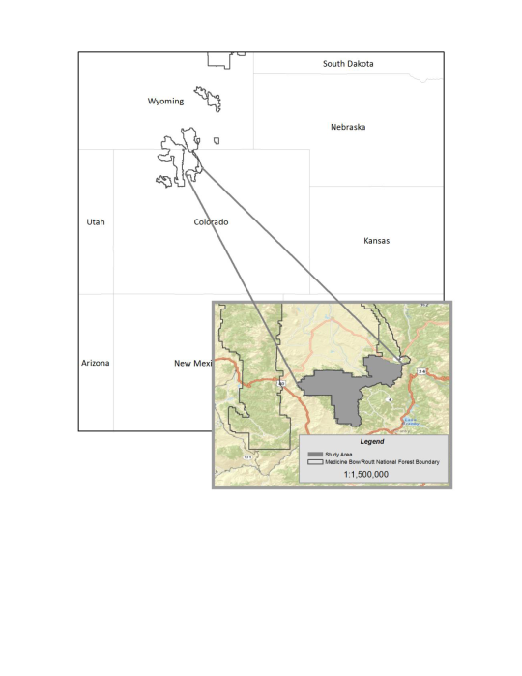
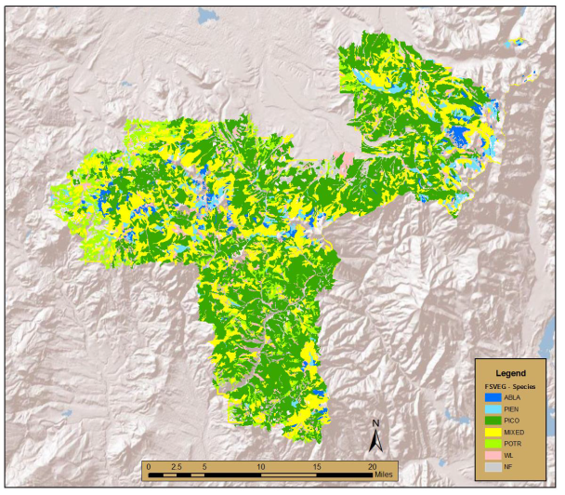
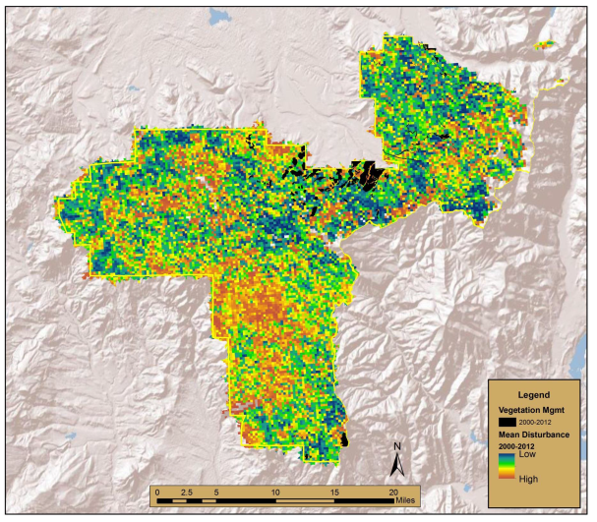
FIDAR: landscape example
X
Medicine Bow-Routt NF, Parks study area
MEDICINE BOW- ROUTT NF
STAND COMPOSITION
DISTURBANCE, 2000-12
Class | Rank (Mean NDVI loss) | Rank (Area) | Combined Rank
PICO-H-Med | 4 | 2 | 2
WL-H-Med | 12 | 10 | 3
MIXED-H-Large | 19 | 3 | 4
PICO-M-Large | 13 | 11 | 5.5
PICO-M-Med | 20 | 5 | 8
TOP 5 STAND TYPES, COVER, AND SIZE CLASS AFFECTED BY INSECT OUTBREAKS
SCHRADER, GRULKE, DRESSLER

Slide 11
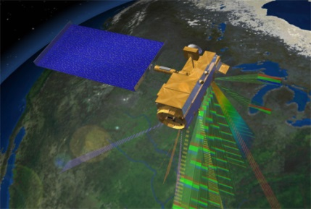
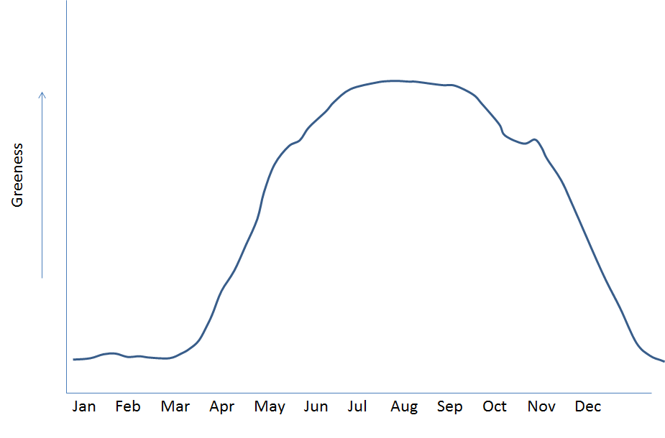
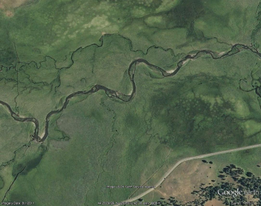
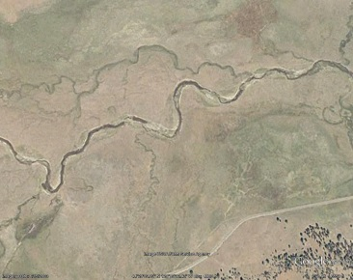
NEAR REAL TIME PHENOLOGY MAPPER
Pheno_Map
MAX NDVI = MAX GREENNESS,
MAX PHOTOSYNTHETIC ACTIVITY
Tool for timing and location of grazing permits on National Grasslands. MODIS imagery is superimposed onto grassland vegetation database. Imagery is updated and delivered every 8 days to range managers. Pixel size is ~ 13 acres.
Notification:
Detection and location of ‘green up:’ 33% of maximum (15 yr average) NDVI and location
Detection and location of ‘brown down:’ 50% of maximum greenness
‘BROWN DOWN’
(50% OF MAX)
‘GREEN UP’
(33% OF MAX)
CATTLE GRAZING
2 WK DELAY
2 WK DELAY
CATTLE REMOVED

Slide 12
MULTISPECTRAL, HIGH RESOLUTION IMAGERY
MULTIPLE CAMERAS AND IMAGERS
MOUNTED UNDER FIXED WING OR HELICOPTERS
AVAILABLE 2016 FOR THE FIRST TIME THIS YEAR IN THE FS
R, NIR (SWIR), THERMAL

Slide 13

IDENTIFICATION OF TREE SPECIES
BB killed PIPO
BB attacked PIPO
Manzanita
Hot bare ground
Healthy QUKE
Healthy ABCO
Healthy PIPO
Healthy PILA

Slide 14
SPECTRAL IDENTIFICATION OF TREE SPECIES
AND GROUND COVER TYPES
White fir
Coulter pine
Ground cover types
Ponderosa
pine

Slide 15
SPECTRAL IDENTIFICATION OF TREE SPECIES
76% ACCURACY
Tree model of the 7 main tree species

Slide 16
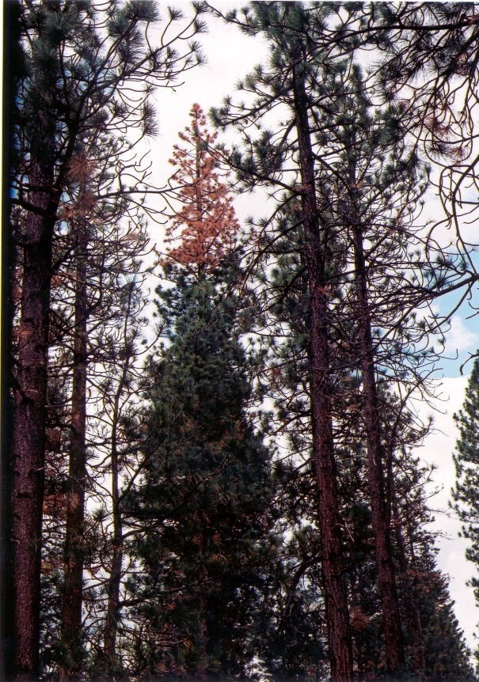
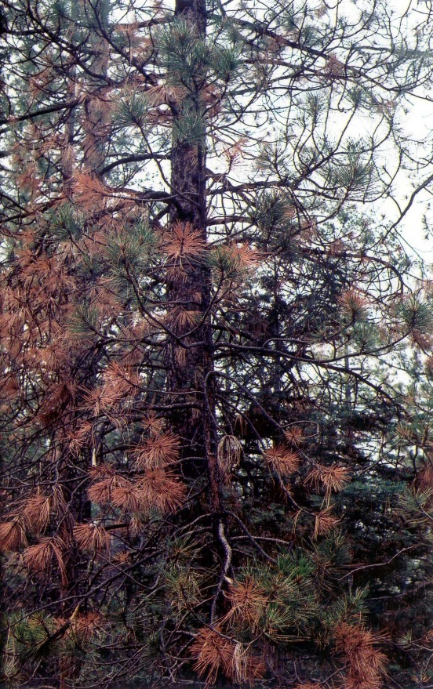

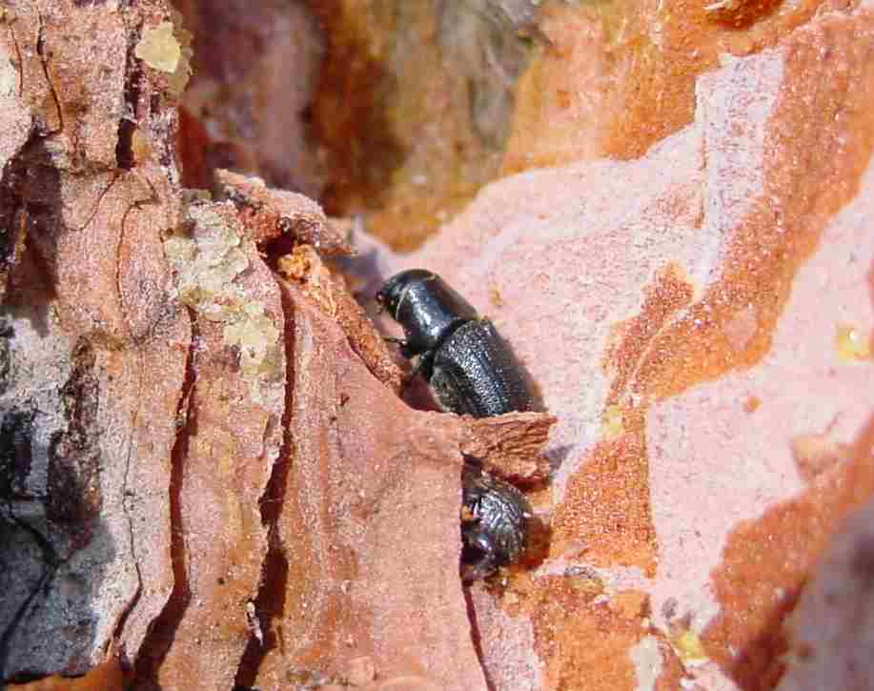
PATTERNS OF WITHIN-CANOPY
MORTALITY:
DETECTABLE AND ATTRIBUTABLE
WITH HIGH RESOLUTION IMAGERY
Chronic drought ‘99-01
Top down:
Beetle kill
Bottom up:
drought
7-20-01
Imagery from Phil Riggan (www.firemapper.com): composited red, near infra-red, thermal bands

Slide 17
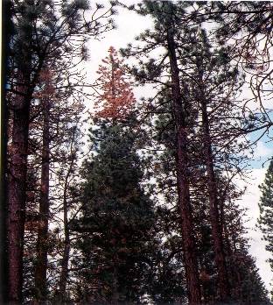
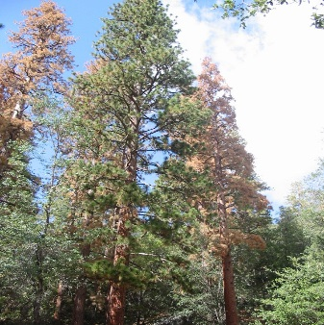
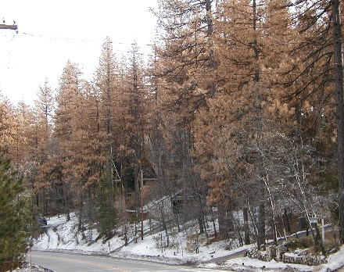
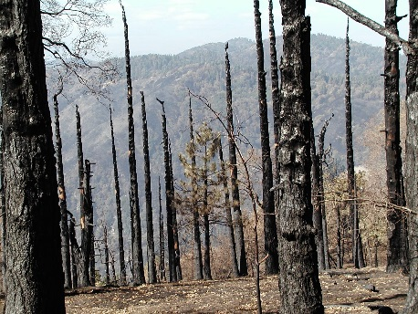



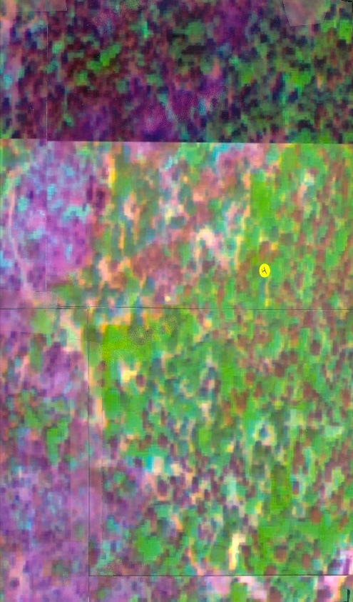
Chronic drought ‘99-01
Chronic + acute drought ‘02
Prior to ‘03 fire
After ‘03 Old Fire
7-20-01
5-27-03
9-18-03
7-10-04
Imagery from Phil Riggan: composited red, near infra-red, thermal bands

Slide 18
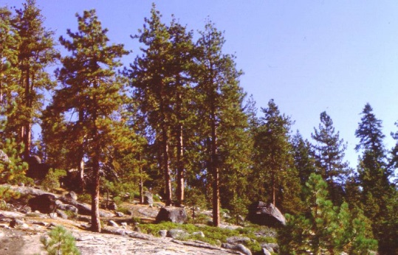
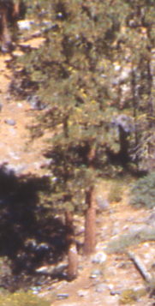




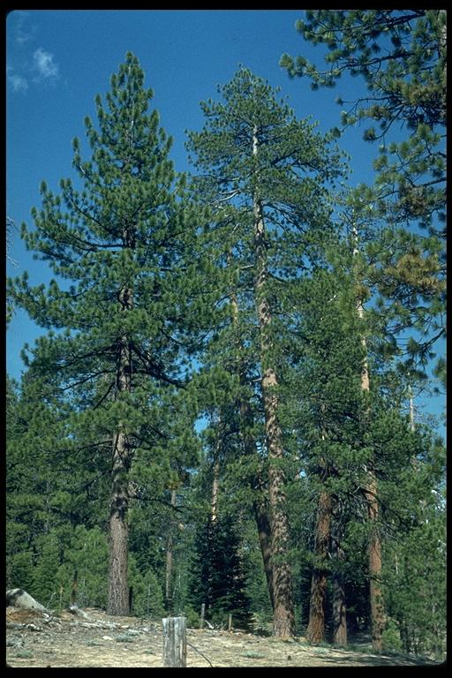
THERMAL IMAGERY
DIURNAL TRENDS IN CANOPY TRANSPIRATON
MAY JUNE JULY AUG SEPT
COOL HOT
CR
SP
BF
TOP DOWN VIEW OF TREE
10 am 10:30 am 11 am 11:30 am
Grulke et al. 2002
‘UNSEEN’
Image credit: Saint Mary’s College, CA
LATERAL VIEW OF TREE

Slide 19
TEST FOR ABILITY TO DISTINGUISH TREE DROUGHT STRESS AND HEALTH
SEPARATED SPECTRAL DATA INTO TOP AND UPPER MID-CANOPY SECTIONS OF THE TREE
MASKED SHADED PORTION OF THE CANOPY
RANDOMLY SAMPLED SPECTRAL SIGNATURE OF 30 POINTS IN EACH SHAPE FILE
‘UNSEEN’
Image credit: Saint Mary’s College, CA

Slide 20
CORRELATION OF REMOTELY SENSED AND CANOPY HEALTH ATTRIBUTES:
SIGNIFICANT CCA
Spectral |  |  | Canopy Health
Top Canopy | Red |  | Whorl #
 | NIR |  | Chlorotic mottle 1
 | R:NIR |  | Chlorotic mottle 2
 | NIR Scalar |  | Chlorotic mottle 4
 | NDVI |  | Chlorotic mottle 6
 | Thermal |  | % Needle length
Upper Mid Canopy | Red |  | % branchlet foliation
 | NIR |  | Branchlet Diameter 2
 | R:NIR |  | Cone frequency
 | NIR Scalar |  | Leaf scale
 | NDVI |  | Leaf cutter
 | Thermal |  | Mistletoe
Δ’s (top-mid) | Red ∆ |  | Elytroderma
 | NIR ∆ |  | Early senescence
 | R:NIR ∆
 | NIR scl. ∆
 | NDVI ∆
 | Therm. ∆
80 TREES, W/ AND W/OUT
DROUGHT STRESS:
ΔT
90% CORRECT
CLASSIFICATION
OF TREES WITH DROUGHT STRESS
80% CORRECT
CLASSIFICATION
OF TREES WITHOUT DROUGHT STRESS
ΔT < 1.3°C
ΔT > 1.3°C
Red (650 nm), NIR (860 nm),
thermal (8.1-12.4 nm) bands
ΔT + NDVI IMPROVED CLASSIFICATION ACCURACY

Slide 21
Spectral signature of drought stressed or trees already attacked by insects or pathogens can be used to identify *at risk* trees (each tree is georeferenced within imagery).
*At risk* trees could be selected for harvest, and leave the healthiest trees for recruitment to old growth.
…WWETAC & TNC working on this on the Fremont
APPLICATION TO FOREST RESTORATION:

Slide 22
info on tree physiology to think about in fuels reduction treatments…

Slide 23
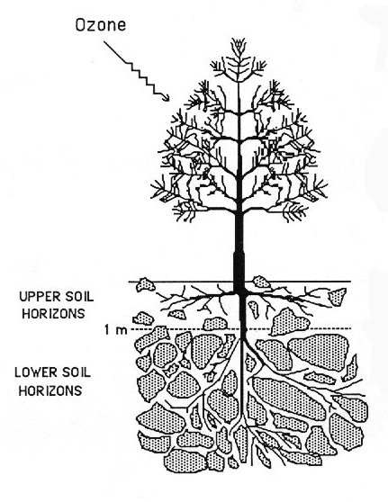
Western yellow pine (ponderosa and Jeffrey pine):
Most (90%) of the roots are in the upper 1 m of soil, and extend out to ~1.2x of the canopy drip line
PIPO is wasteful of water early in the growing season (PIPO more than PIJE)
When the upper soil horizons dry out, the tree relies on deep water sources in deep soil or in cracks in weathered bedrock
Then, the tree shifts physiologically to greater water use efficiency (high CO₂ uptake : water lost in transpiration)
In an average or above precipitation year: no problem
In a year of below average ppt, fewer roots reach water resources
In a severe drought year, the water may be completely consumed and/or inaccessible to the tree
In a dense stand on flat land, more trees are competing for the same water : more drought stress, more trees susceptible to insect attack, more drought-induced mortality >> thin more that you want to
In a dense stand on a slope, water supply is more complex: some trees may have access to mid-slope seeps, and trees that don’t have access will wink out in a severe drought >> can’t predict which will be drought-stressed without some other tools
Trees that are exposed to regular drought stress are more drought- tolerant
1.2x drip line
Summarized in Grulke et al., 2010; Grulke & Retzlaff 2001; Grulke et al., 2002; Grulke & Balduman 1998; Fig. modified from Grulke 1999.

Slide 24
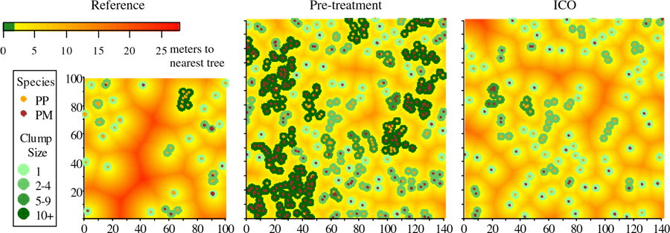
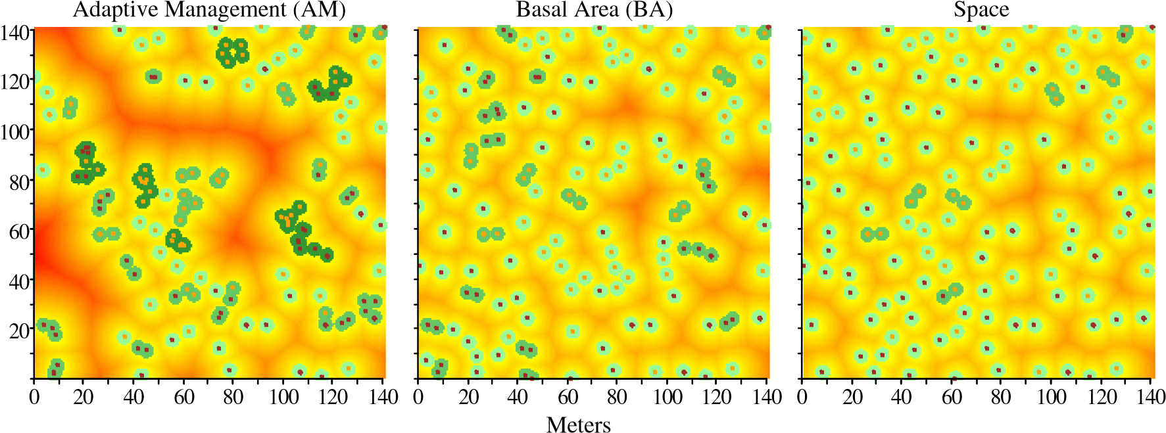
APPROACHES TO RESTORATION ACTIVITIES
Selection of trees to fit an idealized aboveground pattern does not take into account location and amount of belowground resources in increasingly exceptional drought years.
When an aboveground pattern is decided upon, are we leaving the trees with access to deep water sources? Are we leaving the healthiest trees for recruitment to old growth?
>this is the question we worked on
Churchill et al., 2013

Slide 25
120 year average precipitation (ave ppt)
80% of ave ppt induces moderate drought stress (16% of time)
60% of ave ppt induces extreme drought stress (30% of time)
Total annual ppt, cm
120 yr regional precipitation record from Big Bear Dam
Physiological drought stress of yellow pine is related to the % of average precipitation within the same year. Drought, and physiological drought stress of trees is common (Grulke et al. 2010).

Slide 26
120 year average precipitation (ave ppt)
2002: 1/250 yr
drought
Total annual ppt, cm
120 yr regional precipitation record from Big Bear Dam
*After mid 1960’s the low precipitation years have lower and lower total annual precipitation.
There was a 1/250 yr drought in 2002.

Slide 27
120 year average precipitation (ave ppt)
2002: 1/250 yr
drought
Total annual ppt, cm
120 yr regional precipitation record from Big Bear Dam
Over the last 5 yrs in southern California, every year has been a 1/1000 yr drought.

Slide 28
WWETAC and TNC has been working on the effect of the 2014 & 2015 drought on tree health in different fuels treatments on the Fremont NF

Slide 29
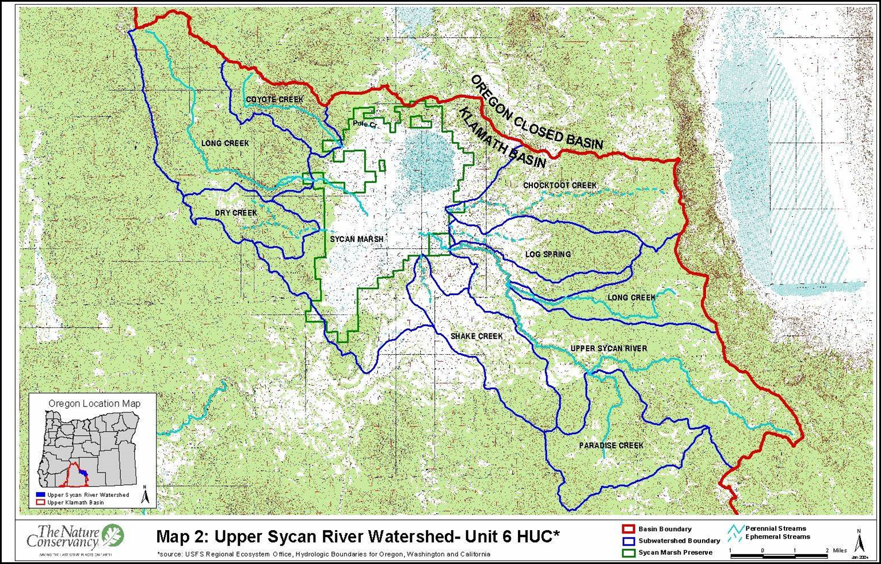
Upper Sycan Watershed
Notes:
Sycan Marsh is in the Modoc Plateau and East Cascades Ecoregions in the headwaters of the Klamath Basin, on the divide between the Great Basin and Klamath Basin. The Upper Sycan Watershed (USW) is composed of seven watersheds (six field Hydrologic Units Codes) from Sycan Marsh to the headwaters, (208,832 acres). Average precipitation at the marsh is almost 20.5 inches a year, with 90 percent of the total falling between October and May. Mean annual air temperatures are 5.6°C .

Slide 30
Intent: assess forest health in different fuels treatments, in upland and lowland sites
Fuels treatments installed:
  Upland and lowland no-harvest (CY1C, CY2C)
  Upland harvest, matched pairs of mature and pole sized trees (CY2H) (2016?)
  Lowland harvest, leave litter 2005 (CY1H)
  Lowland harvest (only) 2015 [S of Long Creek] (LC1H)
  Lowland prescribed burn only 2008 [S of Long Creek] (LC1 1xF)
  Lowland harvest (2005), 1 prescribed burn (2006) (CY1 H1xF)
  Lowland harvest, 2 prescribed burns (2006, 2013) (CY1 H2xF)
  Lowland ICOs, 2 (CY1 ICO, LC1 ICO) (2016?)
Trees were assessed in 2014 and 2015: both severe drought stress years (<60% of average long-term ppt)

Slide 31
APPLICATION OF THIS APPROACH TO ASSESS
FUELS TREATMENTS ON THE FREMONT NF
SPECTRAL ATTRIBUTES
WHOLE TREE HEALTH ATTRIBUTES:
BOLE & BRANCH INFESTATIONS
MECHANICAL DAMAGE
FIRE DAMAGE
CANOPY TRANSPARENCY
CANOPY RETENTION
BRANCH DIE BACK
GROWING POINT DIE BACK
FOLIAR CHLOROSIS
FOLIAR DESICCATION
# CONES
LEVEL OF TREE DROUGHT STRESS
CANOPY HEALTH ATTRIBUTES:
NEEDLE AND BRANCH LENGTH
MAXIMUM NL
BRANCH DIAMETER
BAI
NEEDLE RETENTION
DEFOLIATORS
PHLOEM FEEDERS
FUNGAL INFESTATION
ENVIRONMENTAL DAMAGE
CHLOROSIS
NECROSIS
+
FOR THE PURPOSES OF THIS PRESENTATION, THE TREES WERE GROUPED AND GRAPHED IN 3 HEALTH CLASSES: *ABOVE AVERAGE, *AVERAGE, AND *POOR

Slide 32
EFFECT OF FUELS TREATMENTS ON WHOLE TREE HEALTH, LOWLANDS: proportion of trees in poor, average, and above average health
Fuels reduction treatments, not followed by prescribed fire had a greater proportion of trees in poor health relative to control.
Harvest followed by prescribed fire eliminated all poor health trees.
Harvest followed by two prescribed fires at 7 yr intervals improved the proportion of above average health trees by 25%.

Slide 33
TREE HEALTH ON 2 UPLAND SITES: proportion of trees in poor, average, and above average health
In both sites, old growth trees had the poorest health in the population:
45% of upland OG trees are in decline
CY2C
CY2H
<Harvest site had high DMR score
<No OG trees were healthy: all
were heavily infected
<Mistletoe will infect recruiting
trees

Slide 34
(POPULATION) ‘LEAVE TREES’ HARVEST TREES
POLE-SIZE TREES:
25% of pole sized trees are in poor health; the majority of pole sized trees to be harvested are of aver-age health;
MATURE TREES:
10-25% of mature trees are in poor health, and a larger proportion of healthy vs. average health trees are slated to be harvested;
BOTH SIZE CLASSES:
Harvesting the population as marked will leave a greater proportion of average and poor trees that will be recruited to OG.
CY2
CONTROL
CY2
HARVEST
UPLAND TREE POPULATIONS:
HARVEST (H) vs LEAVE TREES (nH)

Slide 35
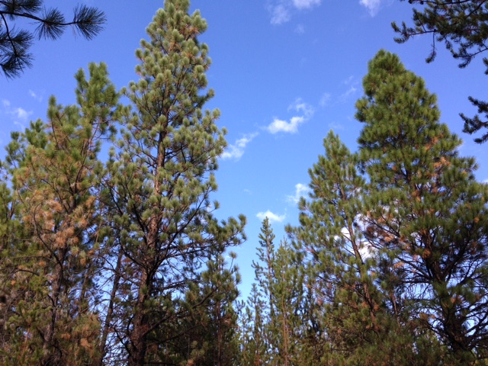
Fremont National Forest,
south-central Oregon, 2014-2015
drought; Interior ponderosa pine
Significant signs of severe drought stress:
  Lower canopy primary branch excision; growing point dieback
  Whole tree desiccation
  Within whorl needle excision

Slide 36
Significant signs of severe drought stress:
  Lower canopy primary branch excision; growing point dieback
  Whole tree desiccation
  Within whorl needle excision

Slide 37
Significant signs of severe drought stress:
  Lower canopy primary branch excision; growing point dieback
  Whole tree desiccation
  Within whorl needle excision

Slide 38
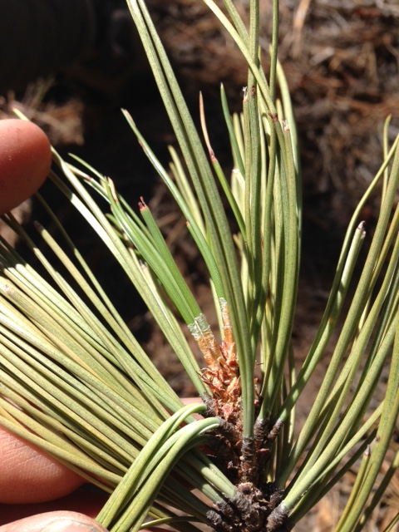
NEEDLE AGE CLASSES OLDER THAN CURRENT YEAR WERE AFFECTED
Significant signs of severe drought stress:
  Lower canopy primary branch excision; growing point dieback
  Whole tree desiccation
  Within whorl needle excision

Slide 39
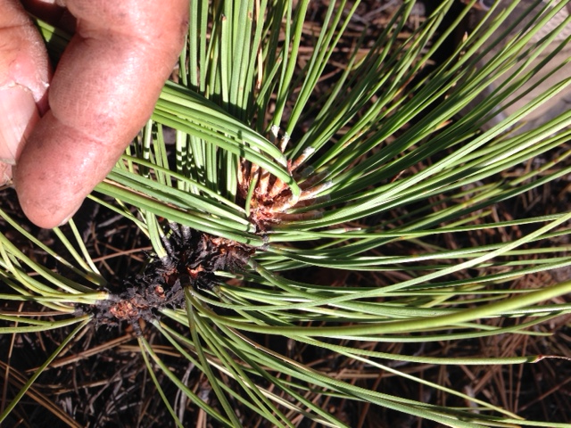
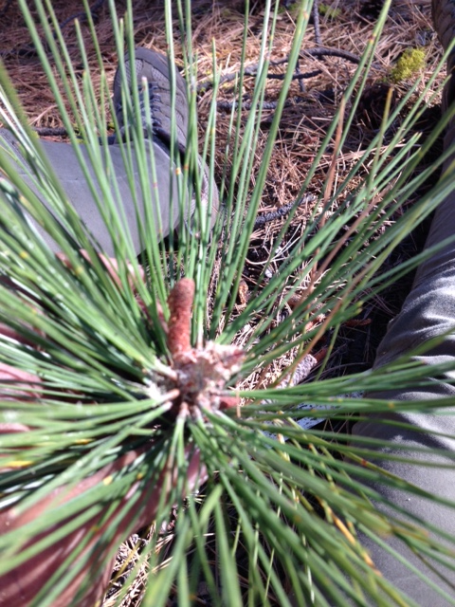
Chlorosis can be generalized:
in this case whorl #1 & 2 are most affected; in other cases all needle age classes are yellowing
In some cases, no needles were produced or if they were, did not survive and/or all primordia (were stimulated to differentiate as male strobili (fate of bud determined in prior year, end of July)

Slide 40
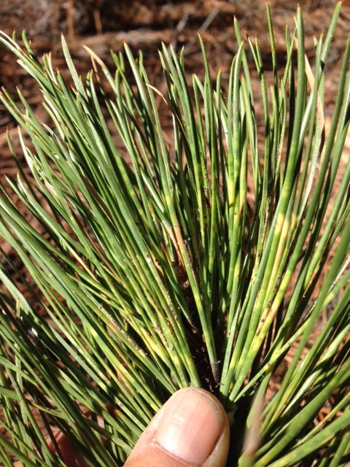
In excising branches, there is a high incidence of:
scale
sap-sucking insects
leaf cutters (caterpillars)
needle tip dieback
whole needle dieback
loss of needle age classes
loss of needles within a whorl
High frequency of these pathologies were associated with/preceded tree mortality in 20 yr study in Sequoia National Park

Slide 41
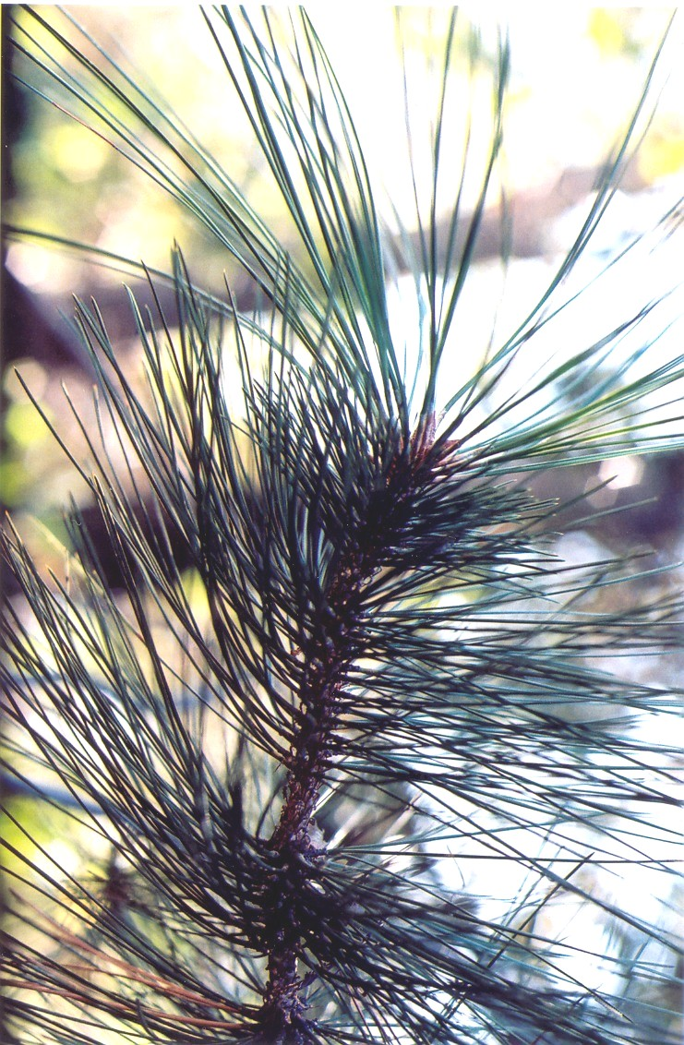
NEEDLE ELONGATION IN CURRENT YEAR INDICATES LEVEL OF TREE DROUGHT STRESS
Needle elongation growth is used as a simple proxy for physiological tree drought stress.
Needle elongation growth was expressed as % of maximum growth observed for all retained needle age classes.
This relative measure corrects for canopy position and effects of competition.
2003
2002
2001
2000

Slide 42
SENSITIVITY OF NEEDLE ELONGATION GROWTH TO ANNUAL PPT
FREMONT NF STUDY
5 Nat’l Forests, 2006 – 2015,
Jeffrey pine, SBNF to LNF

Slide 43
SIMPLE APPROACH TO IDENTIFYING“TREES AT RISK:”
Track site % of average precipitation
Measure % of maximum needle elongation (CURRENT YR:MAX ON BRANCHLET)
Look for LOTS of needle insects and pathogens
Look at whole tree foliar discoloration and location in canopy
*soon* remote sensing tools will be available to identify drought-stressed and unhealthy trees for thinning prescriptions at the landscape level

Slide 44
References:
Churchill DJ, Larson AJ, Dahlgreen MC, Franklin JF, Hessburg PF, Lutz JA 2013 Restoring forest resilience from reference spatial patterns to silvicultural prescriptions and monitoring, Forest Ecology and Management 291: 442-457.
Grulke NE 1999 Physiological responses of ponderosa pine to gradients of environmental stressors. In: Miller PR, McBride J (eds) Oxidant Air Pollution Impacts in the Montane Forests of Southern California: The San Bernardino Mountain Case Study. Ecological Studies 134:126-163. NY:Springer-Verlag.
Grulke NE, Balduman L 1999 Deciduous conifers: high nitrogen deposition and ozone exposure effects on ponderosa pine. Water, Soil, Air Pollution 116:235-248.
Grulke NE, Johnson R, Esperanza A, Jones D, Nguyen T, Posch S, Tausz M 2003 Canopy transpiration of Jeffrey pine in mesic and xeric microsites: O3 uptake and injury response. TREES 17: 292-298.
Grulke NE, Paine T, Minnich R, Chavez D, Riggan P, Dunn A 2009 Air pollution increases forest susceptibility to wildfire. Pgs 365-403, In: Bytnerowicz A, Arbaugh M, Riebau A, Andersen C (eds) Wildland fires and Air Pollution. Developments in Environmental Science, Vol. 8, The Hague, Netherlands: Elsevier Publishers.
Grulke NE, Retzlaff WA 2001 Changes in physiological attributes from seedlings to mature ponderosa pine. Tree Physiology 21:275-286.
Schrader-Patton C, Grulke NE, Dressen M 2016 Rapid reconnaissance of a forest insect outbreak in Colorado using MODIS phenology data. Pacific Northwest Research Station, General Technical Report, PNW-GTR-940e (in press).

