Slide 1
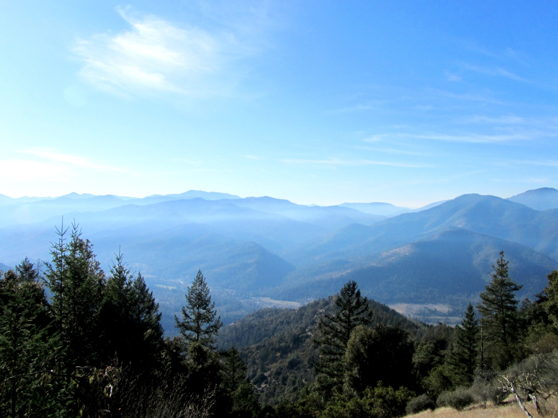
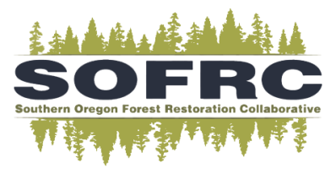

A Cohesive Forest Restoration Strategy for the Rogue Basin
29 April 2016
Kerry Metlen, Ph.D.; Forest Ecologist; The Nature Conservancy
Darren Borgias; Southwest Oregon Program Director; The Nature Conservancy
Bryce Kellogg; Oregon Spatial Analyst; The Nature Conservancy
Mark Stern; The Nature Conservancy
George McKinley; Executive Director; Southern Oregon Forest Restoration Collaborative
Contact: kmetlen@tnc.org

Slide 2
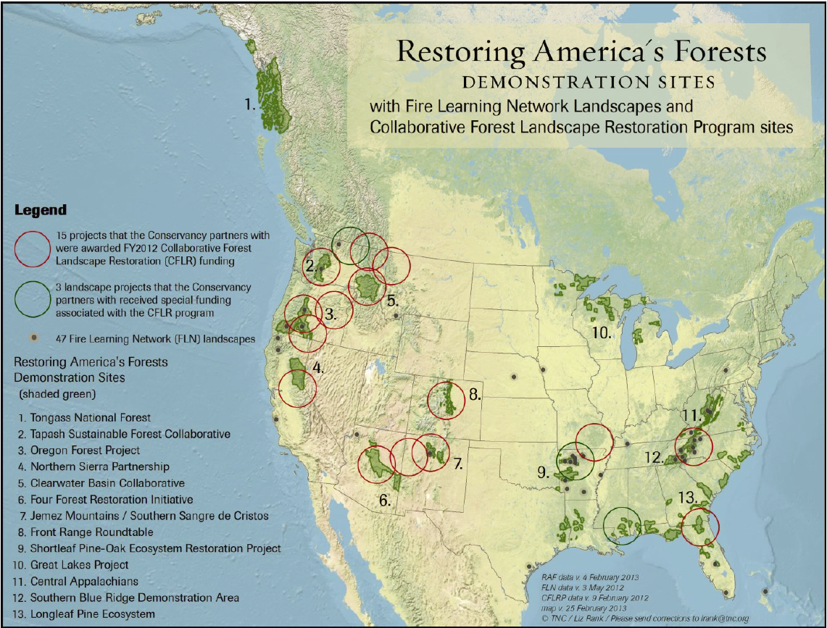


Slide 3
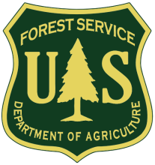
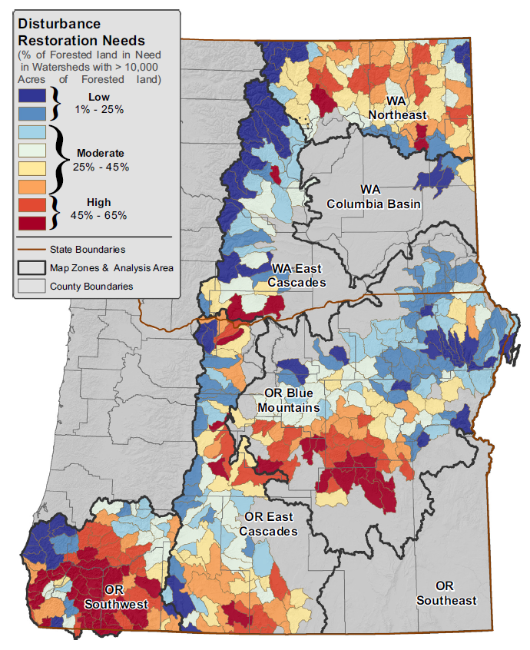
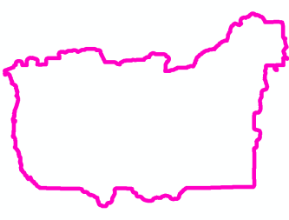
Restoration Needs in Frequent Fire Forest
A collaboration of USFS R6 and TNC
Rogue Basin Forests and Woodlands
4.2 million acres
2.1 million acres are overly dense (50%)
Annual Disturbance need over 20 years:
~ 105,000 ac/yr
Rogue Basin
Haugo, R., C. Zanger, T. DeMeo, C. Ringo, K. Blankenship, M. Simpson, K. Mellen-McLean, A. Shlisky, and J. Kertis, Mark Stern. 2015. A new approach to evaluate forest structure restoration needs across Oregon and Washington, USA. Forest Ecology and Management 335:37-50.

Slide 4
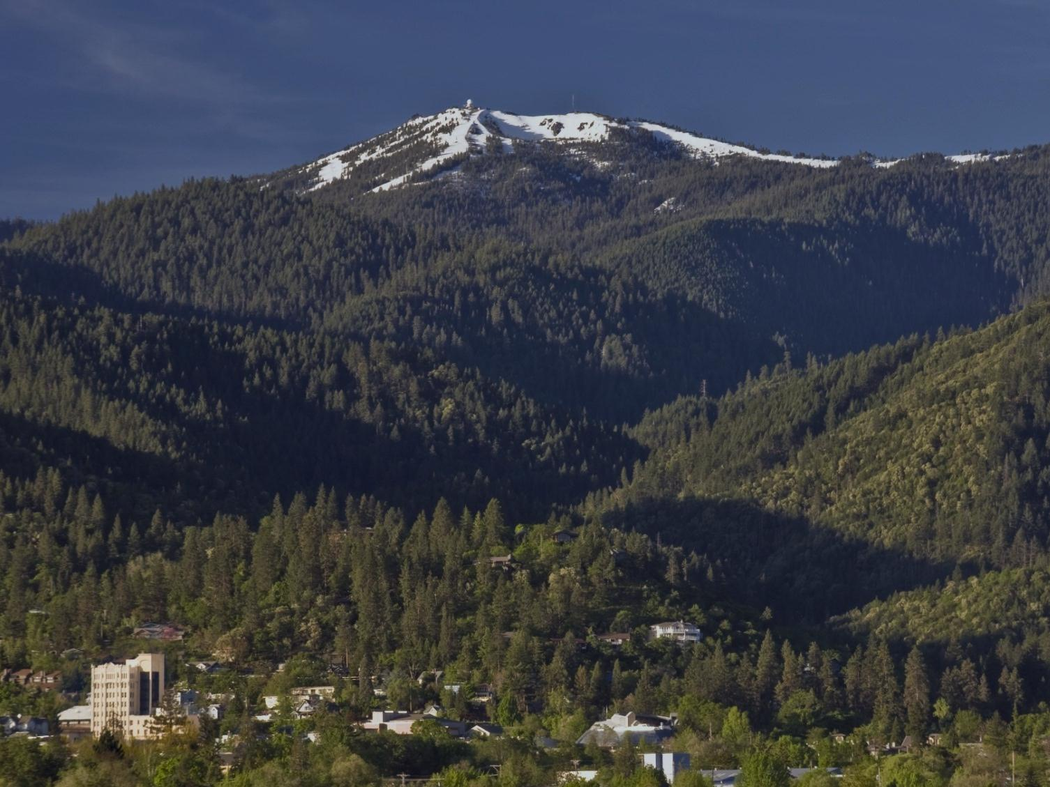
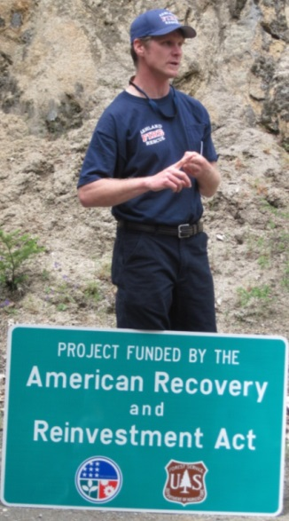
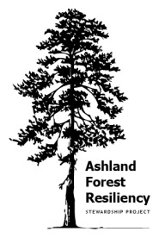
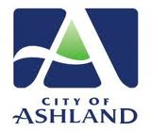
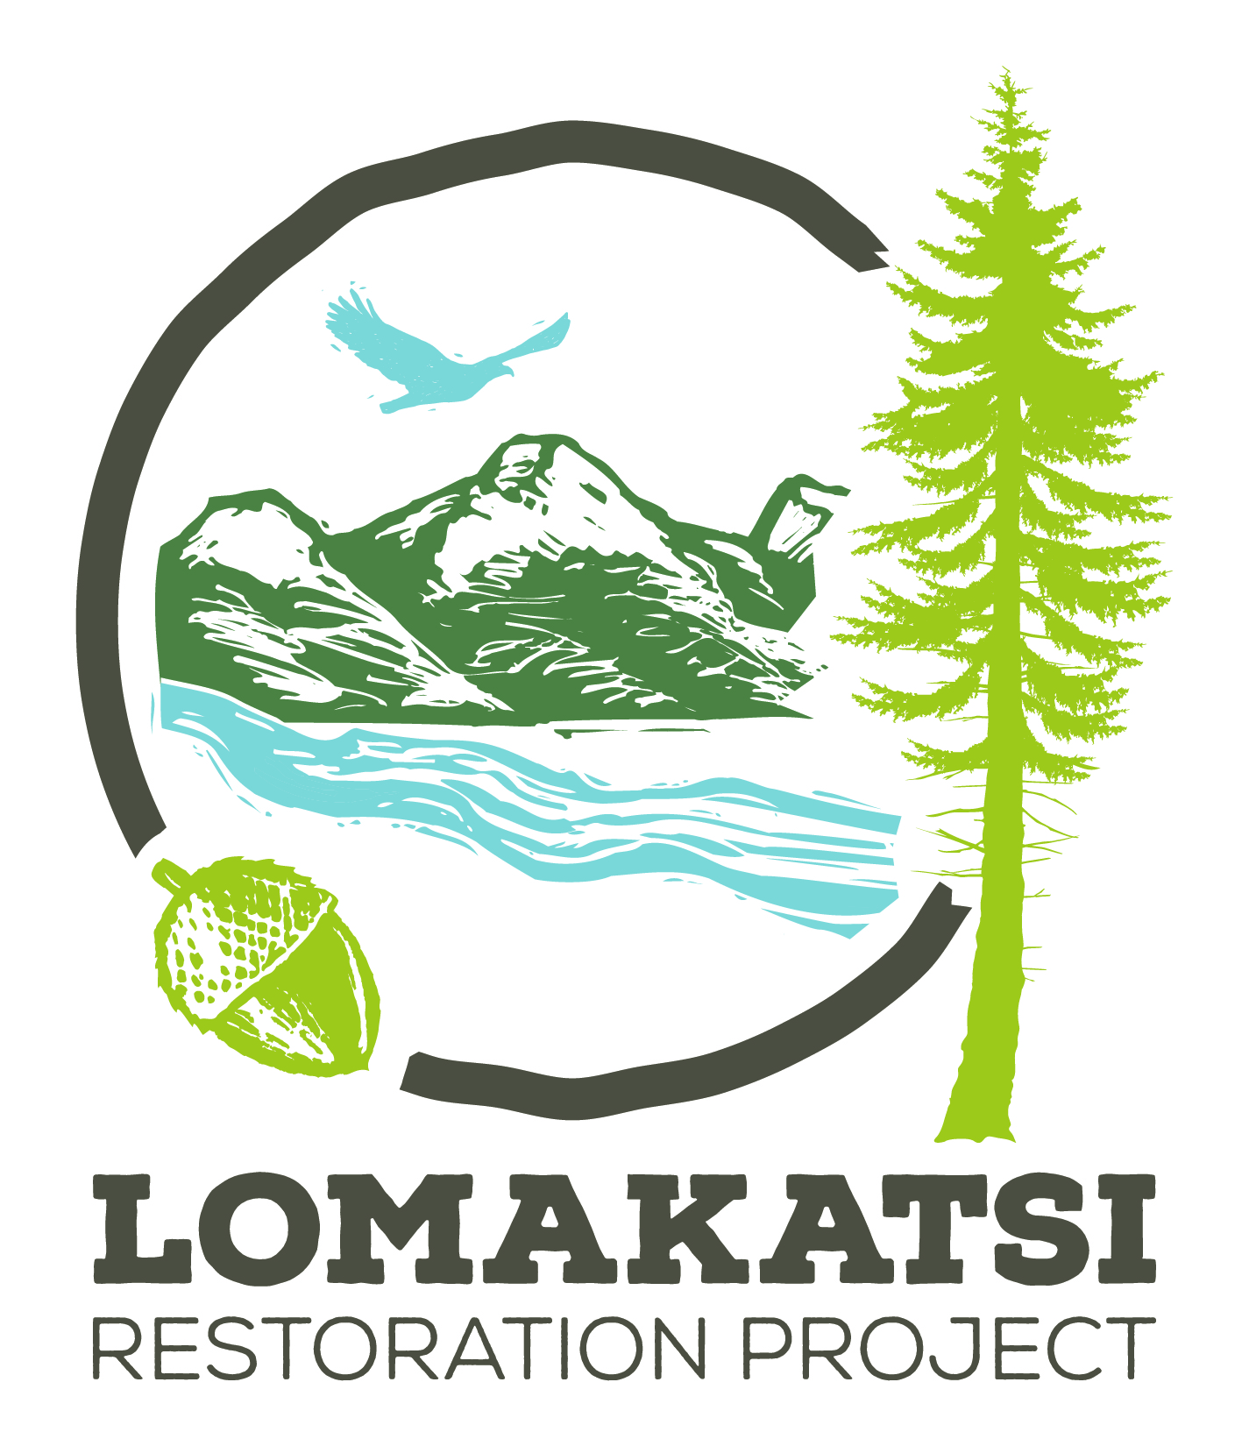
Ashland Forest Resiliency Project
Ashland Forest Resiliency
Reflecting National Cohesive Wildland Fire Management Strategy
  Resilient landscapes
  Fire Adapted Communities
  Safe and effective wildfire response
Active community engagement
Municipal watershed on USFS land
Stewardship Agreement
Photo: Sean Bagshaw

Slide 5
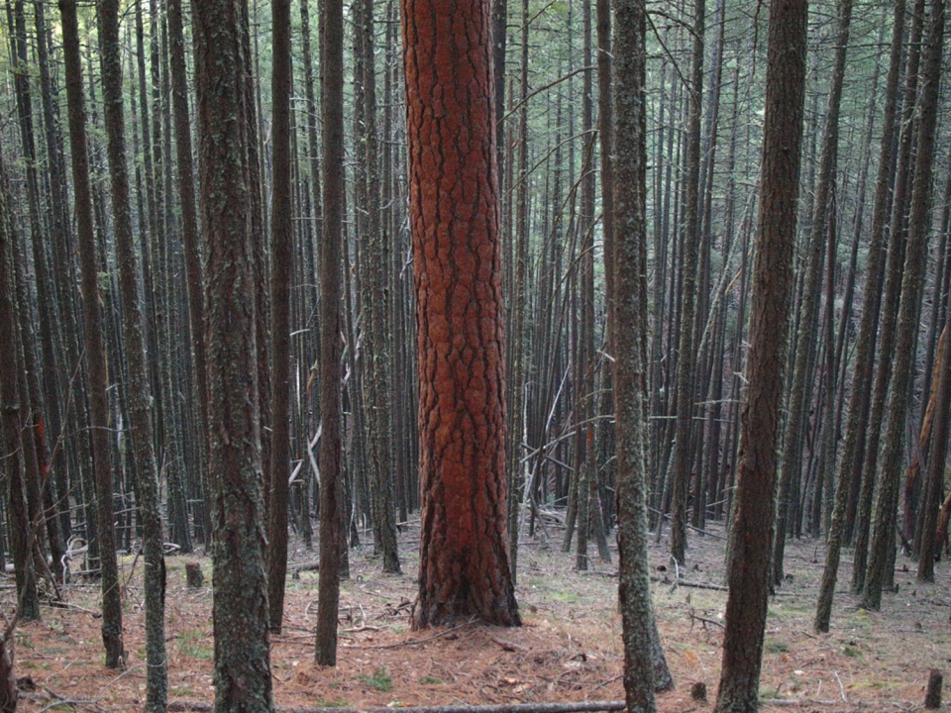

Southern Oregon Forest Restoration Collaborative
Executive Director George McKinley
Board of Directors
Darren Borgias
Max Bennett
Jim Wolf
Blair Moody
Marko Bey
Jack Shipley
“To increase public and agency support for forest restoration in Southwest Oregon”
Collaborative Agency Advisors:
Cindy Donegan – Wildlife Biologist, USFWS
Shannon Downey -- Environmental Coordinator, USFS RRSNF
Terry Fairbanks -- District Silviculturist, Medford BLM
Patricia Hochhalter – Ecologist, USFS RRSNF
Jon Lamb -- Fire and Fuels Management, USFS, RRSNF
Jena Volpe -- Fire Ecologist, Medford BLM
Notes:
CUT?

Slide 6
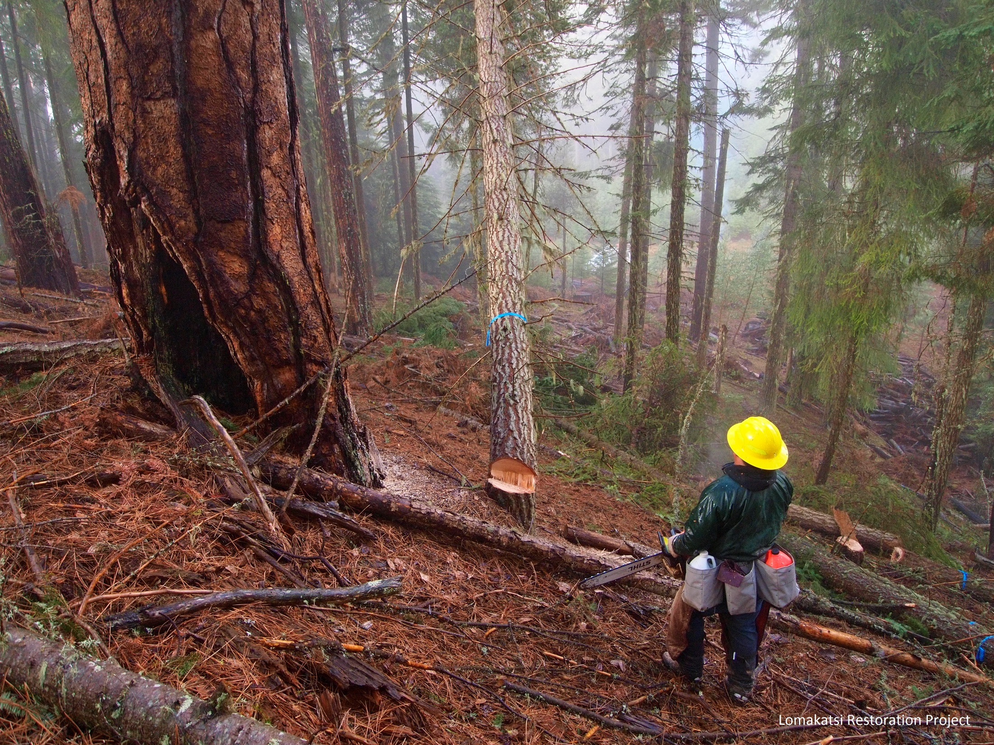
Principled, Collaborative Forest Stewardship
Integrate local ecological references
Plan and monitor at multiple scales
Integrate protection and restoration
Restore and maintain with mechanical thinning and fire
Ensure enduring viability of critical habitats and species
Support fire adapted communities
Promote regional economic and workforce viability

Slide 7
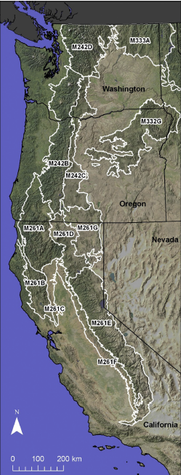
Mechanical Treatments and Managed Fire Are Needed to Increase Resilience in Mixed Severity Forests
(1): Landscape-level approaches to restoring pyrodiversity
(2): Protecting and restoring large and old, early successional tree abundance
(3): Expanding use of prescribed and wildfires to restructure forests
(4): Using topography to tailor restorative treatments to the landscape
(5): Rehabilitating plantations
(6): Creating and maintaining successional heterogeneity
(7): Integrating restoration with late-successional forest habitat needs
(8): Mitigating threats from climate change, forest insects, and pathogens
(9): Creating and maintaining early-successional forests
Hessburg, P. F., T. A. Spies, D. A. Perry, C. N. Skinner, A. H. Taylor, P. M. Brown, S. L. Stephens, A. J. Larson, D. J. Churchill, and N. A. Povak. 2016. Tamm Review: Management of mixed-severity fire regime forests in Oregon, Washington, and Northern California. Forest Ecology and Management.

Slide 8
Integrating Others’ Work
NSO habitat recovery plans RA 10 and RA 32 (U.S. Fish & Wildlife Service 2011, 2013) and NSO critical habitat designation (U.S. Fish & Wildlife Service 2012)
Natural Range of Variability (Haugo et al. 2015)
Quantitative Wildfire Risk Assessment (Scott et al. 2013)
Climate Resilient Landscape Facets (Buttrick et al. 2015)

Slide 9

Revised Recovery Plan for the Northern Spotted Owl
© Rick McEwan
Recovery Action 6: …accelerate the development of structural complexity and biological diversity that will benefit spotted owl recovery.
– RESTORE LOST HABITAT USING BEST KNOWLEDGE
Recovery Action 10: Conserve spotted owl sites and high value spotted owl habitat… protect, enhance and develop habitat in the quantity and distribution necessary to provide for the long-term recovery of spotted owls...
– PROTECT REMAINING HABITAT AND DEVELOP MORE IN APPROPRIATE LANDSCAPE POSITIONS
Recovery Action 12: …post-fire silvicultural activities should concentrate on conserving and restoring habitat elements that take a long time to develop (e.g., large trees, medium and large snags, downed wood)...
– LIMIT SALVAGE LOGGING
Recovery Action 32: …maintain and restore such habitat while allowing for other threats, such as fire and insects, to be addressed by restoration management actions...
- USE BEST SCIENCE TO MANAGE RISK TO LANDSCAPE RESILIENCE
U.S. Fish & Wildlife Service. 2011. Revised recovery plan for the northern spotted owl (Strix occidentalis caurina). Page xvi + 258 US Department of Interior, Portland, Oregon, USA.

Slide 10
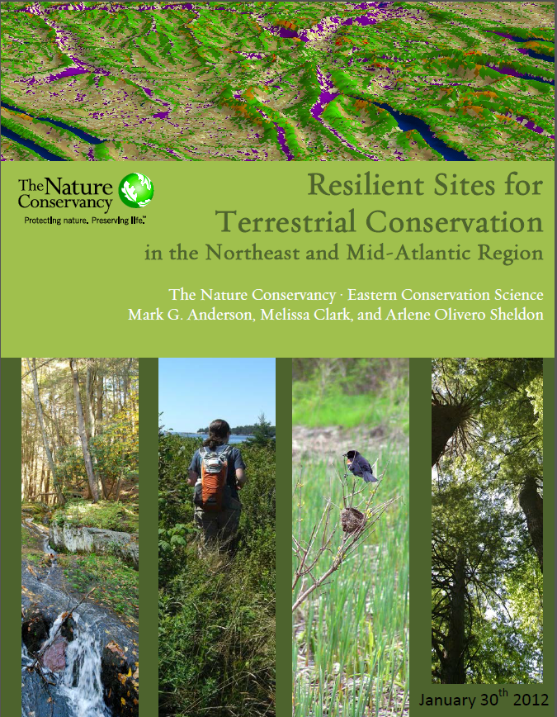
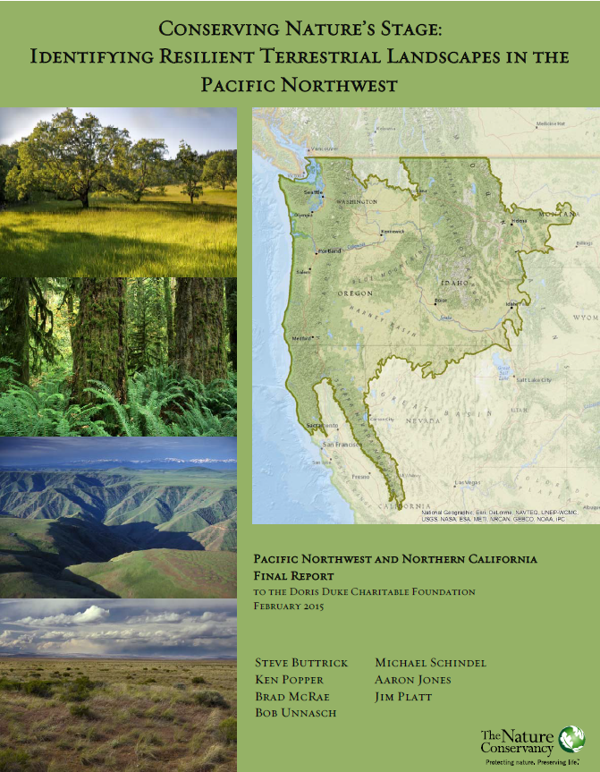
Conserving Nature’s Stage
Notes:
TNC piloted a process in the NE and Mid Atlantic states to identify resilient sites. Refined in the Northwest
Process was developed in collaboration with and vetted by academic and agency partners and seems to have gotten a lot of traction.
This work was funded in part by the Doris Duke Charitable Foundation. – They feel that if they are going to invest in land conservation they would like to have some assurance that their investment will have a long lasting impact on biodiversity.
DDCF has challenged us to evaluate the process done in the East and see if or how we can adapt the process to the landscapes in the NW.
And have given us a grant to do this.
The geography is -

Slide 11
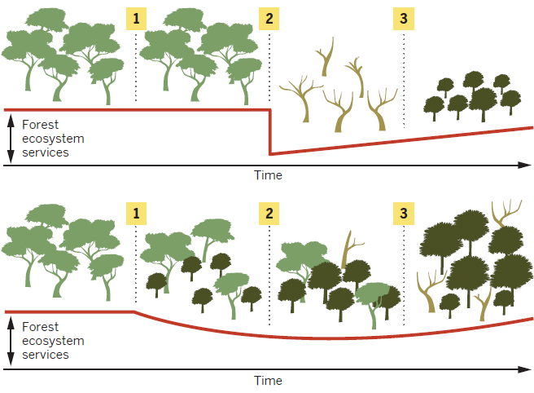
Adapting Forests Under Climate Change
Millar, C. I., and N. L. Stephenson. 2015. Temperate forest health in an era of emerging megadisturbance. Science 349:823-826.
Notes:
Fig. 4. Management practices can influence the nature of transitions between forest types.
Numbers represent forest transitions through time. (Top) (1) Despite rapid directional environmental
changes, managers strive to maintain forests within historical ranges of conditions and may initially
succeed. (2) The forest may be inherently unstable in the new environment and, once a threshold is
exceeded, substantial mortality occurs, with an abrupt loss of most forest ecosystem services. (3) After
the die-back, recovery of forest ecosystem services is slow. (Bottom) (1) Managers anticipate an
impending forest transition and facilitate it by reducing the probability of sudden die-back (e.g., by
thinning the forest to reduce competition for water) and by assisting establishment of species better
adapted to future conditions. (2) The transition is gradual rather than abrupt, and ecosystem services
are maintained at a higher (although reduced) level. (3) Forest ecosystem services more rapidly approach
their original levels. Although some forest ecosystem services are eventually lost in both cases,
active management might facilitate a gradual rather than abrupt transition.

Slide 12
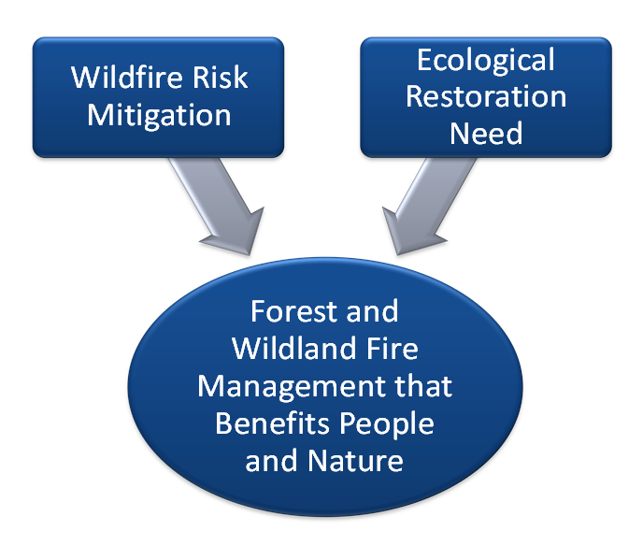
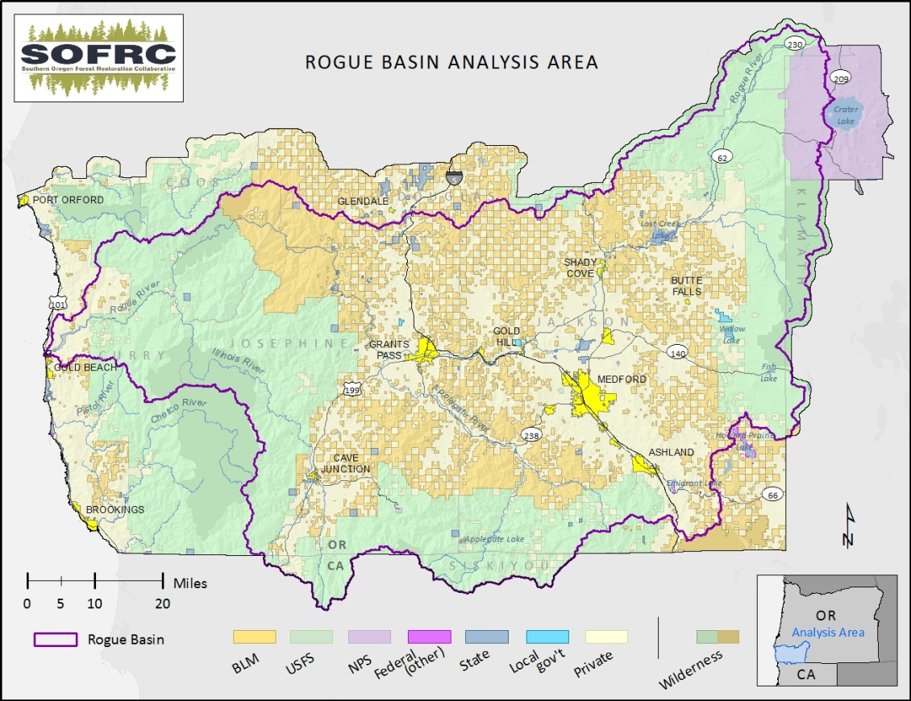
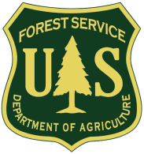

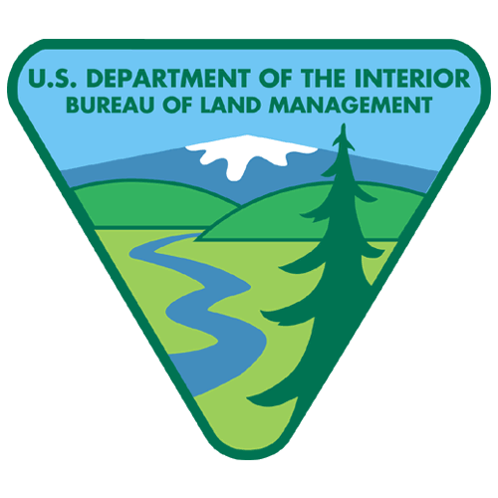

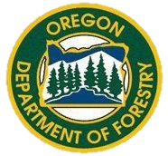

Rogue Basin Cohesive Forest Restoration Strategy: A Collaborative Vision for Resilient Landscapes and Fire Adapted Communities
Mechanical Treatments preparing for Managed Fire

Slide 13
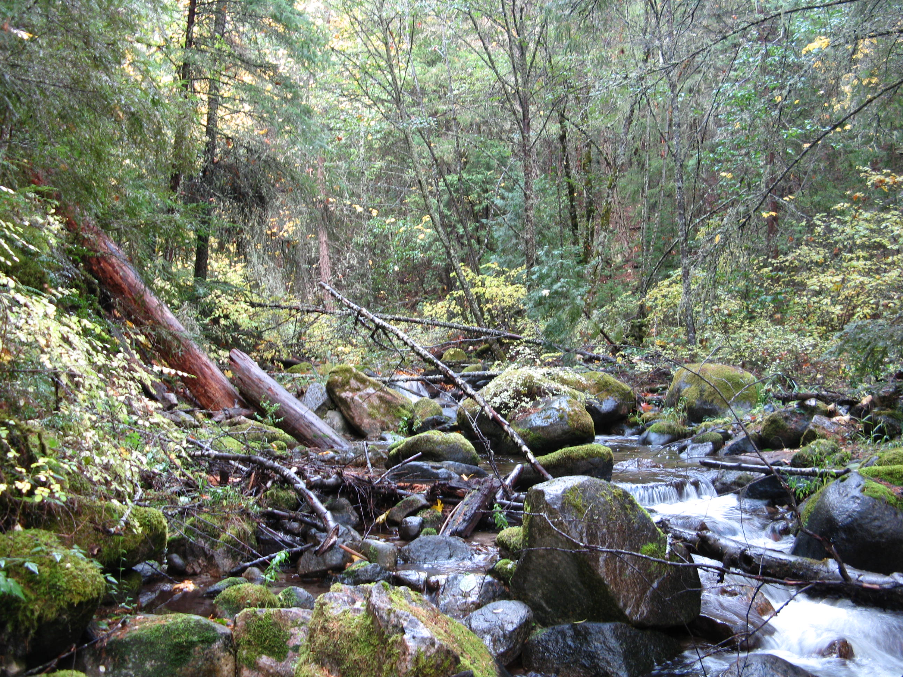
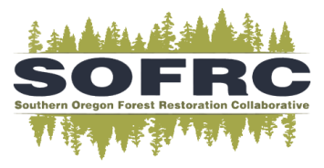
A Conservative Approach
Restoration is the primary objective
Treatments retain large old trees, significant untreated areas, and canopy cover
Limited to existing system roads
Northwest Forest Plan riparian buffers
Grounded in the Northern Spotted Owl Recovery Plan
Ground based yarding limited (<35% slope)
Site specificity needed for project development

Slide 14
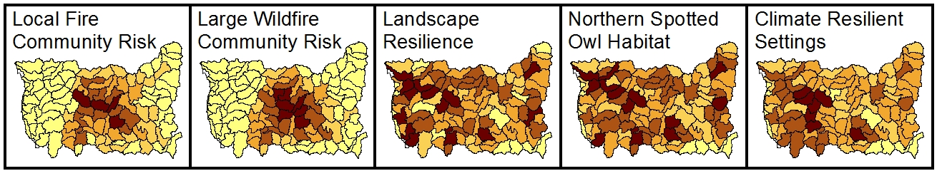
Cohesive Forest Restoration Strategy
Addresses Why and How
Why
How
Prioritized Project Areas with Explicit Objectives
Community at Risk
Resilient Landscapes
Northern Spotted Owl Recovery
Climate Resilience
Treatment Themes
Accessibility and Land Allocation
Predictable Work Flow

Slide 15
Multiple Data Sources
GNN – ILAP
  within stand forest structure
    Restoration need
    Existing habitat
  Potential Vegetation Type (PVT) and seral structural state
  seral structural class and unique PVT’s as a resources for the wildfire risk assessment
LANDFIRE
  Fuels (locally calibrated)
  Reference forest models (crosswalked to PVT’s by R6 and TNC)
Other data sources for mapping high value resources and assets

Slide 16
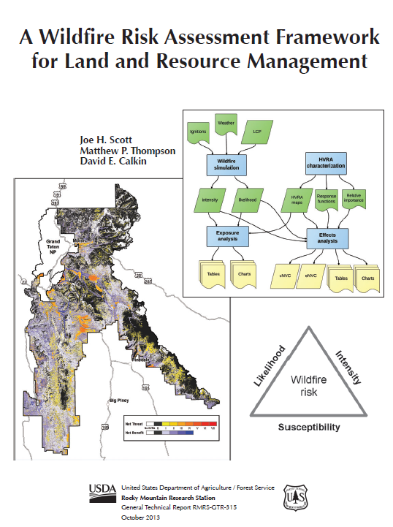
SOFRC Hazard and Risk Assessment
All-hands and all-lands
  >50 participants, >20 organizations
Quantitative risk assessment (methods of Scott et al. 2013)
Locally calibrated fuel data
FSim fire behavior modeling
Collaborative High Value Resources and Assets (HVRA) identification
Collaborative HVRA Relative Importance and Response Functions

Slide 17
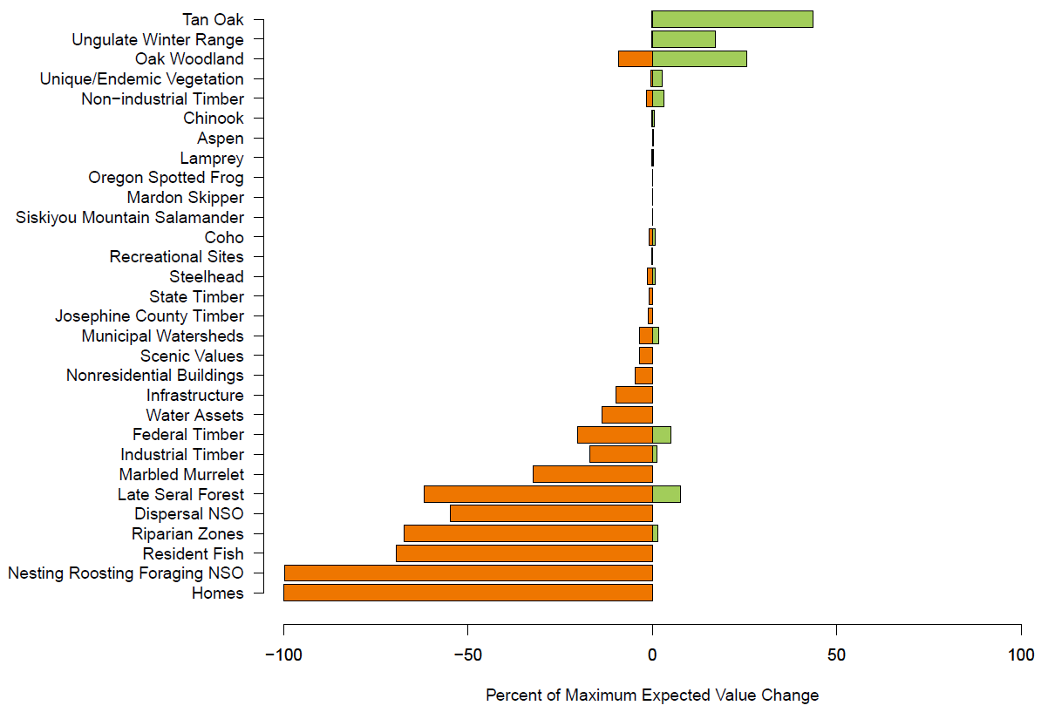
Predicted Fire Effects to Resources and Assets

Slide 18
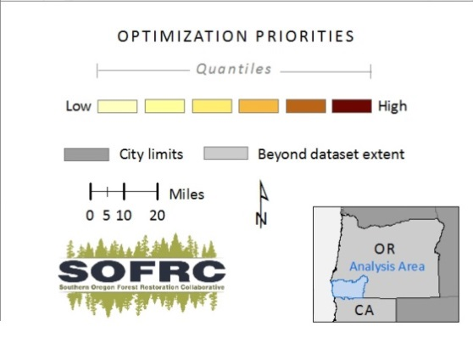
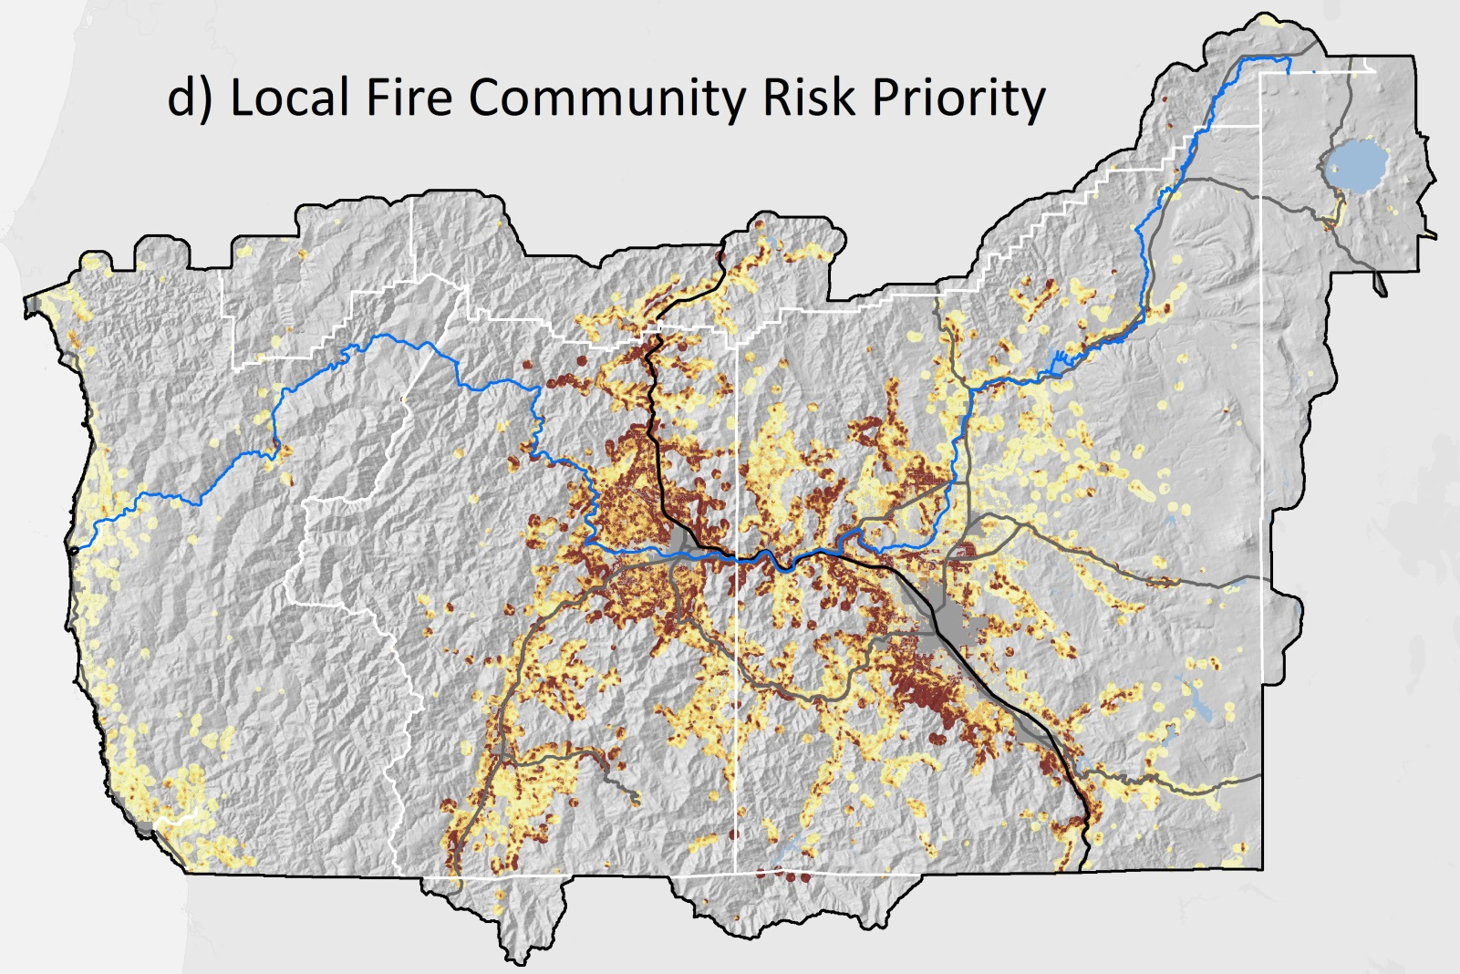
Risk to Community From Local Fires
Westwide Risk Assessment (ignition based risk index
Communities at Risk with ¼ mile buffer

Slide 19
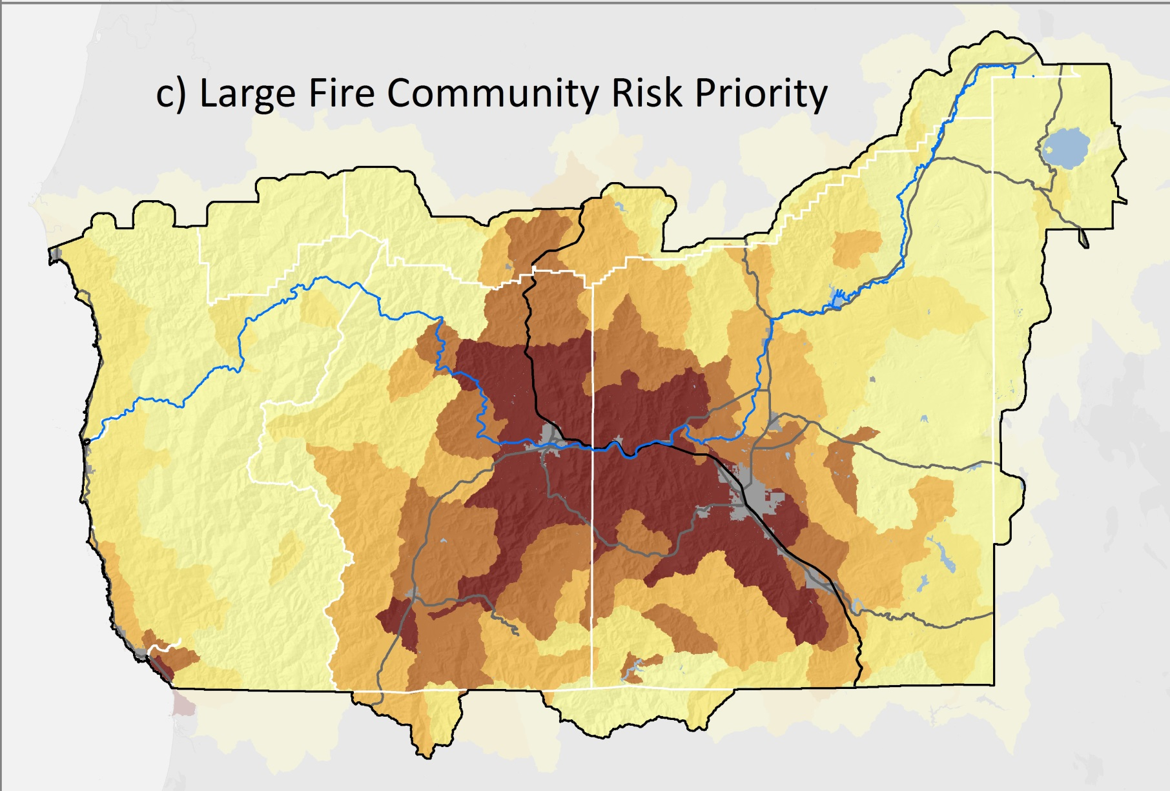
Source Watersheds of Large Fires That Impact the Community
Community Assets: Where people live, non-residential buildings, surface water watersheds

Slide 20
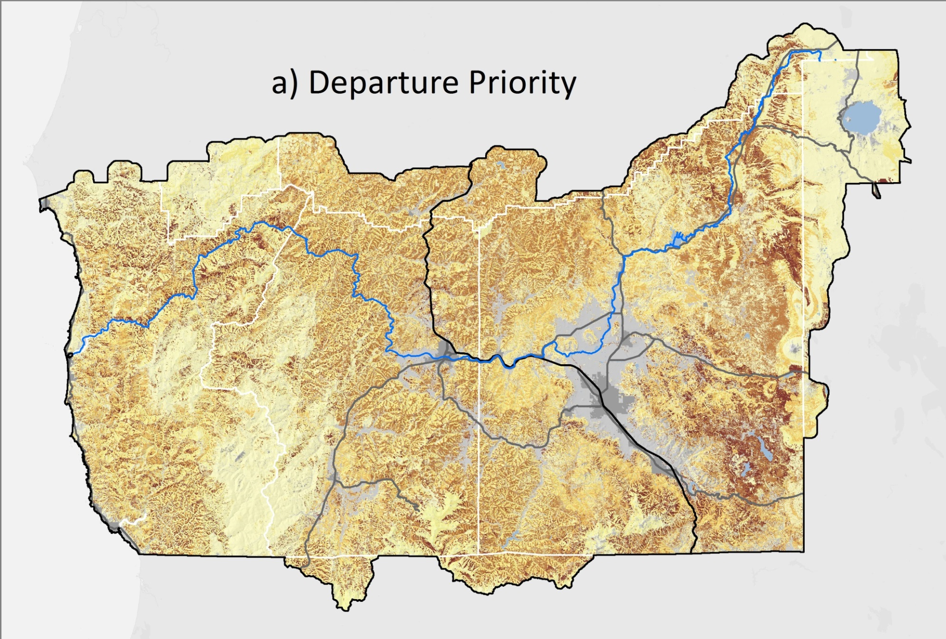
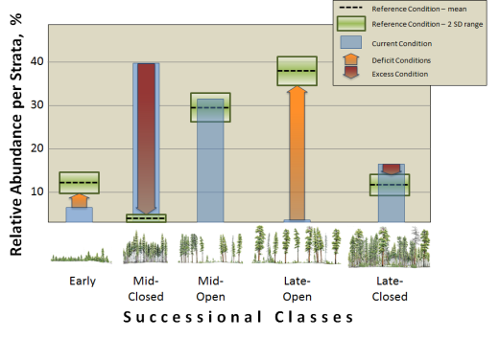
Balancing Open and Closed Successional Classes
Prioritize thinning in closed successional classes on ridges and warm midslopes
Haugo, R. et al. . 2015. A new approach to evaluate forest structure restoration needs across Oregon and Washington, USA. Forest Ecology and Management 335:37-50.

Slide 21
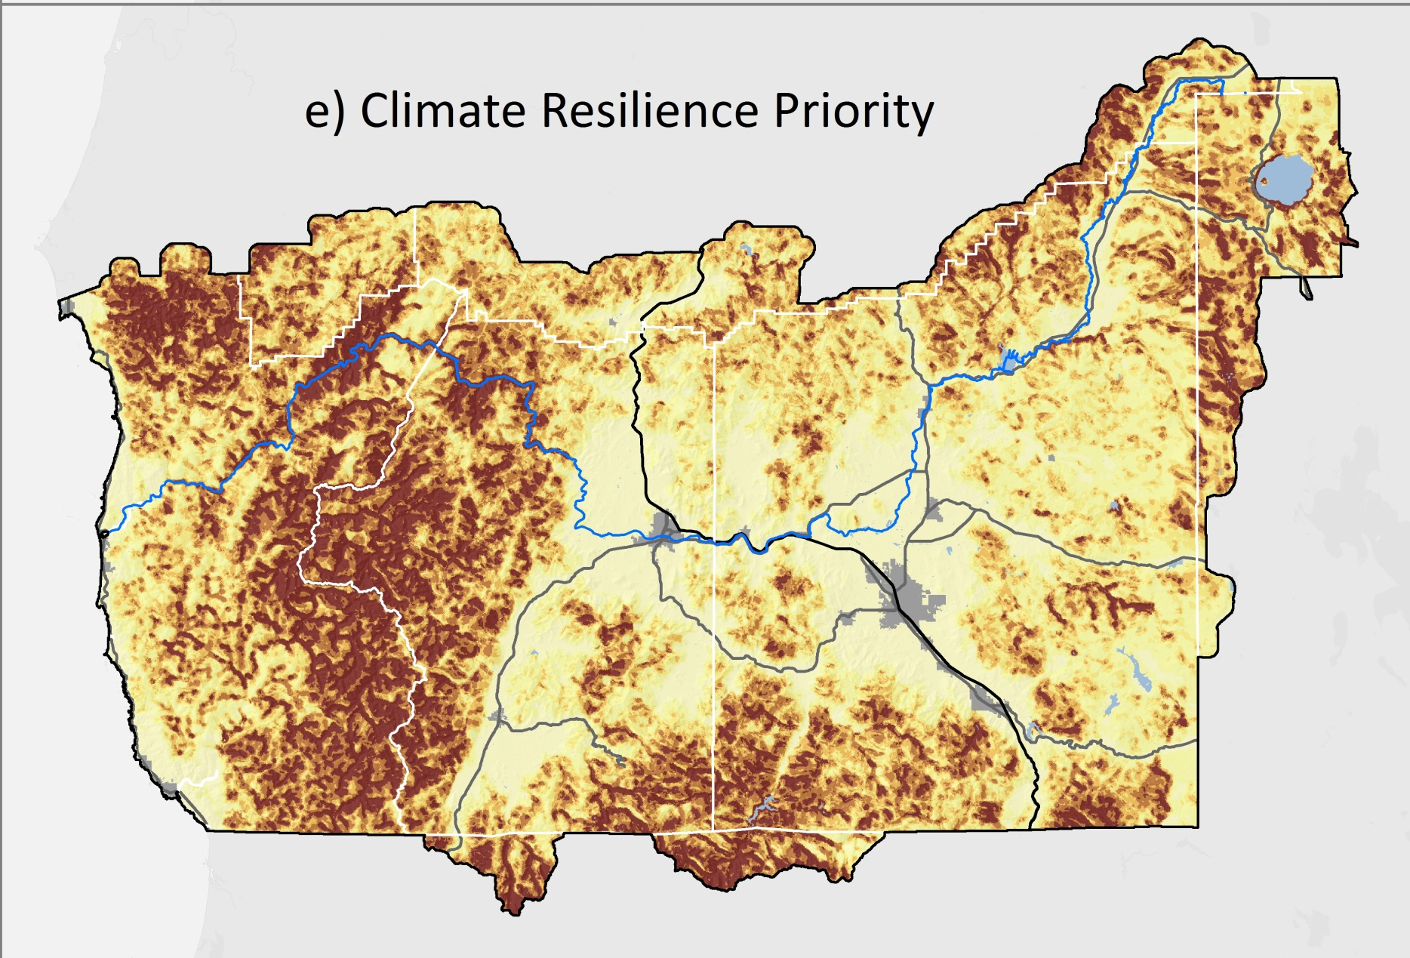
Climate Resilient Settings:
Resistance to rapid change in climate-smart locations
Buttrick, S., K. Popper, M. Schindel, B. McRae, B. Unnasch, A. Jones, and J. Platt. 2015. Conserving Nature's stage: identifying resilient terrestrial landscapes in the Pacific Northwest. The Nature Conservancy, Portland, OR.
Anderson, M. G., and C. E. Ferree. 2010. Conserving the stage: climate change and the geophysical underpinnings of species diversity. PLoS ONE 5:e11554.

Slide 22
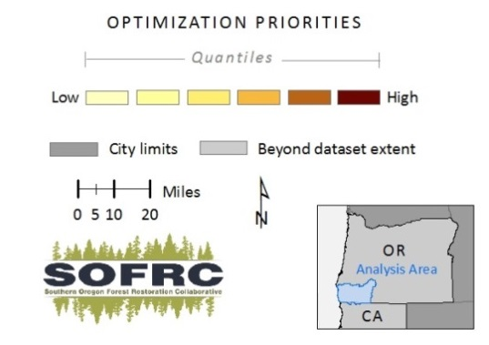
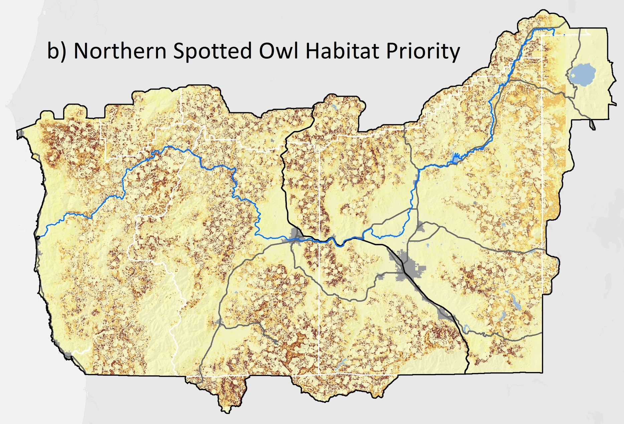
Protect and Promote Complex Closed Habitat
© Rick McEwan
Promote future complex habitat in the right places
Protect existing complex closed habitat in the right places
Promote resilient landscapes including appropriate open forest

Slide 23
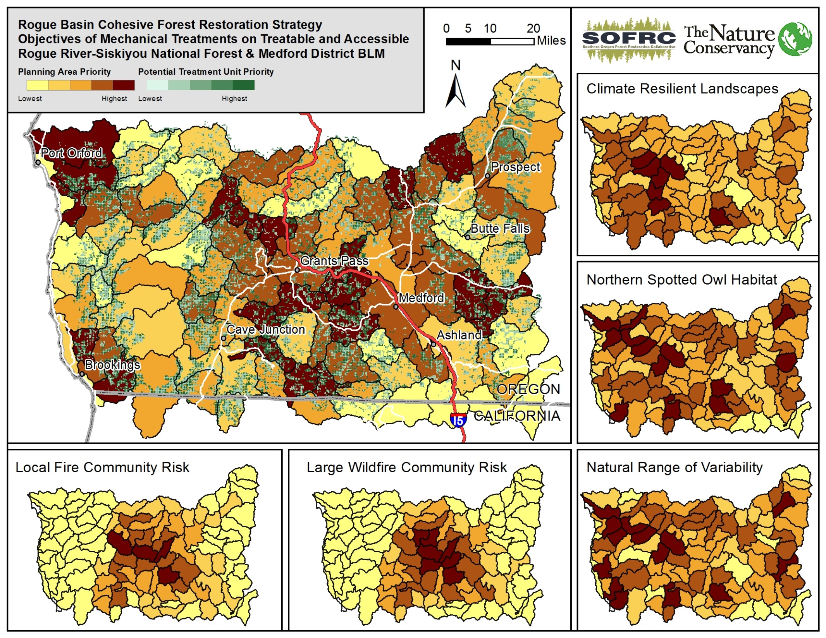

Slide 24
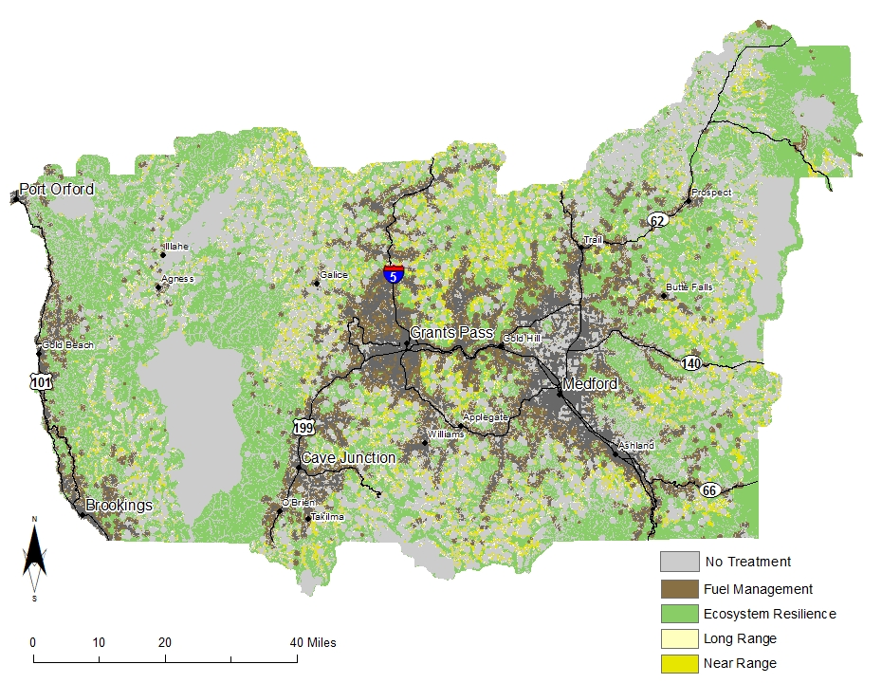
Treatment Themes to Estimate Work Needed
No Mechanical Treatment

Slide 25
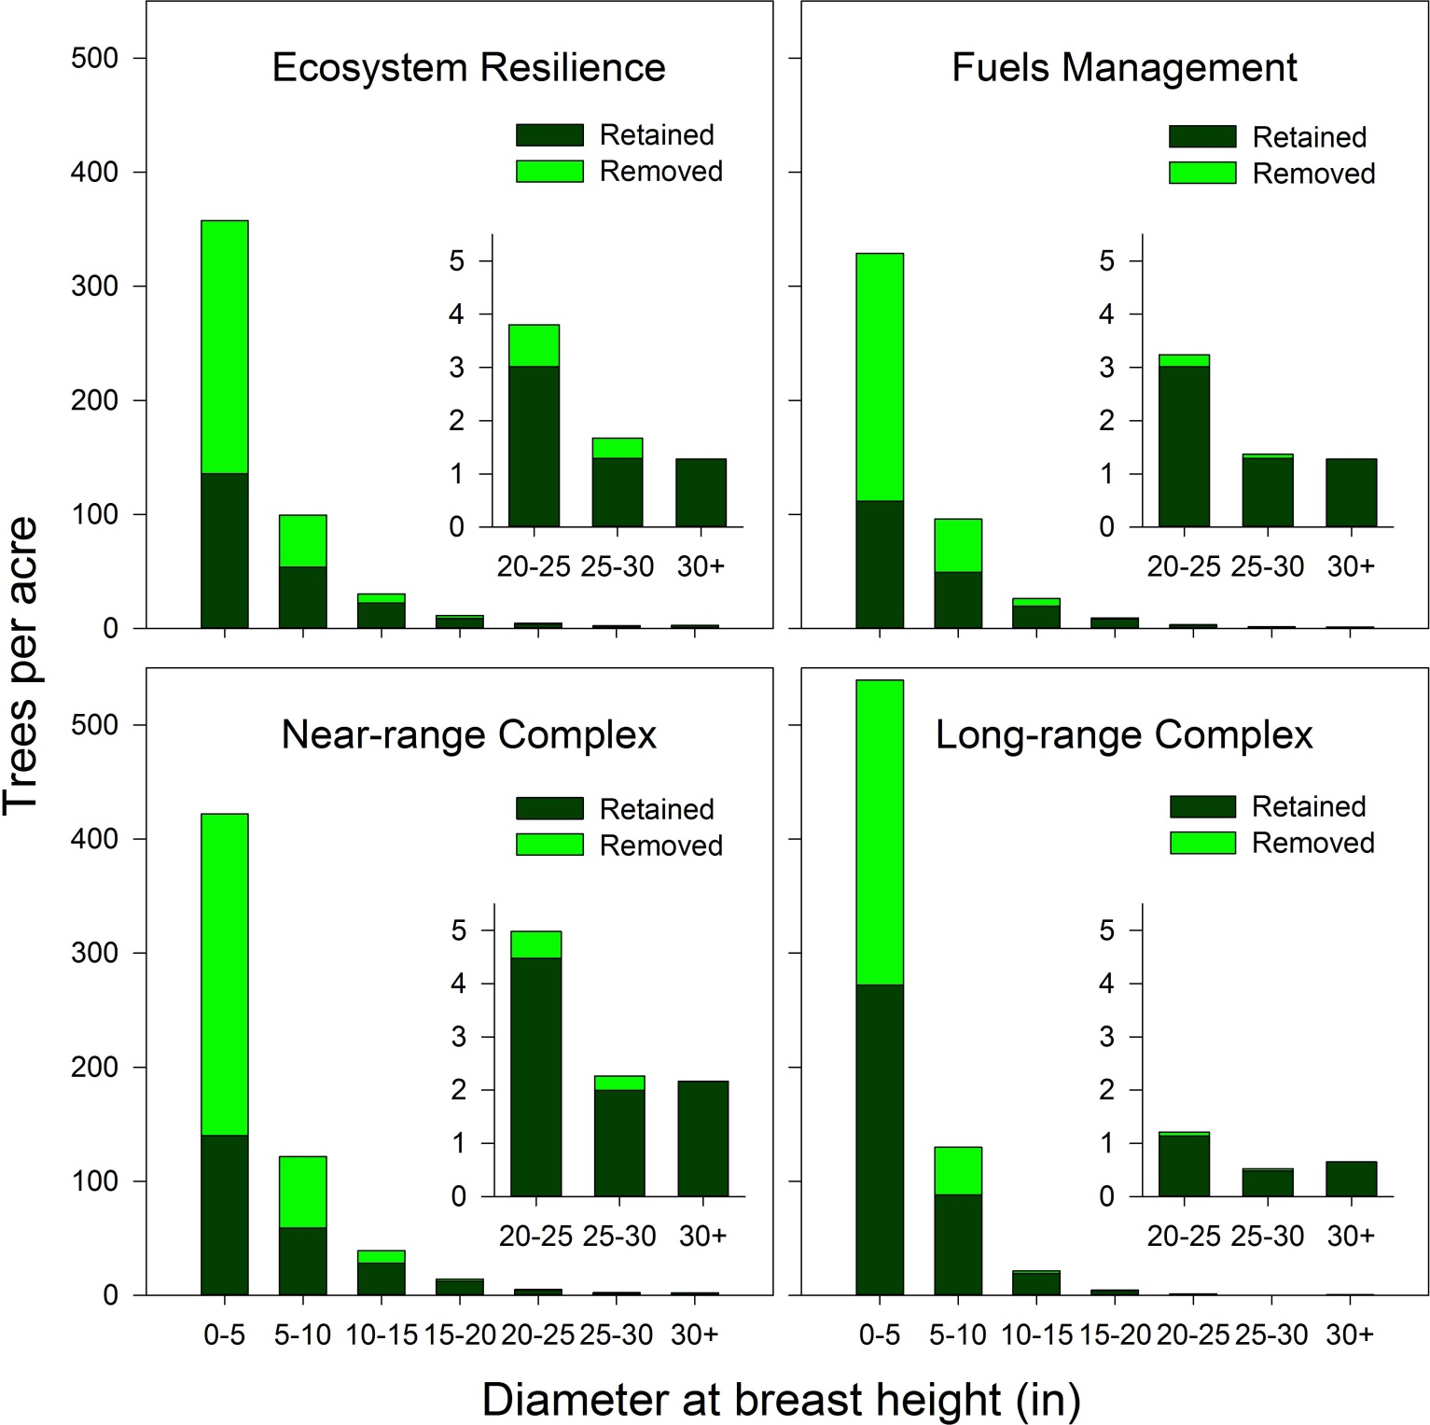
Mechanical Treatment Themes
Existing density and proposed removals by size class
GNN Data, Stakeholder Targets

Slide 26
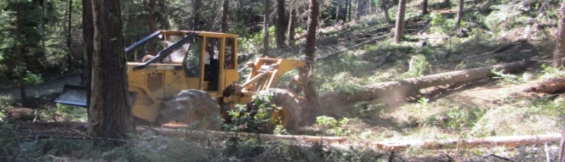
Economic Viability Depends on Byproduct Density and Yarding System
Haul system | Definition | Restoration byproduct (Thousand board feet/ac)
 |  | < 2 | 2-6 | >6
Road based | <200 feet of existing roads
Skidder | Accessible via existing roads with slopes <35% |  | Economically Viable
Short cable | 200-800 downhill of existing roads
Long cable | 800-1600 downhill of existing roads | Subsidy Required
Helicopter | Within ½ mile of existing roads
Limited | Inaccessible barring road construction | No Access

Slide 27
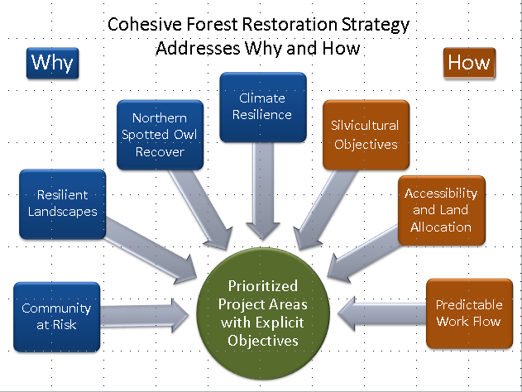
Treatment Placement Optimization
Maximize landscape treatment objectives
    1) large wildfire community risk
2) local fire community risk
3) ecological departure
4) Northern Spotted Owl (NSO) habitat
5) climate resilient landscapes
For the Business as usual scenario
6) economics of commercial volume
Constrain by filters
1) Exclusions - Wilderness
2) No-treatment
a) NSO existing NRF in high RHS & historic ½ mile cores
b) Northwest Forest Plan Interim Riparian Reserves
Optimized “Best Solution”
MARXAN
---Michael Schindel
TNC GIS Portland

Slide 28
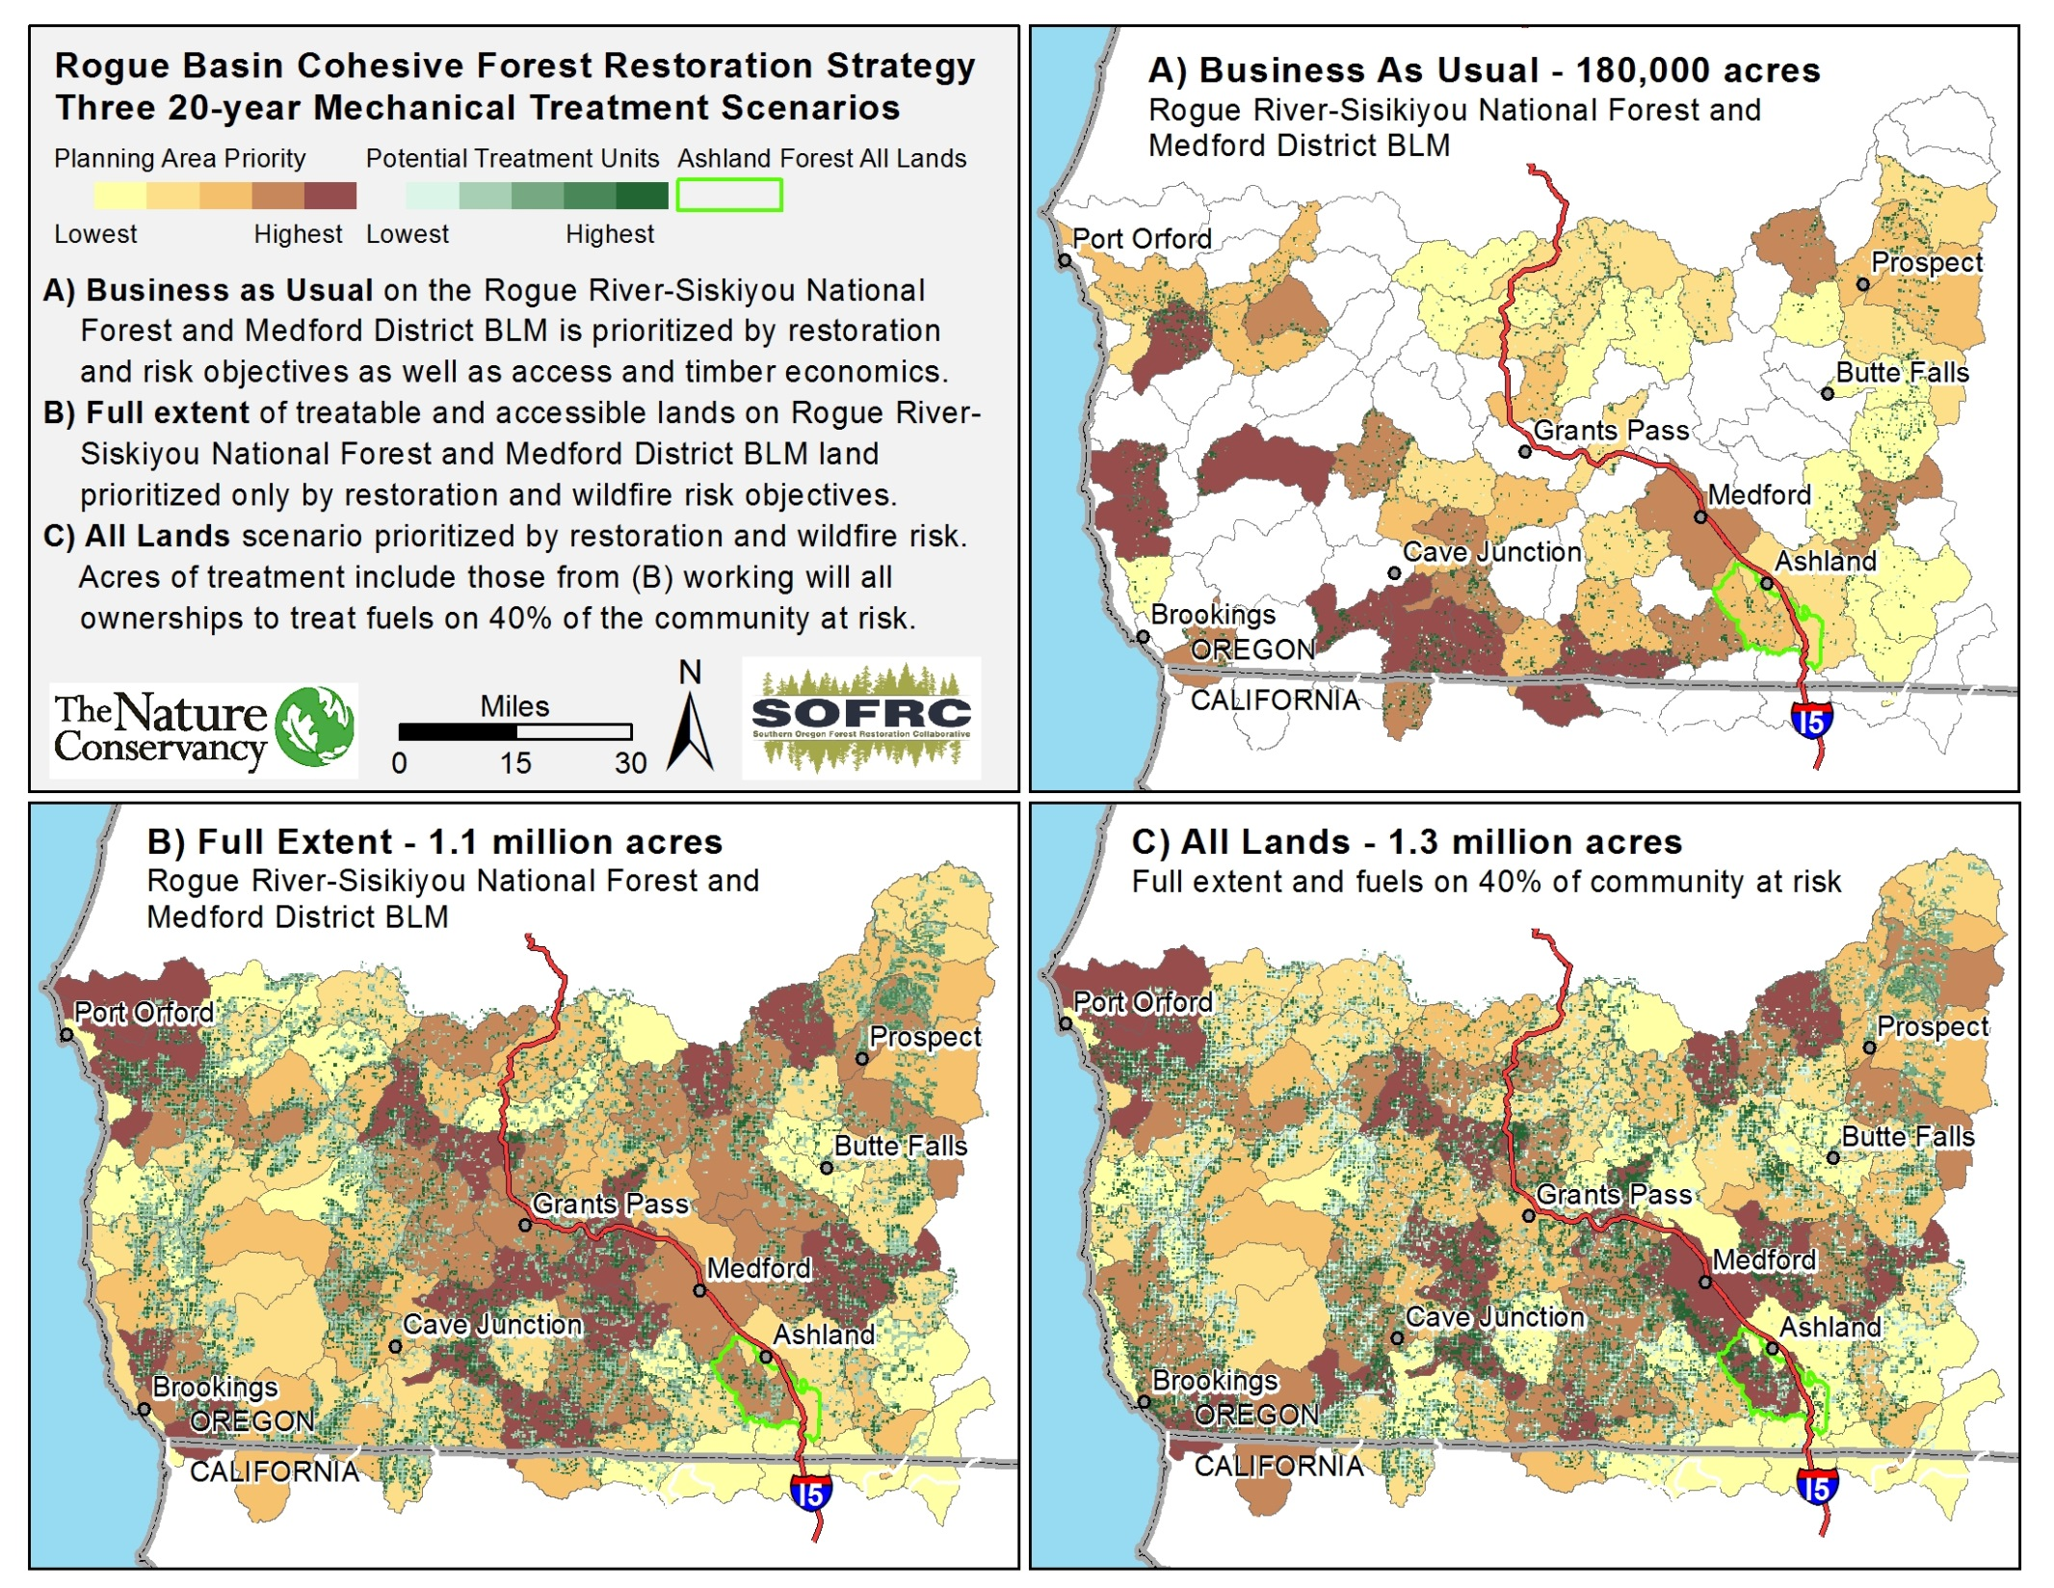

Slide 29
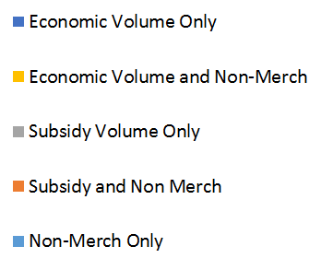
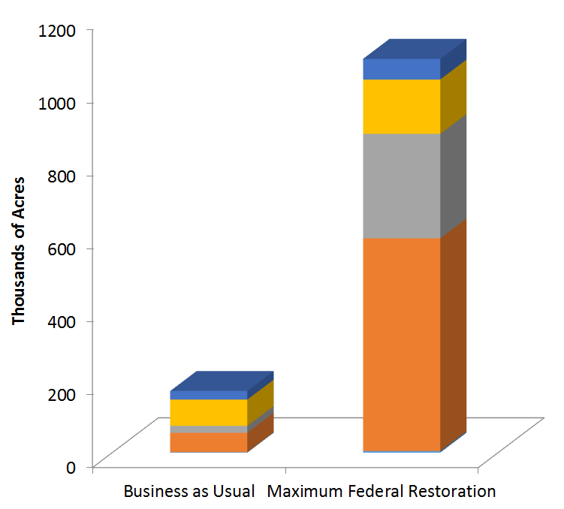
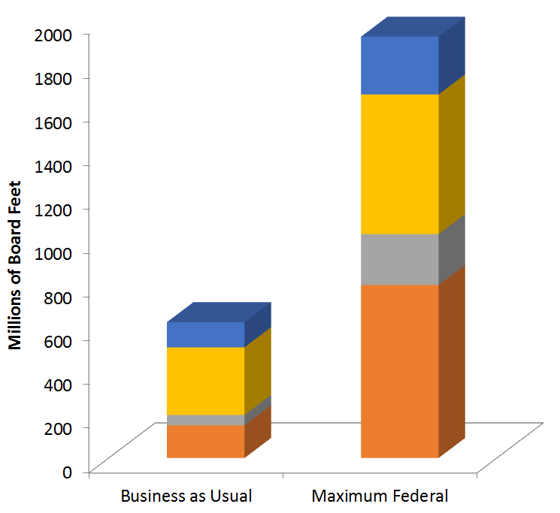
Acres of Treatment and Merchantable Volume on Federal Land
At $1,000/acre lacking commercial material non-economic stands would come in costing about $73 million for the BAU, $873 million for the maximum federal footprint. Stewardship could help.

Slide 30
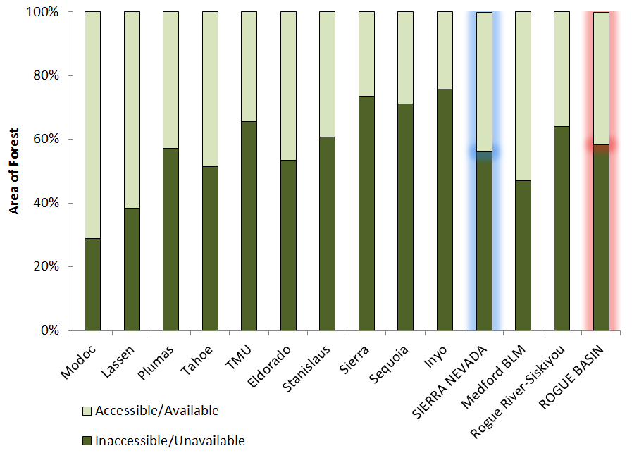
<50% of Federal Lands Available and Accessible for Mechanical Treatment
Sierra Nevada data from North et al. 2015
Notes:
Figure 3. Symbols show the percentages of mechanically available productive forestland
left on each NF under four different operational constraint scenarios (i.e., scenarios A–D
[see L2 criteria in Table 1]) after all four constraint levels, L0–L3, are applied. The difference
between the four scenarios (A is the most restrictive and D is the least constrained) indicates
how sensitive the amount of mechanically available acreage is to different road distance,
slope, and economic variables.

Slide 31
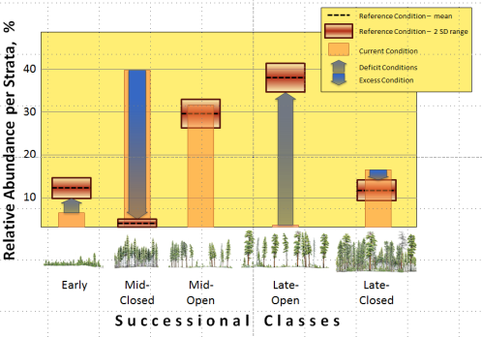
Treating the maximum accessible federal lands improves the proportions of seral states, but much remains to be done – including GROWTH

Slide 32
Landscape scale restoration reduces wildfire risk to core Northern Spotted Owl Habitat.
Near- and long- range habitat is promoted with 10 % of treatments.
© Rick McEwan

Slide 33
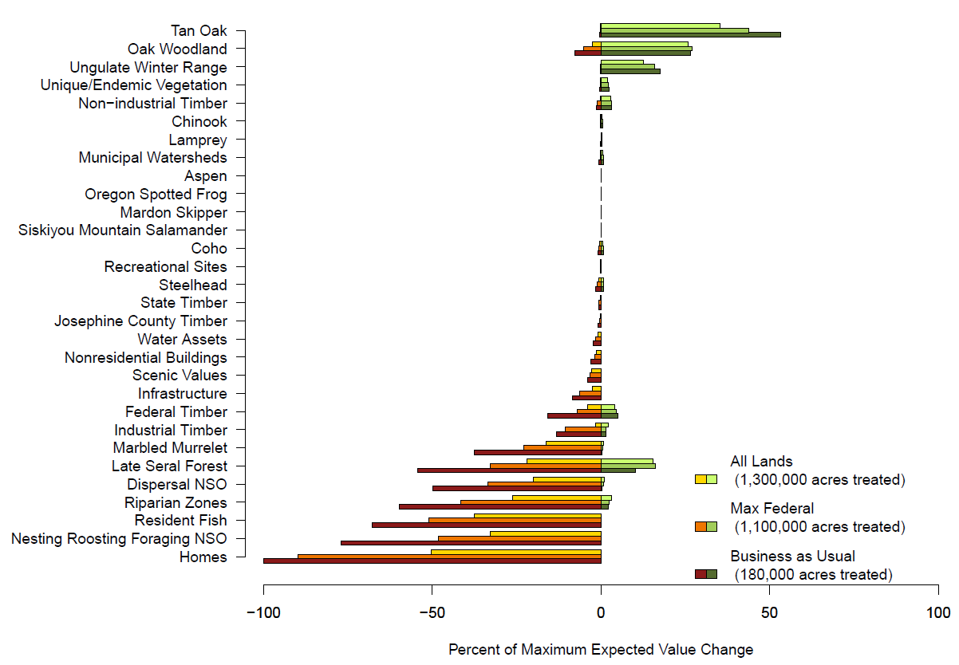
Cumulative Wildfire Response by Management Strategy

Slide 34
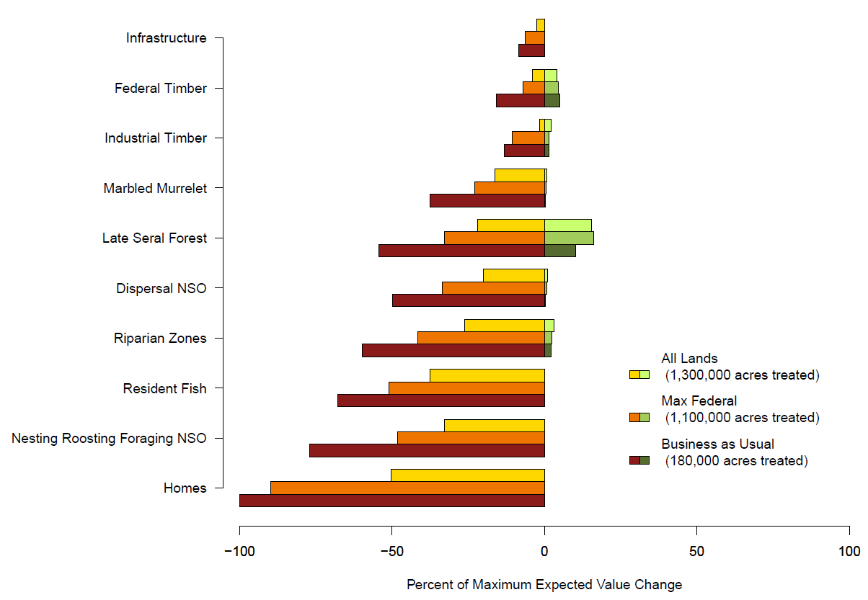
Cumulative Wildfire Response – Most Detrimental

Slide 35
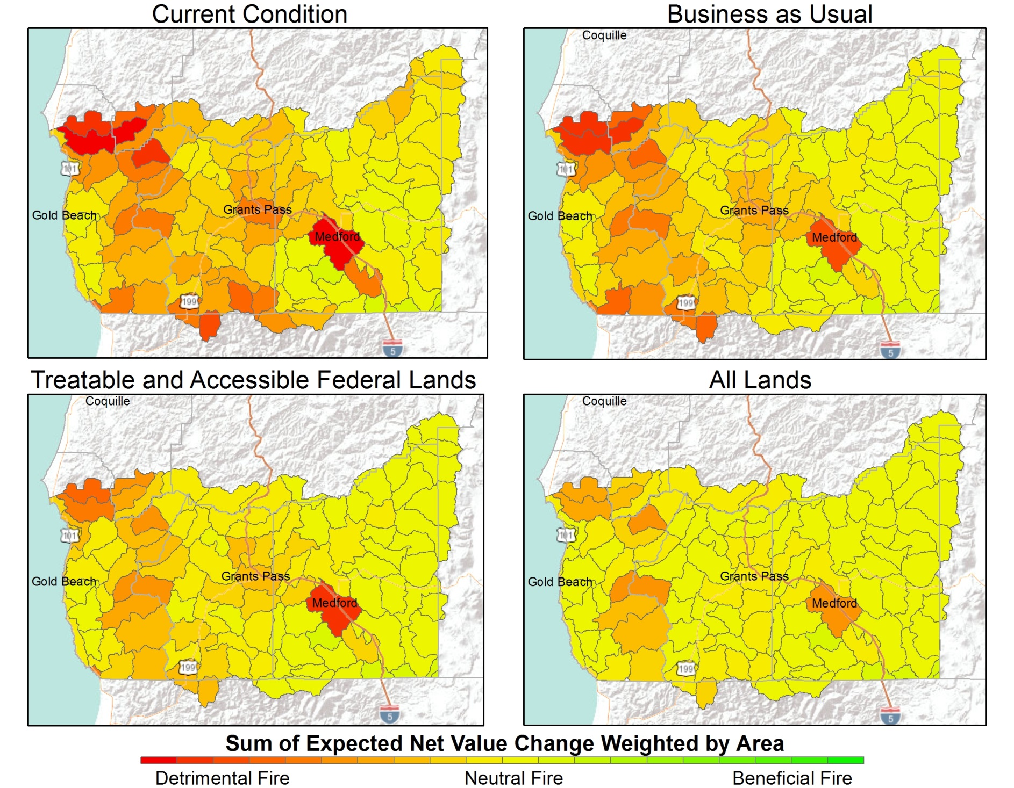
Potential Fire Management Zones by Expected Net Value Change

Slide 36
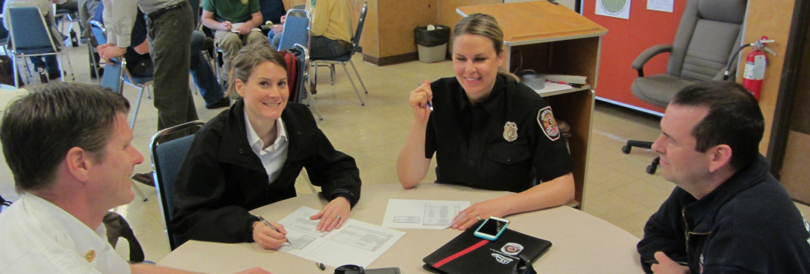
Engagement and Shared Objectives
Vetting strategy with stakeholders
Learning exchanges around restoration rationale and priorities
Developing data and approaches to manifest a landscape perspective
Transparently setting objectives and priorities

Slide 37

Thank You and Questions
Southern Oregon Forest Restoration Collaborative – http://sofrc.org
Funding Support
Northwest Conservation Fund, Oregon Department of Forestry, Oregon Watershed Enhancement Board, Jackson County, Josephine County, USDA USFS Rogue River-Siskiyou National Forest, USDI Bureau of Land Management

Slide 39
Multiple Spatial Scales
0.222395 acre
  LANDFIRE and GNN base
2.001554 acre
  Risk results
18.01398 acre
  Fsim
27.000000 acre
  Yarding economics
  MARXAN optimization
~50,000 acre
  Planning area summarization
4.6 million acre
  Analytical area

Slide 40
Cohesive Restoration Strategy Performance
Landscape resilience based in ecological departure
  Change in overall departure – (need to account for wildfire effects)
Northern Spotted Owl habitat
  Acres and proportion of acres by class
  Wildfire risk to NRF
  Acres of near- and long-range NRF treated
Economics
  Acres to be treated
  Cost of work
  Timber receipts
  Jobs created
Wildfire risk
  Modified modeled fire behavior and risk, overall and by key HVRA’s and sub-HVRA’s, including critical aggregations (e.g. community assets., NSO NRF)
Overall return on investment, near-term and long-term

Slide 41




Draft Strategic Wildfire Management Zones
Yosemite National Park
Phil Bowden - Region 5
Fuels Planner
Alan Taylor – Inyo National Forest Fire Planner
Sierra National Forest

Slide 42
Planning Areas with Summed Expected Net Value Change

Slide 43
A Conservative Approach
Category – All Lands | Acres | Percent of Grand Total
Unavailable for Treatment (overlapping)
Developed/unburnable | 321,870 | 7%
Congressionally withdrawn | 424,206 | 9%
Riparian reserve | 911,745 | 20%
Northern Spotted Owl | 920,399 | 20%
Desirable to treat but inaccessible* | 291,513 | 6%
Unavailable Total | 2,422,845 | 53%
Available and Accessible | 2,149,663 | 47%
Grand Total | 4,572,508
*>1/2 mile from existing system roads

Slide 44


High Value Resources and Assets Identification and Response Function Development
51 Participants
22 organizations –
  State, County, Municipalities, NGO’s, Industry
  Federal including BLM, local and regional Forest Service
Risk = Expected Net Value Change

Slide 45
Cohesive Forest Restoration Strategy Interim Draft Federal Results
Non-commercial treatment
  1.1 million acres
  40,000 acres exclusively non-commercial
Commercial byproduct requiring subsidy
  1.2 billion board feet on 883,000 acres
Economically viable restoration byproduct accessible (~4,300 board feet/acre)
  0.9 billion board feet on 206,000 acres

Slide 46
Four Treatment Themes Relative to Northern Spotted Owl Habitat
Existing Habitat – GNN data and FWS definitions
 | Within ½ mile NSO Core | Nesting Roosting Foraging | Dispersal | Capable | Unsuitable
Low RHS <35 | Conserve | Ecosystem Resilience | Ecosystem Resilience | Ecosystem Resilience | Ecosystem Resilience
High RHS 35+ | Conserve | Conserve | Near-range owl habitat | Long-range owl habitat | Ecosystem Resilience
Relative Habitat
Suitability

Slide 47


20-year large fire record (>35 ac)
10,000 modeled fire year iterations

Slide 48
Assets (no benefits from fire)

Slide 49
Resources (1)
May benefit from fire

Slide 50
Resources (2)
May benefit from fire

Slide 51

Relative Importance Adjusted for Extent
Calibrated with asset replacement costs,
Recovery time for resources

