Slide 1
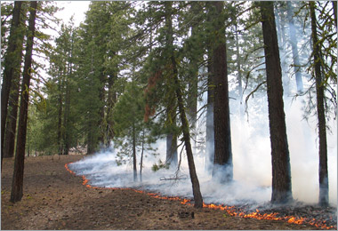
Opportunities and Challenges to Restoring Mixed Severity Fire Regimes:
Examples from the Willamette National Forest
Jane Kertis
Ecologist, Northwest Oregon Program
November 17, 2017

Slide 2
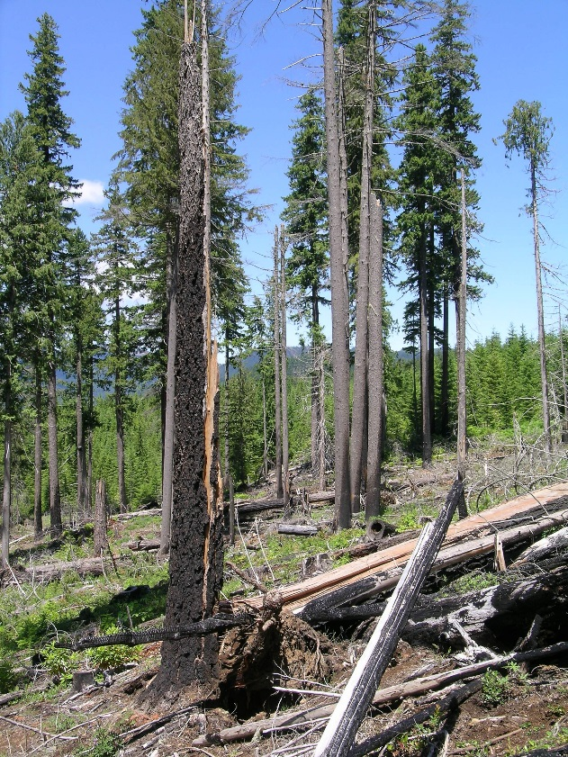
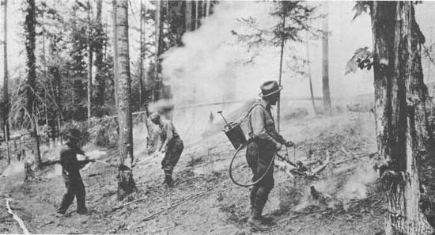
What we know:
fire history
successional trajectories
landscape pattern
2. How we’ve applied mixed severity concepts:
  planning and implementation
  tools
3. Examples of Restoration projects
4. Opportunities and challenges

Slide 3
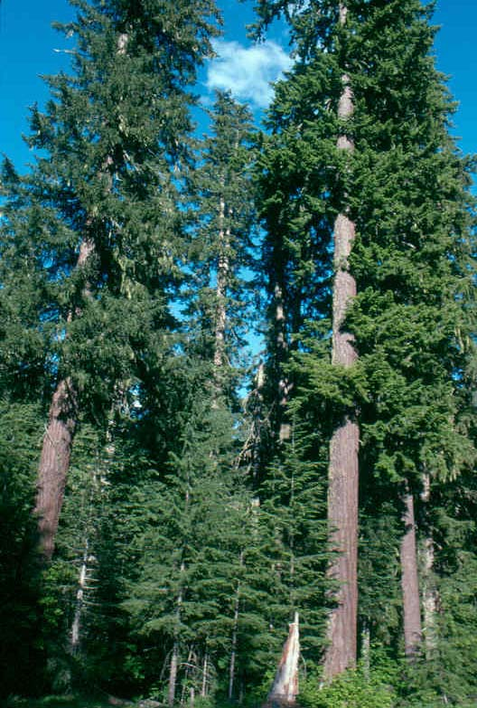
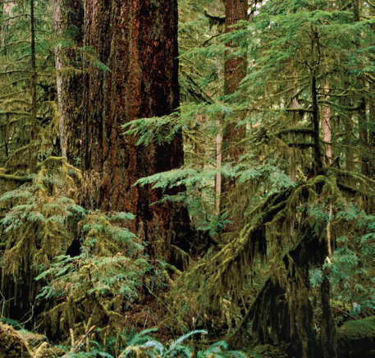
Oregon West Cascades Vegetation Zones:
Western Hemlock
Notes:
Pattens of precipitation, temperature and soil/landform characteristics drive broad vegetation distribution . Potential vegetation zones are named for the “climax” dominant species that will grow there without disturbance.

Slide 4
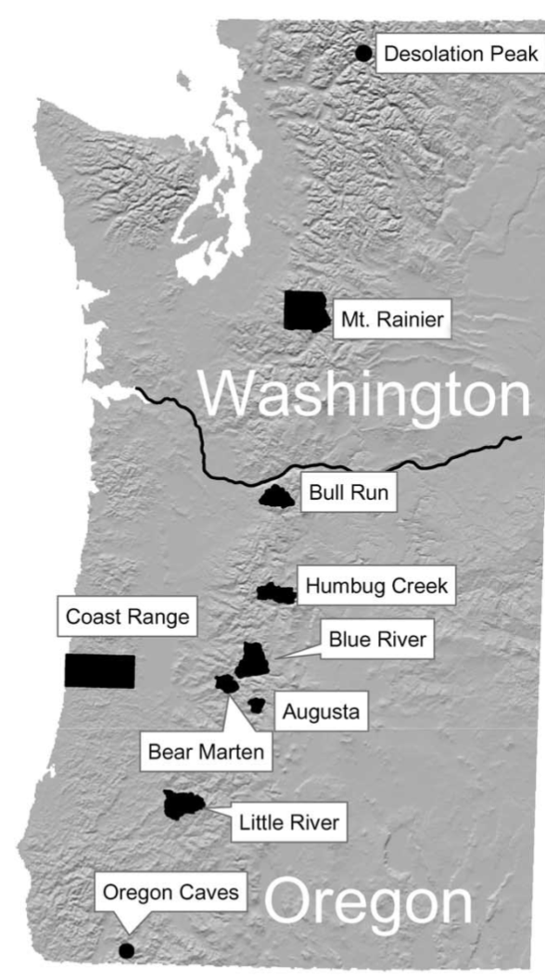
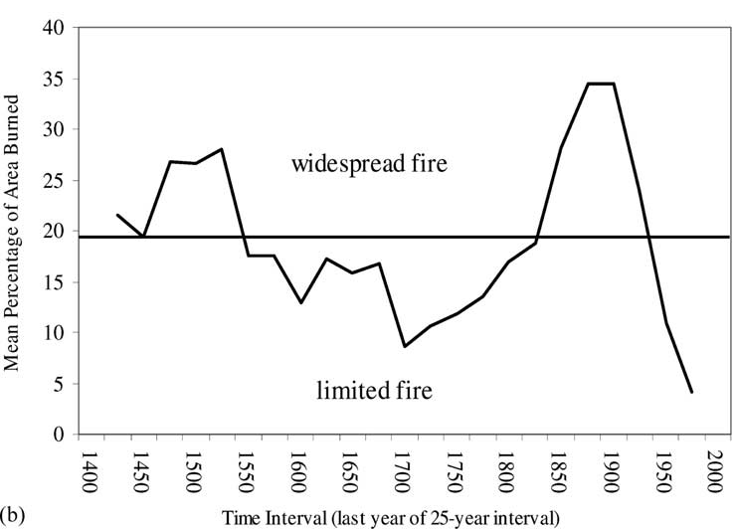
Fire History Record: Variability in Time
Warm break in Little Ice Age
Height of Little Ice Age
Warming period
Weisberg & Swanson, 2003, For. Ecol. Manag.
Mean fire return intervals varied (~50-500 years)
Non-stand replacing fire expression more common than stand replacing expression

Slide 5
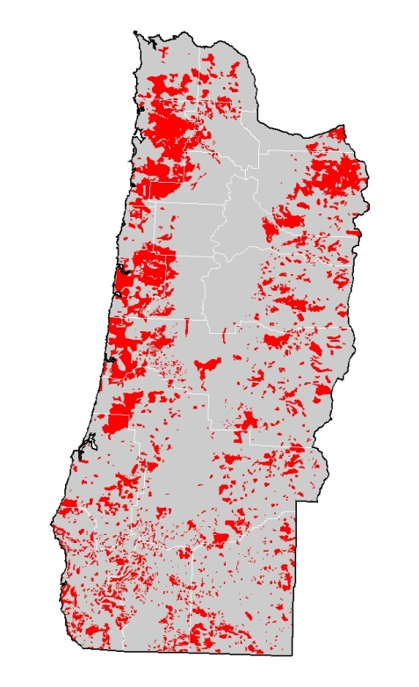
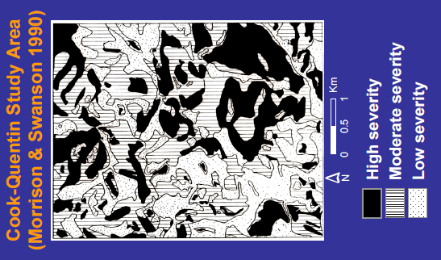
Fire Effects: Variability in Space
Early 20th century high severity patches
Variability in severity patch sizes/shapes
High severity patches large and small

Slide 6
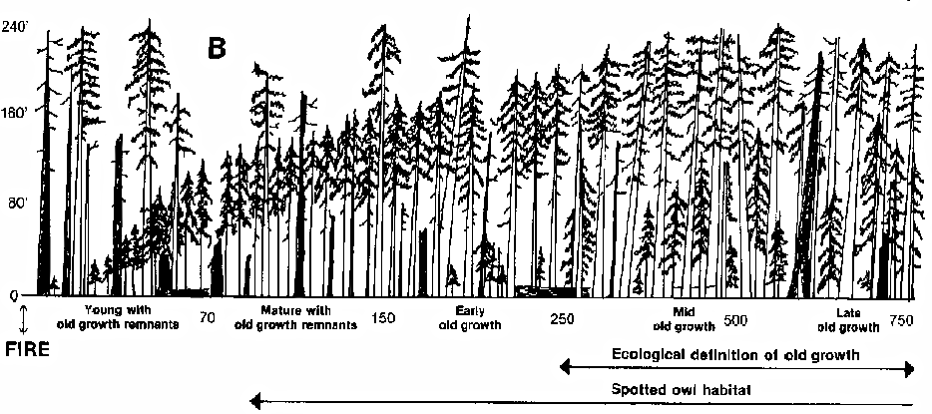
Single Successional Pathway ??????
The gradual and orderly process of change brought about by the progressive replacement of one structural stage by another until a stable climax stage is established
Spies and Franklin. 1988. Natural Areas Journal.

Slide 7
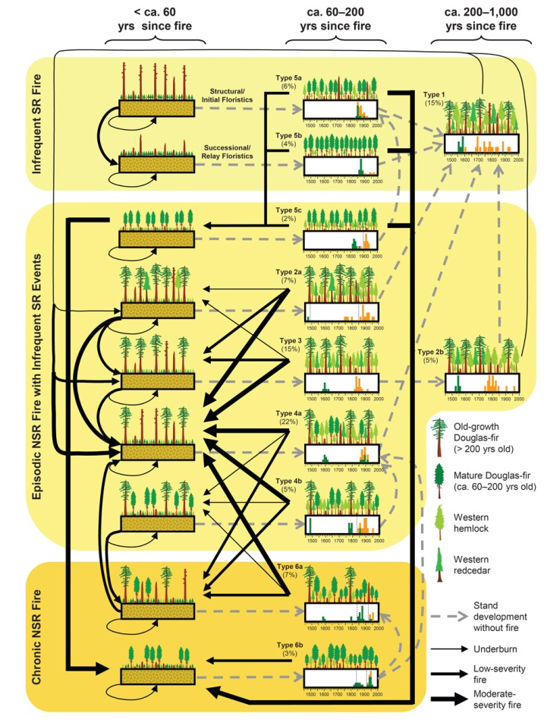
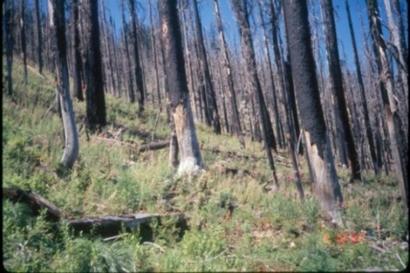
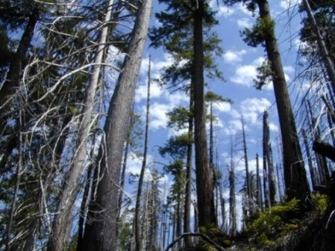
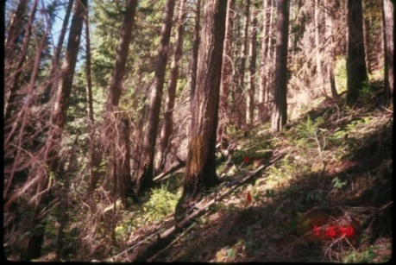
Variable Stand Types and Successional Pathways
% Stands
27%
Low Frequency (200+yrs)
63%
High Severity
Moderate Severity
High Frequency (<30 yrs.)
10%
Tepley et al. 2013 Ecology
Low Severity
Notes:
And you thought the previous slide was confusing! This figure from Tepley and colleagues illustrates the complexity of forest development in mixed severity regimes, with multiple pathways possible given the frequency of fire on the landscape

Slide 8
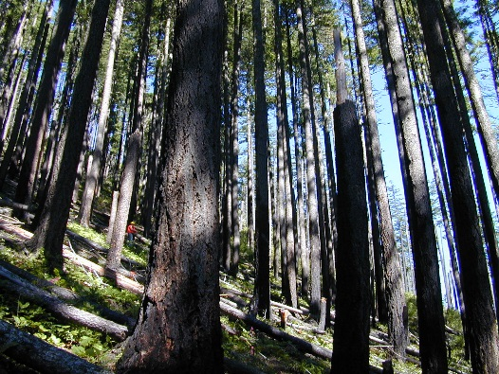
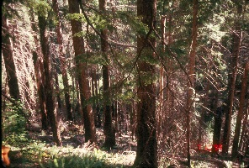
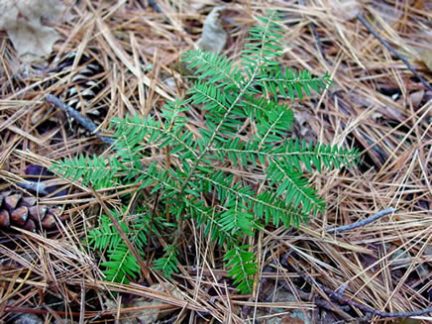
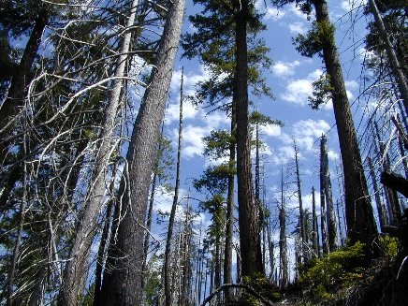
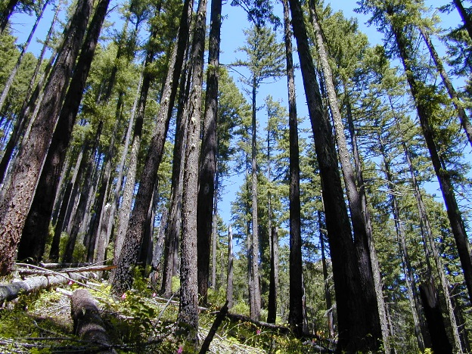
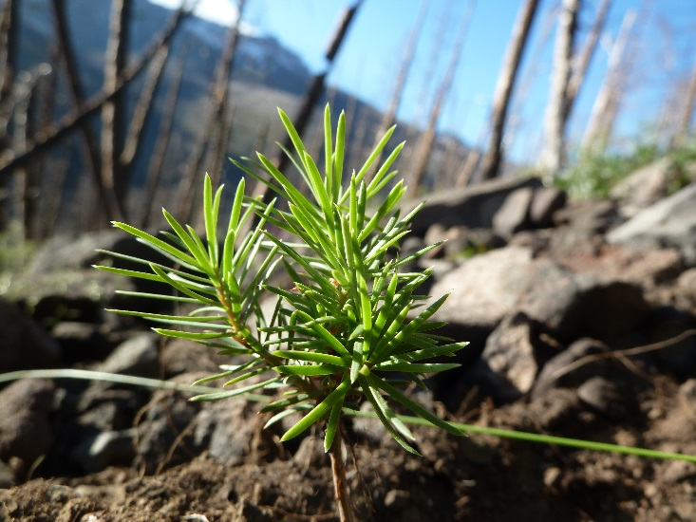
Non-Stand Replacing Fire Effects

Slide 9
Historical Fire Regimes
Spies et al., in press. Northwest Forest Plan Synthesis

Slide 10
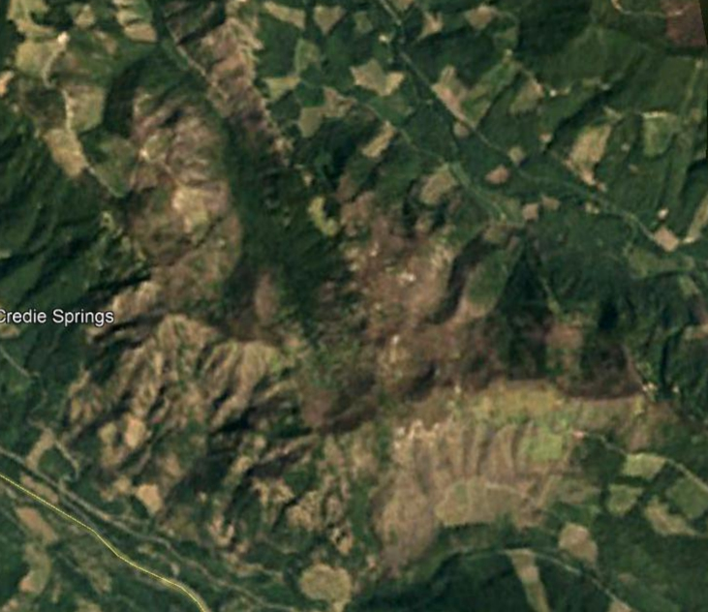
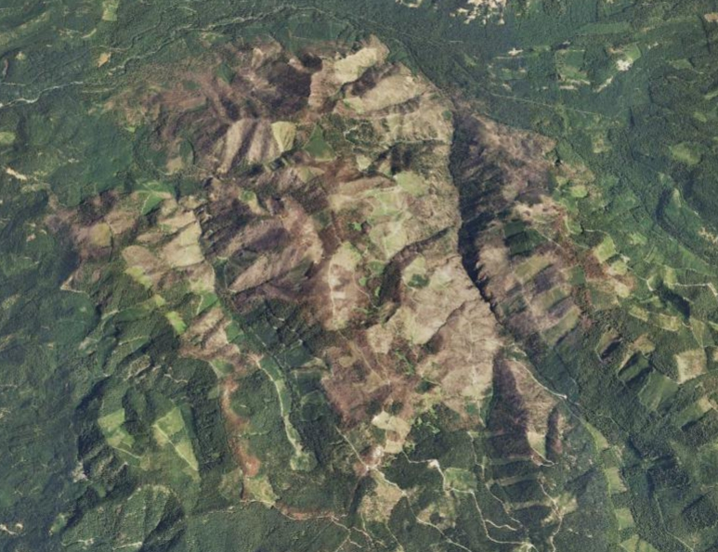
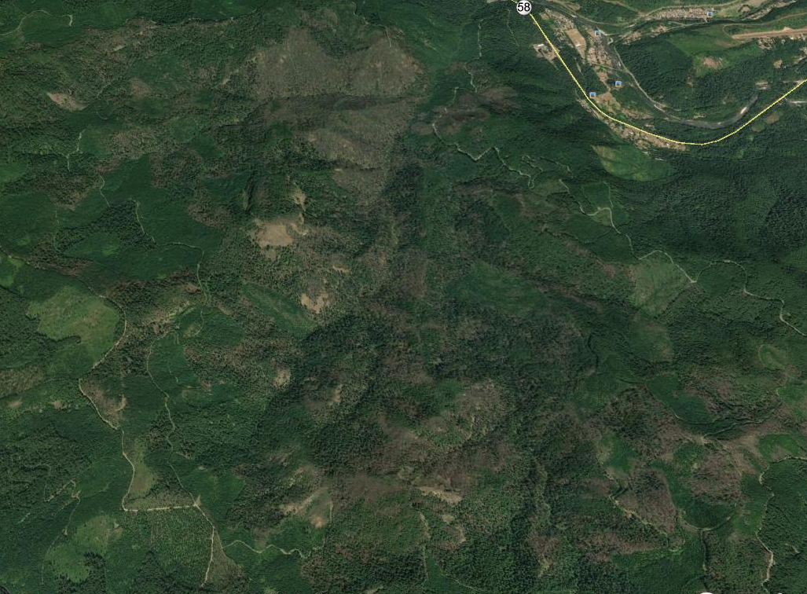
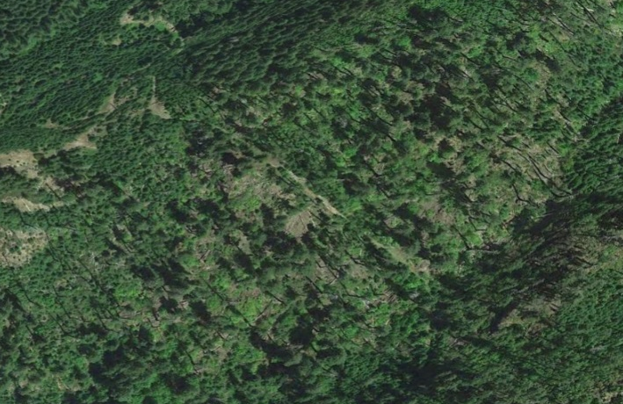
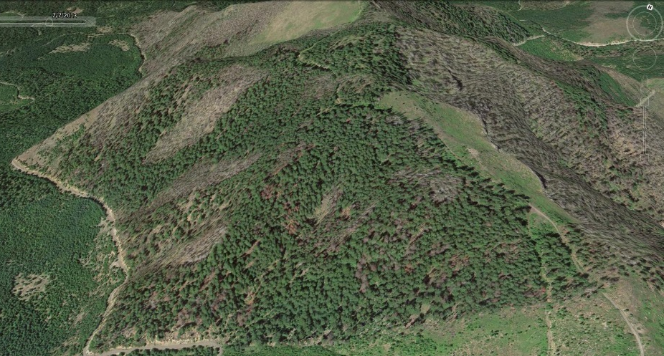
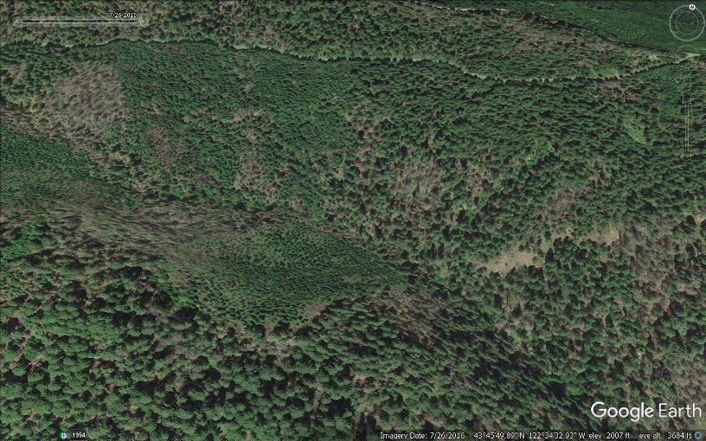
Current Fire Effects and Pattern
Warner 1991
Tumblebug 2009
Deception Complex 2014

Slide 11
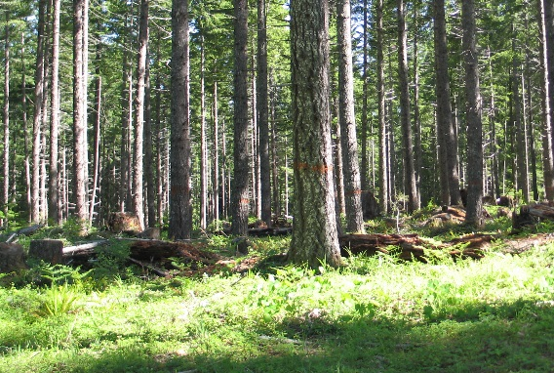
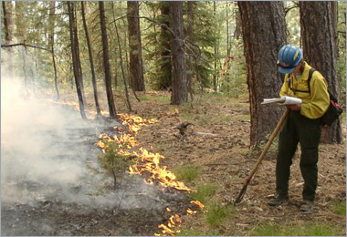
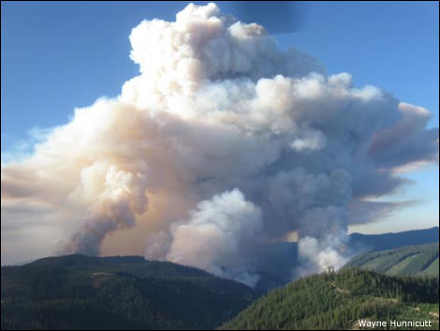
Applying Mixed Severity Regime Concepts to Restoration
Guiding Principles:
THINK BIG --Landscape perspective
THINK LONG TERM--Temporal perspective
Restore range and distribution of desired stand conditions using current conditions and pattern
Follow Plan, Policy Direction
Tools at hand:
Mechanical
Prescribed fire
Wildfire
Growth and Succession

Slide 12
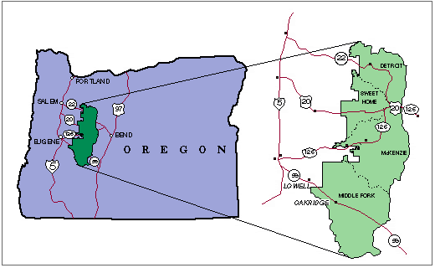
Restoration Examples from the Willamette National Forest

Slide 13
Central Cascades Adaptive Management Area--McKenzie River RD
AMA Focus from Northwest Forest Plan:
Ecosystems and landscape processes
Implications of natural disturbance regimes
Strong research management partnership (HJ Andrews)
Central Cascades
Adaptive Management Area
National

Slide 14
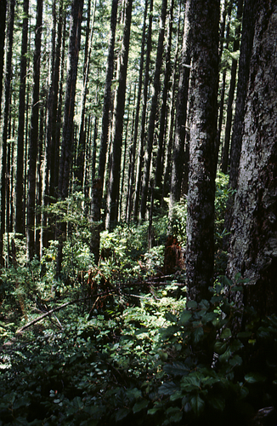
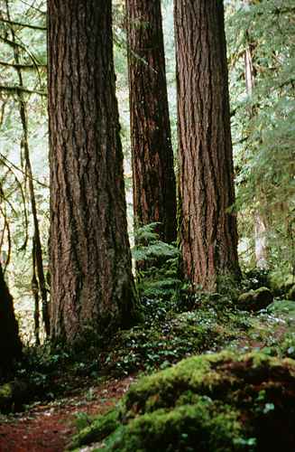
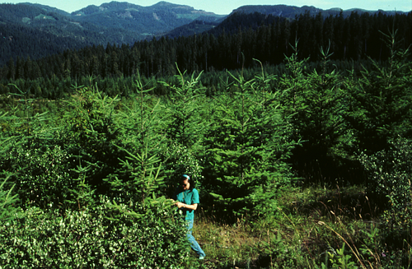
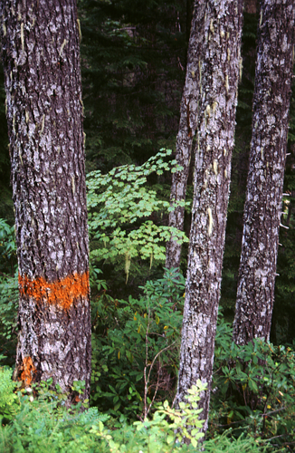
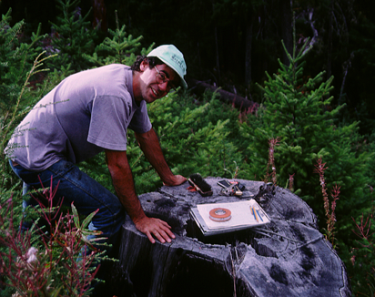
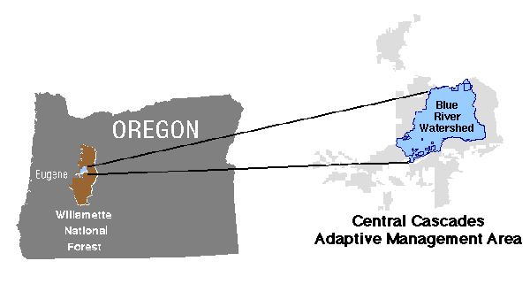
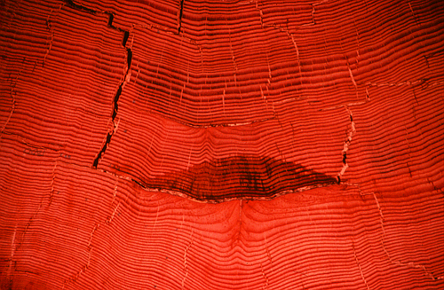
Blue River Landscape Strategy: 1997
Goal:
Use an integrated landscape management strategy to achieve ecological and social objectives based in part on historical disturbance regimes
~57,000 acres

Slide 15
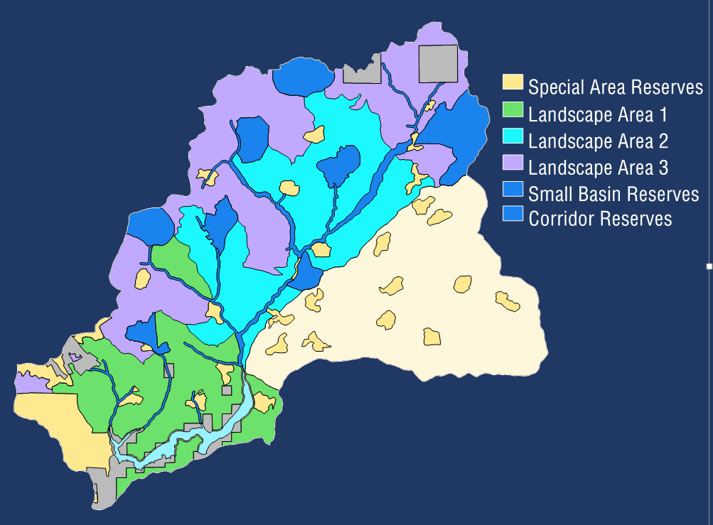
Landscape Areas
LA1:
Short, steep, dissected slopes
~80 year MFRI
Lower end of mixed severity (30-60% mortality)
Small patch size (<100 acres)
LA2:
Longer, variable slopes
~140 MFRI
Mid-mixed severity (60-80% mortality)
Moderate patch size (100-200 acres)
LA3:
Higher slope positions (higher elevations)
~230 MFRI
High severity (> 80% mortality)
Large patch size (>200 acres)
Incorporates Pacific silver fir zone
HJ Andrews

Slide 16
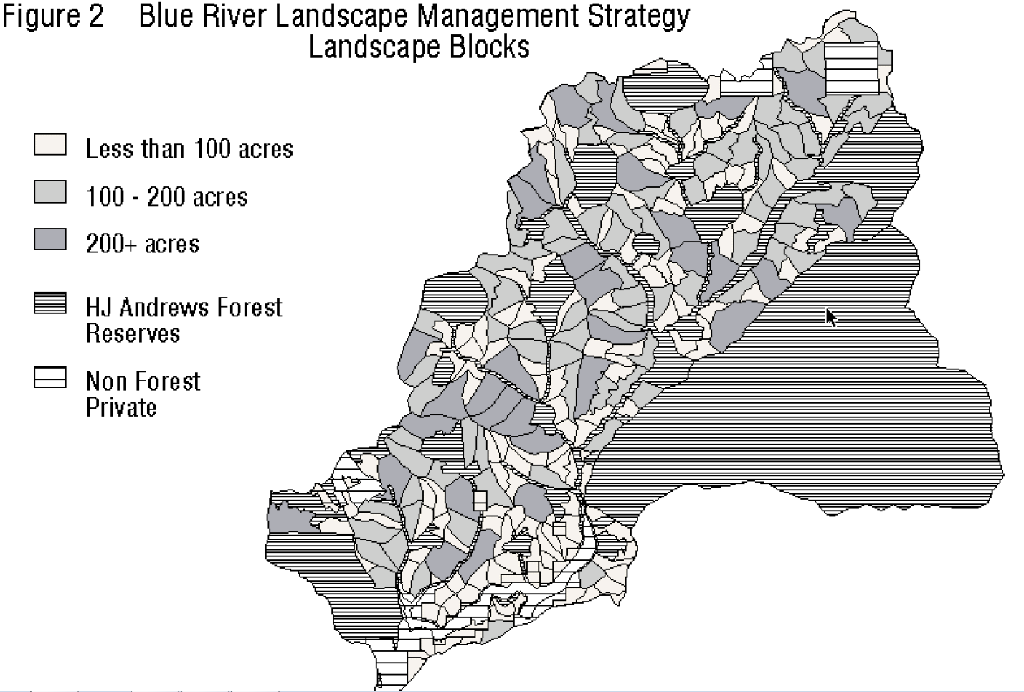
Landscape Areas

Slide 17
Landscape Areas
 |  | % of Landscape Area
Landscape Area | Rotation | Small (<100 ac) | Medium (100-200ac) | Large (200-400ac) | % Retention
1 | 100 | 60 | 20 | 20 | 50
2 | 180 | 40 | 40 | 20 | 30
3 | 260 | 20 | 40 | 40 | 15

Slide 18
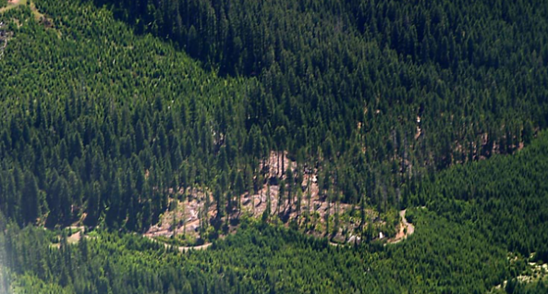
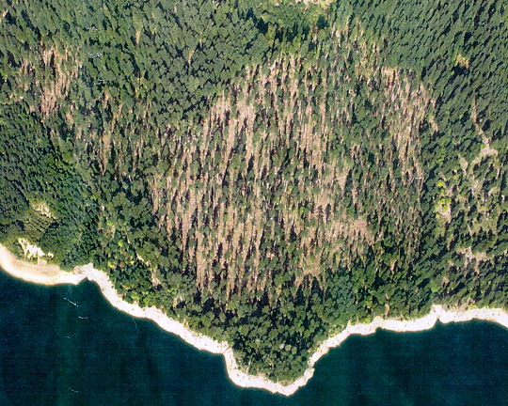
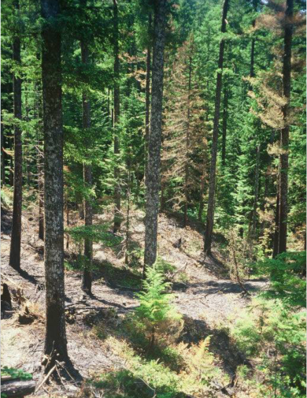
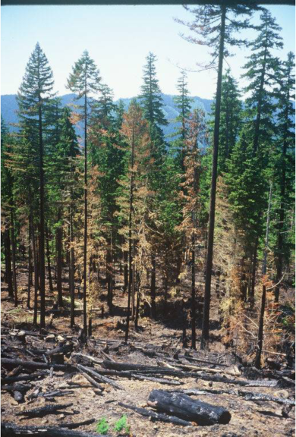
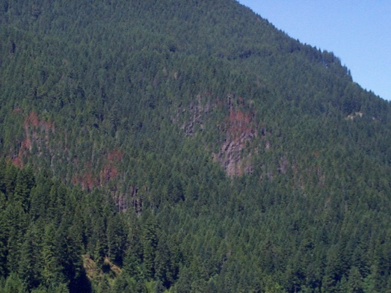
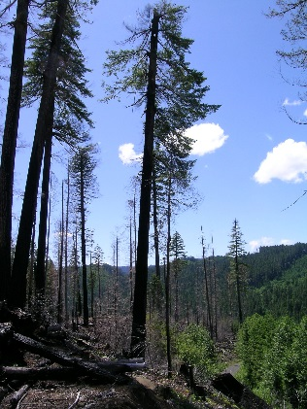
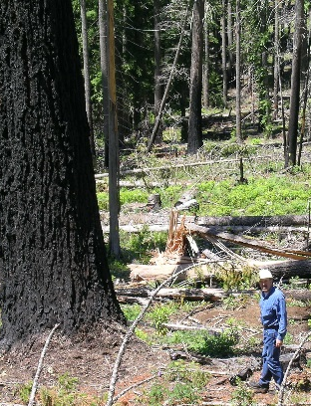
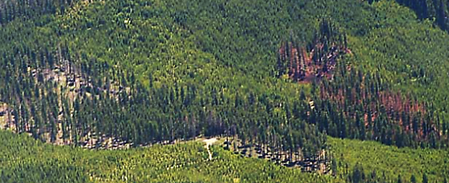
Implementation: 1999-2005
 | North Fork Quartz | Blue River Face
Landscape Area | 1 | 2
Overall Goal | uneven aged, Douglas-fir forest | 2-4 aged, mix of Douglas-fir and western hemlock, cedar
Block Seral Stage | Mature | Mature
Prescription: mechanical Prescribed fire | 50% overall retention diameter limit *high retention areas Additional 5% mortality | 30% overall retention; diameter limit High retention areas Additional 10-15% mortality
Future management | Thin 35yrs, 65yrs (thin from below) Partial cut at 100 yrs. with 50% retention | Thin 40yrs, 70 yrs. (thin from below)

Slide 19
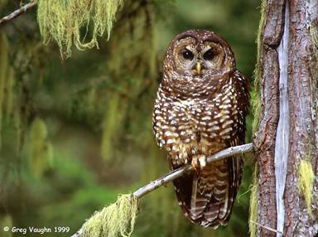
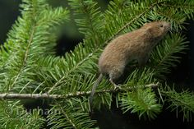
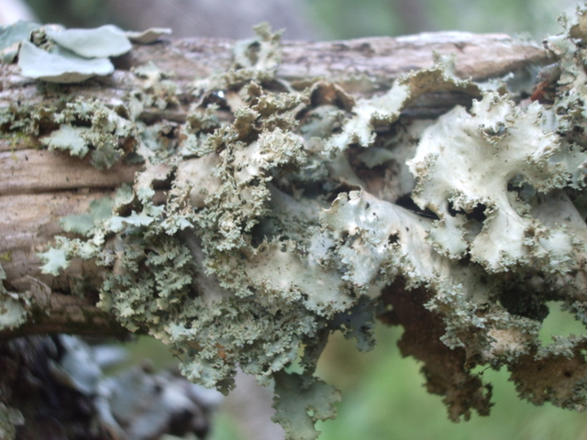
Ecological concerns:
Red Tree voles
Survey and manage lichen (Pseudocyphellaria rainierensis)
Social concern over treating old growth
Tree sitters, vandalism, threats
Photo by Karen Dillman, Courtesy of USFS

Slide 20

12 Years Later…..Big Blue Project: 2009
Portion of the Blue River Watershed (~28,500 federal acres)
Implementation: Mechanical finishes 2017; underburning ~ 2019
GOALS:
Create late successional forest landscapes using Blue River Strategy concepts.
Restore riparian function in corridor and headwater aquatic reserves

Slide 21




Applied similar prescriptions to original plan:
  Only in 40-80 year old stands (LA2)
  Increased retention to 40% in LA2
Landscape Classes | Project Area |  | Activity Units
 | Acres | % | Acres | %
Landscape Area 1 | 887 | 3% | 22 | 2%
Landscape Area 2 | 9,594 | 35% | 860 | 59%
Landscape Area 3 | 10,763 | 40% | 201 | 14%
Aquatic Reserves | 3,868 | 14% | 298 | 21%
Aquatic/Terrestrial Reserves | 1,210 | 4% | 69 | 5%
Terrestrial Reserves | 714 | 3% | 0 | 0%
Total Acres | 27,036 | 100% | 1,450 | 100%

Slide 22
Restoration Using Wildfire:
Deception Complex Fire
Middle Fork RD
2014 Fire Starts
Middle Fork Ranger District
Summer 2014:
over 100 lightning ignited fires
Suppressed all but 5 fires

Slide 23
Deception Complex : Indirect Attack
3 fires~ 1 mile from MF office, 3 residential areas, Highway 58
Steep, inaccessible ground
Indirect attack
  ridges and roads, contingency lines
  bucket drops, backfires, aerial ignition and mechanical fuel removal
~ 2 months until full containment
2014 Fire Starts
Middle Fork Ranger District
Tony Patten, Columbia Helicopters

Slide 24




Fire Effects: Mixed Severity
Monitoring Trends in Burn Severity (MTBS)
High Severity: ~10%
Low-Moderate: ~65%

Slide 25

Restoring Mixed Severity Fire Regimes
What Have We Learned?
It’s challenging! It takes take time (~ 10 years). Realizing landscape patterns takes even longer! Need commitment and continuity to think BIG, plan BIG, and be able to apply adaptive management.
We may not be able to restore everywhere. Some late successional restoration objectives may be in conflict with mixed severity restoration if they have inflexibility around speed of achievement. Social constraints in available stand types and AGES (< 80 years only) and resultant patterns.
Interpretation of Plan and policy direction is evolving. The devil is in the details.

Slide 26



Restoring Mixed Severity Fire Regimes
What Have We Learned?
4. Prescribed fire is an unprecise tool. Need flexibility in stand mortality effects! Increase opportunities for underburn in some natural stands. Public buy off on smoke issues.
5. Wildfire, although limited has potential to achieve stand and landscape goals in a speedier manner. Need to be flexible with outcome pattern. Increased, strategic opportunities to utilize.

Slide 27

Thanks!
John Cissel, retired USFS/BLM,
Fred Swanson, retired PNW
Pete Weisberg, University of Nevada, Reno
Steve Acker, Willamette NF
Mei Lin Lantz, Willamette NF
Jim Rudisill, Willamette NF
Shadi Nimer, Willamette NF
Duane Bishop, Willamette NF
Molly Juillerat, Willamette NF
Allan Braun, Willamette NF
Cheryl Friesen, Willamette NF
Norm Michaels, retired Willamette NF

Slide 28

Questions?

Slide 29

Variable Stand Types and Successional Pathways
Infrequent Stand Replacing Fire
  ~27% of stands
  Single disturbance then growth/succession
  lower slope positions, protected areas

Slide 30
Variable Stand Types and Successional Pathways
Low to Moderate Frequency Mixed severity Fire
~ 63% of stands
Growth/succession followed by one to several non-stand replacing fires
Diversity of composition/structures
No strong correlation with topographic position

Slide 31
Variable Stand Types and Successional Pathways
Frequent Mixed Severity Fire
  ~10% of stands
  Multiple disturbances growth/succession
  Multiple cohorts of Douglas-fir, some western hemlock
  Upper slopes, south aspects, dry sites

